Slide 1
Calculus 2-4
Chain Rule

Slide 2
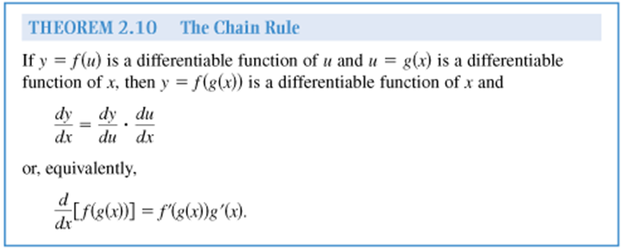
Chain Rule

Slide 3
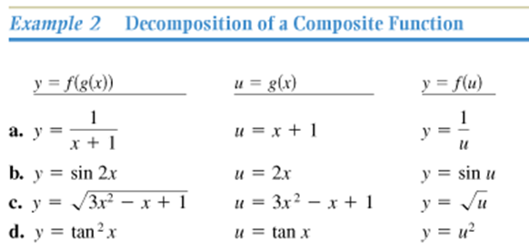
Chain Rule
Book

Slide 4
Chain Rule

Slide 5
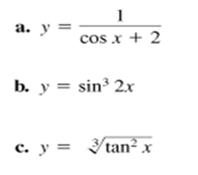
Chain Rule

Slide 6
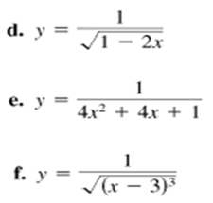
Chain Rule

Slide 7
Chain Rule

Slide 8
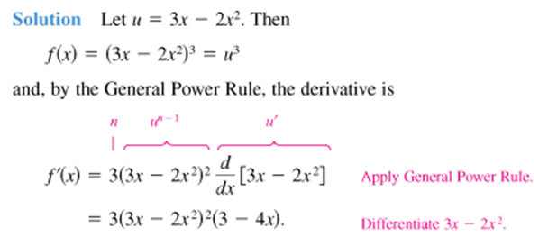
Chain Rule
Book

Slide 9
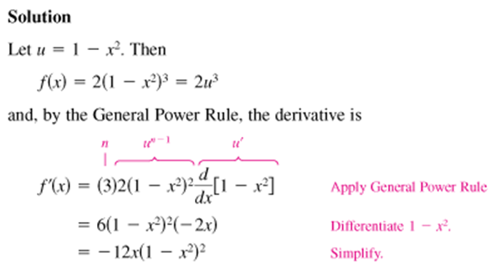
Chain Rule

Slide 10
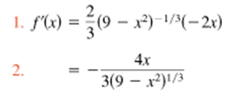
Chain Rule

Slide 11
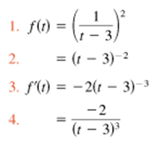
Chain Rule

Slide 12
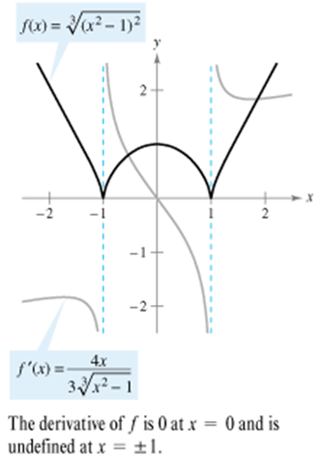
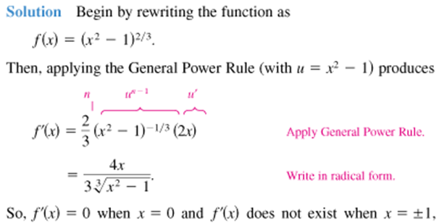
Chain Rule
Book

Slide 13
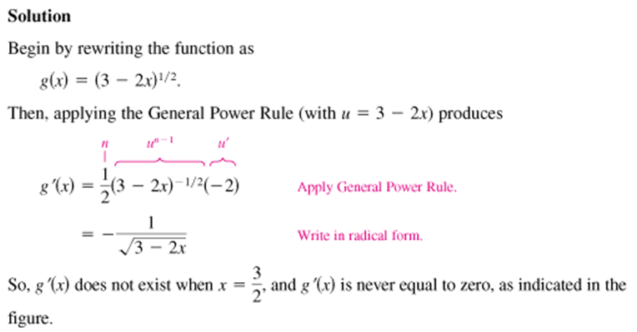
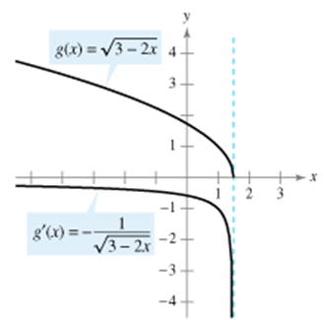
Chain Rule

Slide 14
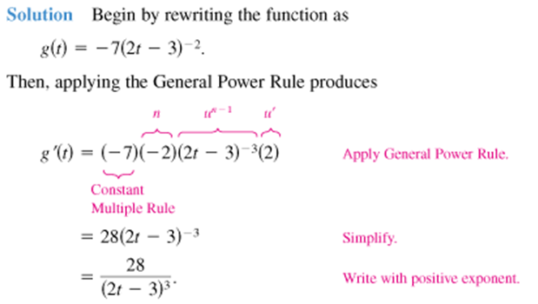
Chain Rule
Book

Slide 15
Chain Rule

Slide 16
Chain Rule

Slide 17
Chain Rule

Slide 18
Chain Rule

Slide 19
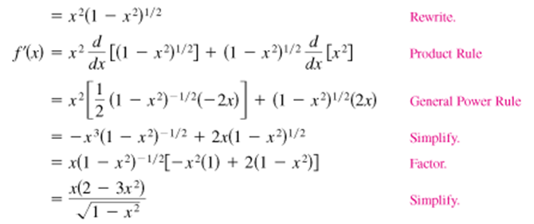
Chain Rule
Book

Slide 20
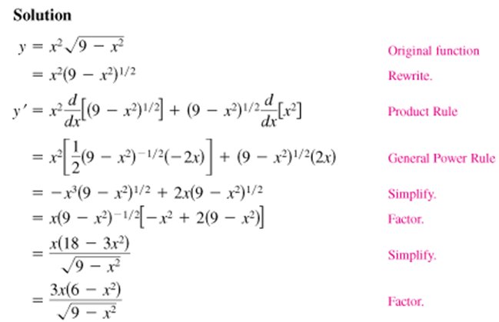
Chain Rule

Slide 21
Chain Rule

Slide 22
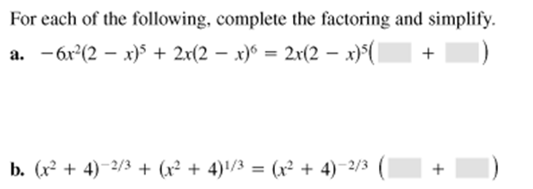
Chain Rule

Slide 23
Chain Rule
Book

Slide 24
Chain Rule

Slide 25
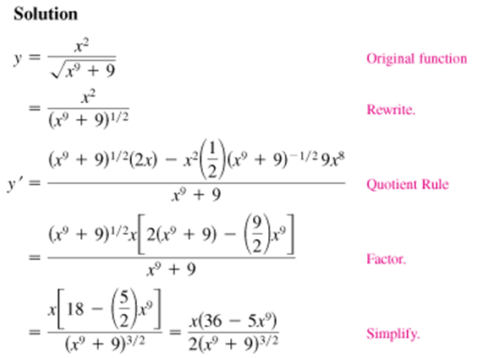
Chain Rule

Slide 26
Chain Rule
Book

Slide 27
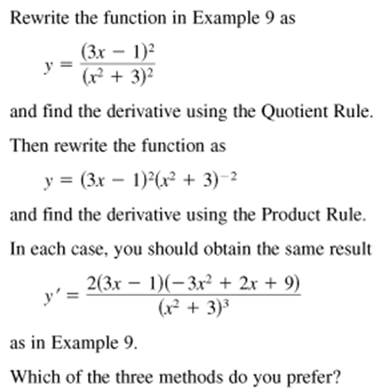
Chain Rule

Slide 28
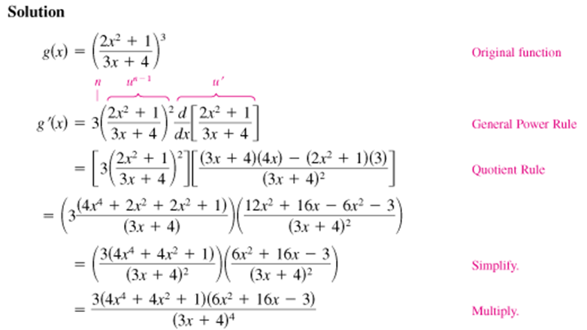
Chain Rule

Slide 29
Chain Rule

Slide 30
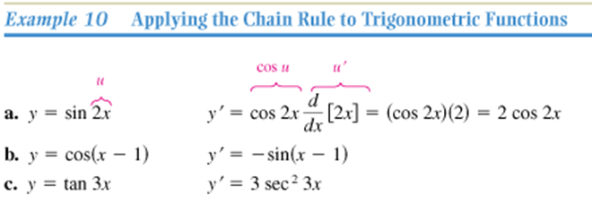
Chain Rule
Book

Slide 31
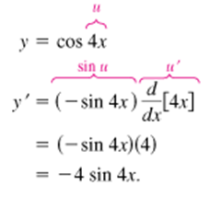
Chain Rule

Slide 32
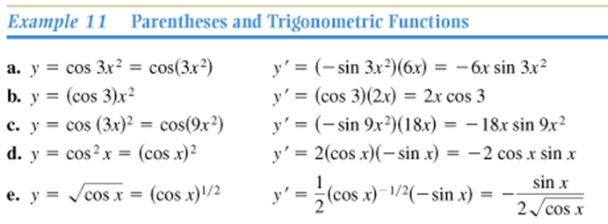
Chain Rule
Book

Slide 33
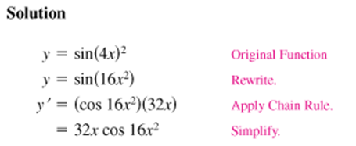
Chain Rule

Slide 34
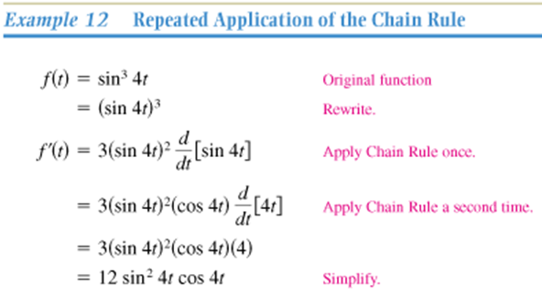
Chain Rule
Book

Slide 35
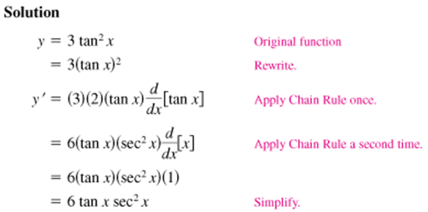
Chain Rule

Slide 36
Chain Rule

Slide 37
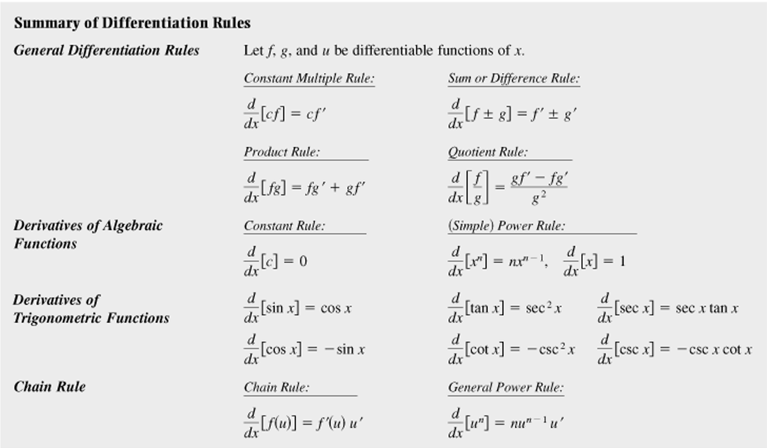
Chain Rule
Book

Slide 38
Chain Rule
Homework
pg 133 – 135
9, 15, 22, 29, 49, 53, 59, 63, 65, 67, 83, 84, 85, 86, 89

