Slide 1
Statistics 3
Resource Activities

Slide 2
Activity
Is the color distribution of M&Ms independent of the type of candy? Break open bags of plain and peanut M&Ms and count the colors. Is the color distribution of M&Ms independent of type of candy?

Slide 3
Writing Assignment
Race and the Death Penalty
In 1976 the Supreme Court ruled that the death penalty does not violate the U.S. Constitution’s ban on “cruel and unusual punishments”. Since then many states have passed capital punishment statutes, and over 500 convicted murderers have been executed nationwide.
Capital punishment may be constitutional, but there continues to be a debate about whether or not it is fair. One of the major issues in this debate involves race – the race of both the defendant and the murder victim. The central question: is justice blind?
In 1998 the Death Penalty Information Center published The Death Penalty in Black and White, a study examining the sentences following 667 murder convictions in Philadelphia courts between 1983 and 1993. This 3-way table shows how many death sentences were given among all the murder convictions.

Slide 4
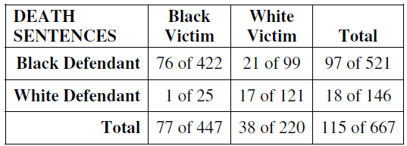
Writing Assignment
Race and the Death Penalty
In 1976 the Supreme Court ruled that the death penalty does not violate the U.S. Constitution’s ban on “cruel and unusual punishments”. Since then many states have passed capital punishment statutes, and over 500 convicted murderers have been executed nationwide.
Capital punishment may be constitutional, but there continues to be a debate about whether or not it is fair. One of the major issues in this debate involves race – the race of both the defendant and the murder victim. The central question: is justice blind?
In 1998 the Death Penalty Information Center published The Death Penalty in Black and White, a study examining the sentences following 667 murder convictions in Philadelphia courts between 1983 and 1993. This 3-way table shows how many death sentences were given among all the murder convictions.

Slide 5
Writing Assignment
Race and the Death Penalty
In 1976 the Supreme Court ruled that the death penalty does not violate the U.S. Constitution’s ban on “cruel and unusual punishments”. Since then many states have passed capital punishment statutes, and over 500 convicted murderers have been executed nationwide.
Capital punishment may be constitutional, but there continues to be a debate about whether or not it is fair. One of the major issues in this debate involves race – the race of both the defendant and the murder victim. The central question: is justice blind?
In 1998 the Death Penalty Information Center published The Death Penalty in Black and White, a study examining the sentences following 667 murder convictions in Philadelphia courts between 1983 and 1993. This 3-way table shows how many death sentences were given among all the murder convictions.
Is our system of justice colorblind in the administration of the death penalty? Based upon the above information, write a newspaper article discussing the association between race and death sentences in the United States.
(Don’t forget: the best analyses of data usually combine visual, numerical, and verbal descriptions.)

Slide 6
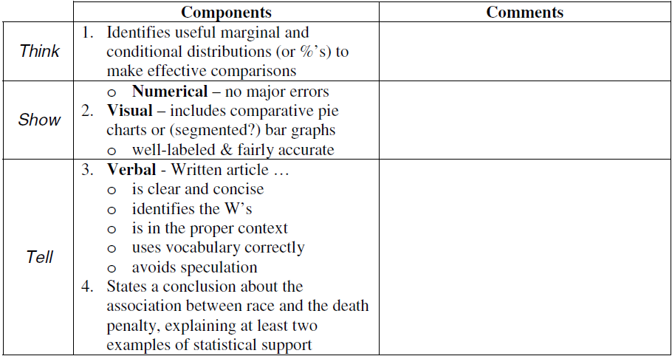
Writing Assignment

Slide 7
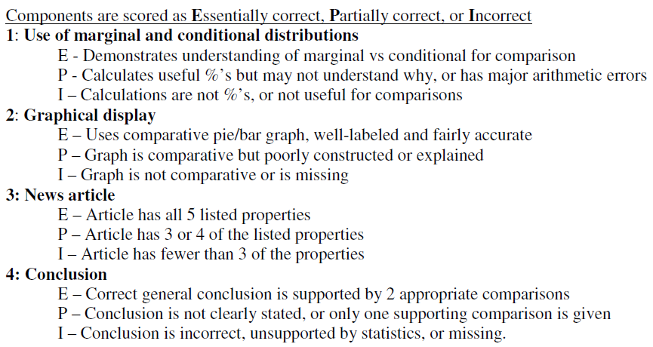
Writing Assignment

