Slide 1
Statistics 2
Data

Slide 2
What Are Data?
Data can be numbers, record names, or other labels.
Not all data represented by numbers are numerical data (e.g., 1 = male, 2 = female).
Data are useless without their context…

Slide 3
The “W’s”
To provide context we need the W’s
Who
What (and in what units)
When
Where
Why (if possible)
and How
of the data.
Note: the answers to “who” and “what” are essential.

Slide 4
Data Tables
The following data table clearly shows the context of the data presented:
Notice that this data table tells us the What (column) and Who (row) for these data.

Slide 5
Who
The Who of the data tells us the individual cases for which (or whom) we have collected data.
Individuals who answer a survey are called respondents.
People on whom we experiment are called subjects or participants.
Animals, plants, and inanimate subjects are called experimental units.

Slide 6
Who
Sometimes people just refer to data values as observations and are not clear about the Who.
But we need to know the Who of the data so we can learn what the data say.

Slide 7
What and Why
Variables are characteristics recorded about each individual.
The variables should have a name that identify What has been measured.
To understand variables, you must Think about what you want to know.
Statistics Variables are different than Algebra variables

Slide 8
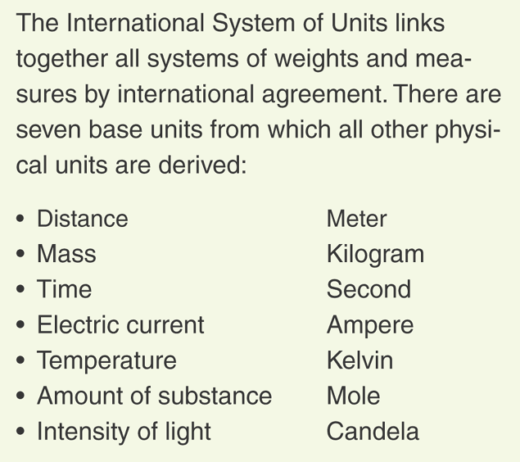
What and Why
Some variables have units that tell how each value has been measured and tell the scale of the measurement.

Slide 9
What and Why
A categorical (or qualitative) variable names categories and answers questions about how cases fall into those categories.
Categorical examples: sex, race, ethnicity
A quantitative variable is a measured variable (with units) that answers questions about the quantity of what is being measured.
Quantitative examples: income ($), height (inches), weight (pounds)

Slide 10
What and Why
The questions we ask a variable (the Why of our analysis) shape what we think about and how we treat the variable.

Slide 11
What and Why
Example: In a student evaluation of instruction at a large university, one question asks students to evaluate the statement “The instructor was generally interested in teaching” on the following scale:
1 = Disagree Strongly;
2 = Disagree;
3 = Neutral;
4 = Agree;
5 = Agree Strongly.
Question: Is interest in teaching categorical or quantitative?

Slide 12
What and Why
Question: Is interest in teaching categorical or quantitative?
We sense an order to these ratings, but there are no natural units for the variable interest in teaching.
Variables like interest in teaching are often called ordinal variables.
With an ordinal variable, look at the Why of the study to decide whether to treat it as categorical or quantitative.

Slide 13
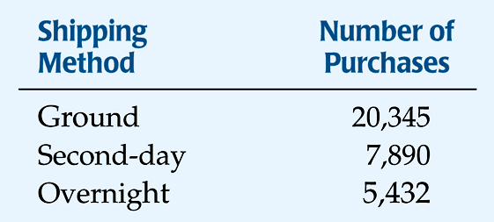
Counts Count
When we count the cases in each category of a categorical variable, the counts are not the data, but something we summarize about the data.
The category labels are the What, and
the individuals counted are the Who.

Slide 14
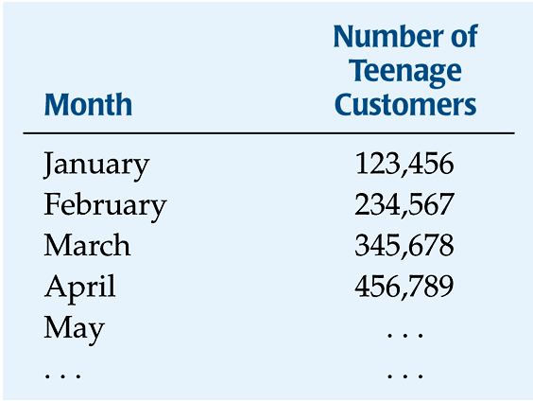
Counts Count
When we focus on the amount of something, we use counts differently. For example, Amazon might track the growth in the number of teenage customers each month to forecast CD sales (the Why).
The What is teens, the Who is months, and the units are number of teenage customers.

Slide 15
Identifying Identifiers
Identifier variables are categorical variables with exactly one individual in each category.
Examples: Social Security Number, ISBN, FedEx Tracking Number
Don’t be tempted to analyze identifier variables.
Be careful not to consider all variables with one case per category, like year, as identifier variables.
The Why will help you decide how to treat identifier variables.

Slide 16
Where, When, and How
We need the Who, What, and Why to analyze data. But, the more we know, the more we understand.
When and Where give us some nice information about the context.
Example: Values recorded at a large public university may mean something different than similar values recorded at a small private college.

Slide 17
Where, When, and How
How the data are collected can make the difference between insight and nonsense.
Example: results from Internet surveys are often useless
The first step of any data analysis should be to examine the W’s—this is a key part of the Think step of any analysis.
And, make sure that you know the Why, Who, and What before you proceed with your analysis.

Slide 18
What Can Go Wrong?
Don’t label a variable as categorical or quantitative without thinking about the question you want it to answer.
Just because your variable’s values are numbers, don’t assume that it’s quantitative.
Always be skeptical—don’t take data for granted.

Slide 19
What have we learned?
Data are information in a context.
The W’s help with context.
We must know the Who (cases), What (variables), and Why to be able to say anything useful about the data.

Slide 20
What have we learned? (cont.)
We treat variables as categorical or quantitative.
Categorical variables identify a category for each case.
Quantitative variables record measurements or amounts of something and must have units.
Some variables can be treated as categorical or quantitative depending on what we want to learn from them.

Slide 21
Displaying Data
How can we display our combined survey data?

Slide 22
Displaying Data
Which categories are quantitative and qualitative?

Slide 23
Example
Name the Who, What, When, Where, How, and why
A Consumer Reports article on energy bars gave the brand name, flavor, price, number of calories, and grams of protein and fat.
Who: energy bars
What: brand name, flavor, price, calories, protein, fat
When: not specified
Where: not specified
How: not specified. Are data collected from the label? Are independent tests performed?
Why: information for potential consumers

Slide 24
Example
Which are categorical and which are quantitative – give units
brand name, flavor, price, calories, protein, fat
Categorical variables: brand name, flavor
Quantitative variables: price (US$), number of calories (calories), protein (grams), fat(grams)

Slide 25
Example
Name the Who, What, When, Where, How, and why
A report on the Boston Marathon listed each runner’s gender, country, age, and time.
Who: Boston Marathon runners
What: gender, country, age, time
When: not specified
Where: Boston
How: not specified. Presumably, the data were collected from registration information.
Why: race result reporting

Slide 26
Example
Which are categorical and which are quantitative – give units
gender, country, age, time
Categorical variables: gender, country
Quantitative variables: age (years), time (hours, minutes, seconds)

Slide 27
Homework
Pages 16 - 18
7, 9, 12, 17, 24

