Slide 1
Statistics 26
Comparing Counts

Slide 2
Goodness-of-Fit
A test of whether the distribution of counts in one categorical variable matches the distribution predicted by a model is called a goodness-of-fit test.
As usual, there are assumptions and conditions to consider…

Slide 3
Assumptions and Conditions
Counted Data Condition: Check that the data are counts for the categories of a categorical variable.
Independence Assumption: The counts in the cells should be independent of each other.
Randomization Condition: The individuals who have been counted and whose counts are available for analysis should be a random sample from some population.

Slide 4
Assumptions and Conditions
Sample Size Assumption: We must have enough data for the methods to work.
Expected Cell Frequency Condition: We should expect to see at least 5 individuals in each cell.
This is similar to the condition that np and nq be at least 10 when we tested proportions.

Slide 5
Calculations
Since we want to examine how well the observed data reflect what would be expected, it is natural to look at the differences between the observed and expected counts (Obs – Exp).
These differences are actually residuals, so we know that adding all of the differences will result in a sum of 0. That’s not very helpful.

Slide 6
Calculations
We’ll handle the residuals as we did in regression, by squaring them.
To get an idea of the relative sizes of the differences, we will divide each squared difference by the expected count fro that cell.

Slide 7
Calculations
The test statistic, called the chi-square (or chi-squared) statistic, is found by adding up the sum of the squares of the deviations between the observed and expected counts divided by the expected counts:

Slide 8
Calculations
The chi-square models are actually a family of distributions indexed by degrees of freedom (much like the t-distribution).
The number of degrees of freedom for a goodness-of-fit test is n – 1, where n is the number of categories.

Slide 9
One-Sided or Two-Sided?
The chi-square statistic is used only for testing hypotheses, not for constructing confidence intervals.
If the observed counts don’t match the expected, the statistic will be large—it can’t be “too small.”
So the chi-square test is always one-sided.
If the calculated statistic value is large enough, we’ll reject the null hypothesis.

Slide 10
One-Sided or Two-Sided?
The mechanics may work like a one-sided test, but the interpretation of a chi-square test is in some ways many-sided.
There are many ways the null hypothesis could be wrong.
There’s no direction to the rejection of the null model—all we know is that it doesn’t fit.

Slide 11
The Chi-Square Calculation
Find the expected values:
Every model gives a hypothesized proportion for each cell.
The expected value is the product of the total number of observations times this proportion.
Compute the residuals: Once you have expected values for each cell, find the residuals, Observed – Expected.
Square the residuals.

Slide 12
The Chi-Square Calculation
Compute the components. Now find the components
for each cell.
Find the sum of the components (that’s the chi-square statistic).

Slide 13
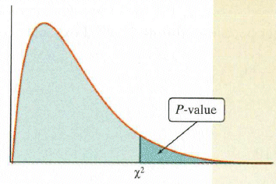
The Chi-Square Calculation
Find the degrees of freedom. It’s equal to the number of cells minus one.
Test the hypothesis.
Use your chi-square statistic to find the P-value. (Remember, you’ll always have a one-sided test.)
Large chi-square values mean lots of deviation from the hypothesized model, so they give small P-values.
Reject the null with a high P-value

Slide 14
But I Believe the Model…
Goodness-of-fit tests are likely to be performed by people who have a theory of what the proportions should be, and who believe their theory to be true.
Unfortunately, the only null hypothesis available for a goodness-of-fit test is that the theory is true.
As we know, the hypothesis testing procedure allows us only to reject or fail to reject the null.

Slide 15
Example
Calculate how many of each color you should have found in your bag (based on the total number of candies)
Complete a goodness-of-fit test.
M&M'S MILK CHOCOLATE: 24% cyan blue, 20% orange, 16% green,
14% bright yellow, 13% red, 13% brown.
Each large production batch is blended to those ratios and mixed thoroughly. However, since the individual packages are filled by weight on high-speed equipment, and not by count, it is possible to have an unusual color distribution.

Slide 16
Example
Complete a goodness-of-fit test.
M&M'S MILK CHOCOLATE: 24% cyan blue, 20% orange, 16% green,
14% bright yellow, 13% red, 13% brown.

Slide 17
But I Believe the Model…
We can never confirm that a theory is in fact true.
At best, we can point out only that the data are consistent with the proposed theory.
Remember, it’s that idea of “not guilty” versus “innocent.”

Slide 18
Comparing Observed Distributions
A test comparing the distribution of counts for two or more groups on the same categorical variable is called a chi-square test of homogeneity.
A test of homogeneity is actually the generalization of the two-proportion z-test.

Slide 19
Comparing Observed Distributions
The statistic that we calculate for this test is identical to the chi-square statistic for goodness-of-fit.
In this test, however, we ask whether choices are the same among different groups (i.e., there is no model).
The expected counts are found directly from the data and we have different degrees of freedom.

Slide 20
Assumptions and Conditions
The assumptions and conditions are the same as for the chi-square goodness-of-fit test:
Counted Data Condition: The data must be counts.
Randomization Condition and 10% Condition: As long as we don’t want to generalize, we don’t have to check these conditions.
Expected Cell Frequency Condition: The expected count in each cell must be at least 5.

Slide 21
Calculations
To find the expected counts, we multiply the row total by the column total and divide by the grand total.
We calculated the chi-square statistic as we did in the goodness-of-fit test:
In this situation we have (R – 1)(C – 1) degrees of freedom, where R is the number of rows and C is the number of columns.
We’ll need the degrees of freedom to find a P-value for the chi-square statistic.

Slide 22
Examining the Residuals
When we reject the null hypothesis, it’s always a good idea to examine residuals.
For chi-square tests, we want to work with standardized residuals, since we want to compare residuals for cells that may have very different counts.
To standardize a cell’s residual, we just divide by the square root of its expected value:

Slide 23
Examining the Residuals
These standardized residuals are just the square roots of the components we calculated for each cell, with the + or the – sign indicating whether we observed more cases than we expected, or fewer.
The standardized residuals give us a chance to think about the underlying patterns and to consider the ways in which the distribution might not match what we hypothesized to be true.

Slide 24
Independence
Contingency tables categorize counts on two (or more) variables so that we can see whether the distribution of counts on one variable is contingent on the other.
A test of whether the two categorical variables are independent examines the distribution of counts for one group of individuals classified according to both variables in a contingency table.
A chi-square test of independence uses the same calculation as a test of homogeneity.

Slide 25
Assumptions and Conditions
We still need counts and enough data so that the expected values are at least 5 in each cell.
If we’re interested in the independence of variables, we usually want to generalize from the data to some population.
In that case, we’ll need to check that the data are a representative random sample from that population.

Slide 26
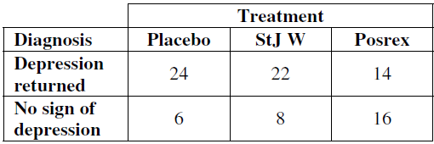
Example
Medical researchers enlisted 90 subjects for an experiment comparing treatments for depression. The subjects were randomly divided into three groups and given pills to take for a period of three months. Unknown to them, one group received a placebo, the second group the “natural” remedy St. John’s wort, and the third group the prescription drug Posrex. After six months, psychologists and physicians (who did not know which treatment each person had received) evaluated the subjects to see if their depression had returned.

Slide 27
Example
Medical researchers enlisted 90 subjects for an experiment comparing treatments for depression. The subjects were randomly divided into three groups and given pills to take for a period of three months. Unknown to them, one group received a placebo, the second group the “natural” remedy St. John’s wort, and the third group the prescription drug Posrex. After six months, psychologists and physicians (who did not know which treatment each person had received) evaluated the subjects to see if their depression had returned.

Slide 28
Example
Add row and column totals to the table, Those 60 subjects would be expected to divide 20-20-20 under the null hypothesis. We can look at this three ways. Since 30/90 = 1/3 of all subjects got the placebo, 1/3 of the 60 with recurrent depression should have been in the placebo group. Or, since 60/90 = 2/3 of the subjects suffered returning depression, we’d expect that to be true of 2/3 of the 30 who got the placebo. Or, there’s always the mindless explanation: row total column total/grand total = (60× 30)/90 = 20.

Slide 29
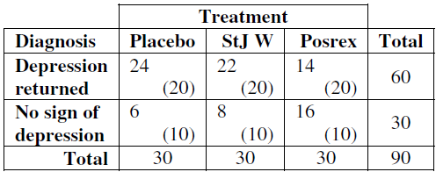
Example
Add row and column totals to the table, Those 60 subjects would be expected to divide 20-20-20 under the null hypothesis. We can look at this three ways. Since 30/90 = 1/3 of all subjects got the placebo, 1/3 of the 60 with recurrent depression should have been in the placebo group. Or, since 60/90 = 2/3 of the subjects suffered returning depression, we’d expect that to be true of 2/3 of the 30 who got the placebo. Or, there’s always the mindless explanation: row total column total/grand total = (60× 30)/90 = 20.

Slide 30
Example
Here we have (2 – 1)(3 – 1) = 2 degrees of freedom.

Slide 31
Example

Slide 32
Examine the Residuals
Each cell of a contingency table contributes a term to the chi-square sum.
It helps to examine the standardized residuals, just like we did for tests of homogeneity.

Slide 33
Chi-Square and Causation
Chi-square tests are common, and tests for independence are especially widespread.
We need to remember that a small P-value is not proof of causation.
Since the chi-square test for independence treats the two variables symmetrically, we cannot differentiate the direction of any possible causation even if it existed.
And, there’s never any way to eliminate the possibility that a lurking variable is responsible for the lack of independence.

Slide 34
Chi-Square and Causation
In some ways, a failure of independence between two categorical variables is less impressive than a strong, consistent, linear association between quantitative variables.
Two categorical variables can fail the test of independence in many ways.
Examining the standardized residuals can help you think about the underlying patterns.

Slide 35
Example

Slide 36
Example

Slide 37
Example

Slide 38
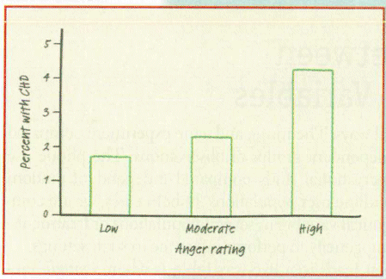
Example

Slide 39
Example

Slide 40
Example

Slide 41
Example

Slide 42
Example

Slide 43
Example

Slide 44
Example

Slide 45
Example

Slide 46
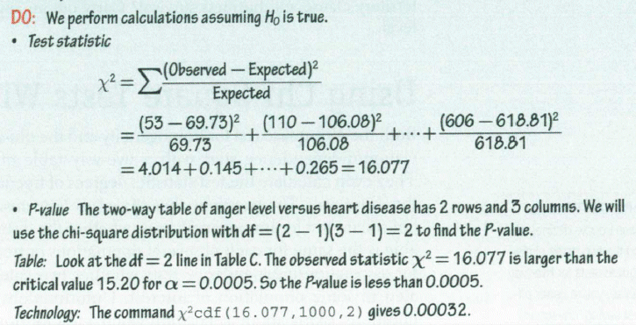
Example

Slide 47
Example

Slide 48
What Can Go Wrong?
Don’t use chi-square methods unless you have counts.
Just because numbers are in a two-way table doesn’t make them suitable for chi-square analysis.
Beware large samples.
With a sufficiently large sample size, a chi-square test can always reject the null hypothesis.
Don’t say that one variable “depends” on the other just because they’re not independent.
Association is not causation.

Slide 49
What have we learned?
We’ve learned how to test hypotheses about categorical variables.
All three methods we examined look at counts of data in categories and rely on chi-square models.
Goodness-of-fit tests compare the observed distribution of a single categorical variable to an expected distribution based on theory or model.
Tests of homogeneity compare the distribution of several groups for the same categorical variable.
Tests of independence examine counts from a single group for evidence of an association between two categorical variables.

Slide 50
What have we learned?
Mechanically, these tests are almost identical.
While the tests appear to be one-sided, conceptually they are many-sided, because there are many ways that the data can deviate significantly from what we hypothesize.
When we reject the null hypothesis, we know to examine standardized residuals to better understand the patterns in the data.

Slide 51
Homework
Pages 628 – 633
1, 4, 6, 10, 11, 16, 20, 22, 24, 26, 30

