Slide 1
Statistics 7
Scatterplots, Association, and Correlation

Slide 2
Correlation

Slide 3
Definition

Slide 4
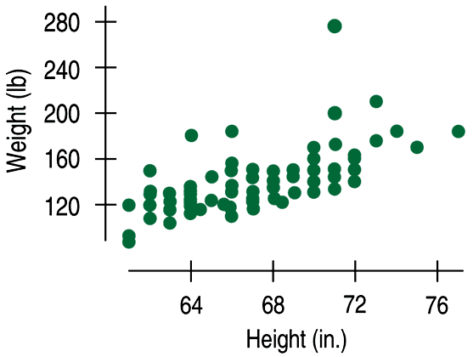
Correlation
Data collected from students in Statistics classes included their heights (in inches) and weights (in pounds):
Here we see a positive association and a fairly straight form, although there seems to be a high outlier.

Slide 5
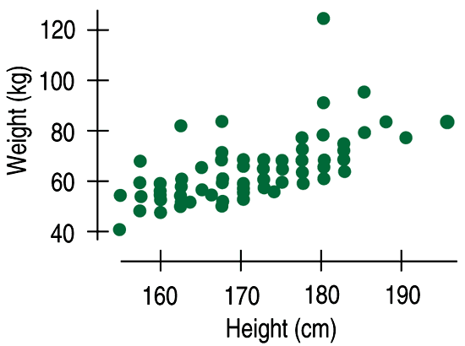
Correlation
How strong is the association between weight and height of Statistics students?
If we had to put a number on the strength, we would not want it to depend on the units we used.
A scatterplot of heights (in centimeters) and weights (in kilograms) doesn’t change the shape of the pattern:

Slide 6
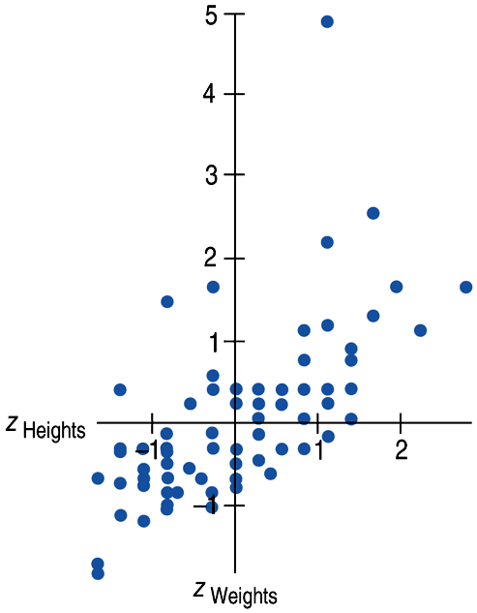
Correlation
Since the units don’t matter, why not remove them altogether?
We could standardize both variables and write the coordinates of a point as (z_{x}, z_{y}).
Here is a scatterplot of the standardized weights and heights:

Slide 7
Correlation
Note that the underlying linear pattern seems steeper in the standardized plot than in the original scatterplot.
That’s because we made the scales of the axes the same.
Equal scaling gives a neutral way of drawing the scatterplot and a fairer impression of the strength of the association.

Slide 8
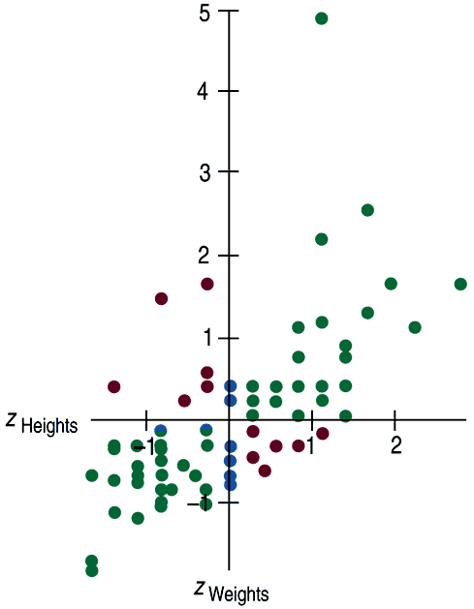
Correlation
Some points (those in green) strengthen the impression of a positive association between height and weight.
Other points (those in red) tend to weaken the positive association.
Points with z-scores of zero (those in blue) don’t vote either way.

Slide 9
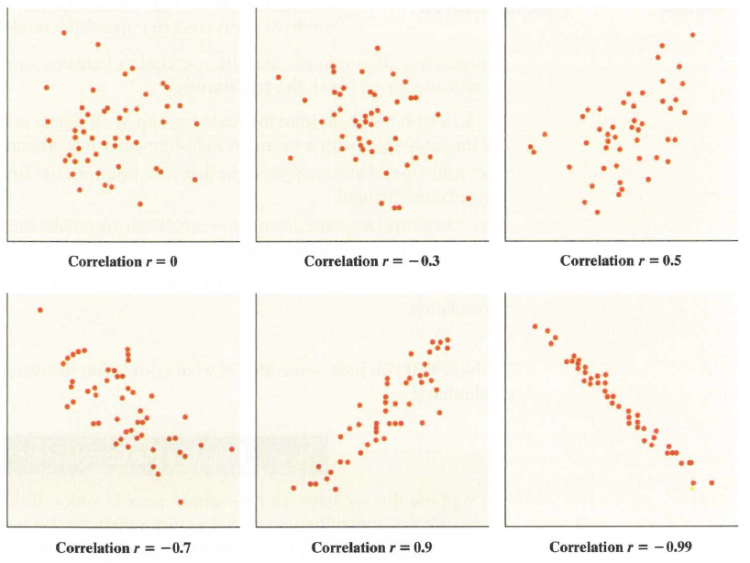
Correlations

Slide 10
Correlation
The correlation coefficient (r) gives us a numerical measurement of the strength of the linear relationship between the explanatory and response variables.

Slide 11
Correlation
For the students’ heights and weights, the correlation is 0.644.
What does this mean in terms of strength? We’ll address this shortly.

Slide 12
Correlation Conditions
Correlation measures the strength of the linear association between two quantitative variables.
Before you use correlation, you must check several conditions:
Quantitative Variables Condition
Straight Enough Condition
Outlier Condition

Slide 13
Correlation Conditions
Quantitative Variables Condition:
Correlation applies only to quantitative variables.
Don’t apply correlation to categorical data masquerading as quantitative.
Check that you know the variables’ units and what they measure.

Slide 14
Correlation Conditions
Straight Enough Condition:
You can calculate a correlation coefficient for any pair of variables.
But correlation measures the strength only of the linear association, and will be misleading if the relationship is not linear.

Slide 15
Correlation Conditions
Outlier Condition:
Outliers can distort the correlation dramatically.
An outlier can make an otherwise small correlation look big or hide a large correlation.
It can even give an otherwise positive association a negative correlation coefficient (and vice versa).
When you see an outlier, it’s often a good idea to report the correlations with and without the point.

Slide 16
Correlation Properties
The sign of a correlation coefficient gives the direction of the association.
Correlation is always between –1 and +1.
Correlation can be exactly equal to –1 or +1, but these values are unusual in real data because they mean that all the data points fall exactly on a single straight line.
A correlation near zero corresponds to a weak linear association.

Slide 17
Correlation Properties
Correlation treats x and y symmetrically:
The correlation of x with y is the same as the correlation of y with x.
Correlation has no units.
Correlation is not affected by changes in the center or scale of either variable.
Correlation depends only on the z-scores, and they are unaffected by changes in center or scale.

Slide 18
Correlation Properties
Correlation measures the strength of the linear association between the two variables.
Variables can have a strong association but still have a small correlation if the association isn’t linear.
Correlation is sensitive to outliers. A single outlying value can make a small correlation large or make a large one small.

Slide 19
Correlation ≠ Causation
Whenever we have a strong correlation, it is tempting to explain it by imagining that the predictor variable has caused the response to help.
Scatterplots and correlation coefficients never prove causation.
A hidden variable that stands behind a relationship and determines it by simultaneously affecting the other two variables is called a lurking variable.

Slide 20
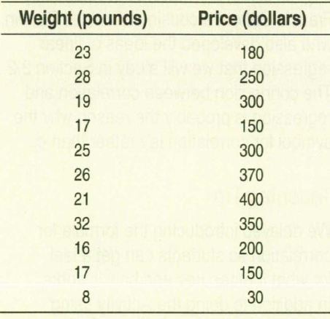
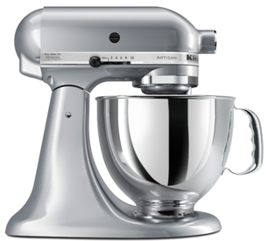
Practice

Slide 21
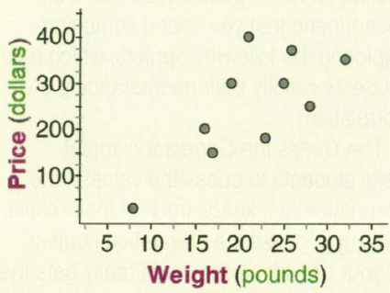
Practice

Slide 22
Practice

Slide 23
Practice

Slide 24
Practice

Slide 25
Correlation Tables
It is common in some fields to compute the correlations between each pair of variables in a collection of variables and arrange these correlations in a table.

Slide 26
Straightening Scatterplots
Straight line relationships are the ones that we can measure with correlation.
When a scatterplot shows a bent form that consistently increases or decreases, we can often straighten the form of the plot by re-expressing one or both variables.

Slide 27
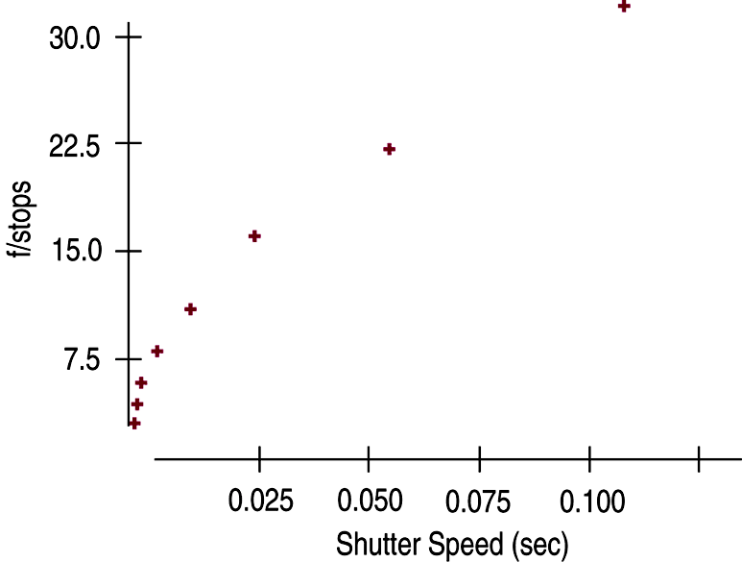
Straightening Scatterplots
A scatterplot of f/stop vs. shutter speed shows a bent relationship:

Slide 28
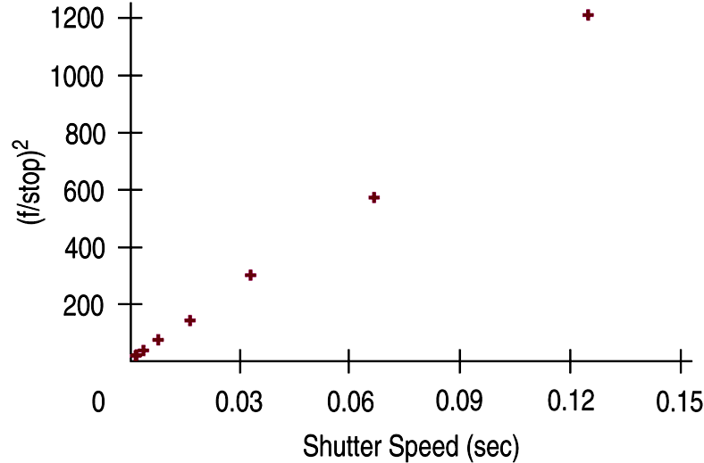
Straightening Scatterplots
Re-expressing f/stop vs. shutter speed by squaring the f/stop values straightens the relationship:

Slide 29
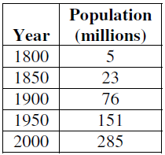
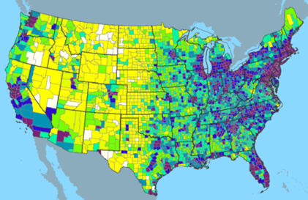
Example
Straighten the scatterplot

Slide 30
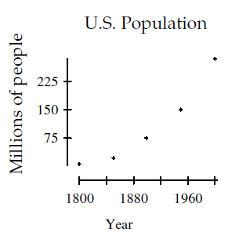
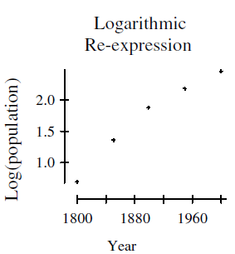
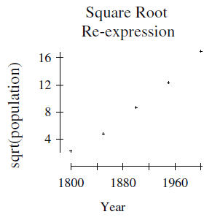
Example
Straighten the scatterplot

Slide 31
Example
Straighten the scatterplot
The scatterplot of log(population) and year shows a strong, positive association, but it is still
curved. This is not a good re-expression. The scatterplot of square root of population and year
shows a strong, positive, more linear association. The square root re-expression straightens the
scatterplot well.

Slide 32
Tip

Slide 33
What Can Go Wrong?
Don’t say “correlation” when you mean “association.”
More often than not, people say correlation when they mean association.
The word “correlation” should be reserved for measuring the strength and direction of the linear relationship between two quantitative variables.

Slide 34
What Can Go Wrong?
Don’t correlate categorical variables.
Be sure to check the Quantitative Variables Condition.
Don’t confuse “correlation” with “causation.”
Scatterplots and correlations never demonstrate causation.
These statistical tools can only demonstrate an association between variables.

Slide 35
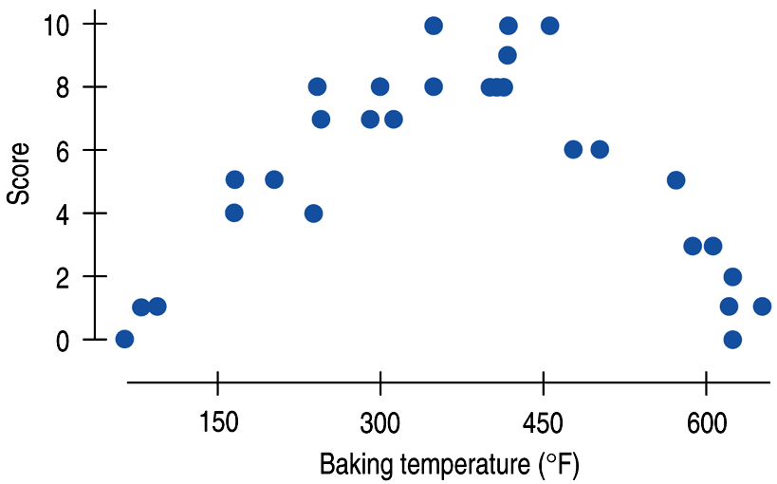
What Can Go Wrong?
Be sure the association is linear.
There may be a strong association between two variables that have a nonlinear association.

Slide 36
What Can Go Wrong?
Don’t assume the relationship is linear just because the correlation coefficient is high.
Here the correlation is 0.979, but the relationship is actually bent.

Slide 37
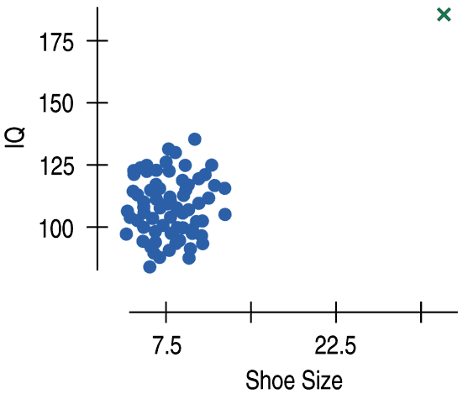
What Can Go Wrong?
Beware of outliers.
Even a single outlier
can dominate the correlation value.
Make sure to check the Outlier Condition.

Slide 38
What have we learned?
We examine scatterplots for direction, form, strength, and unusual features.
Although not every relationship is linear, when the scatterplot is straight enough, the correlation coefficient is a useful numerical summary.
The sign of the correlation tells us the direction of the association.
The magnitude of the correlation tells us the strength of a linear association.
Correlation has no units, so shifting or scaling the data, standardizing, or swapping the variables has no effect on the numerical value.

Slide 39
What have we learned?
Doing Statistics right means that we have to Think about whether our choice of methods is appropriate.
Before finding or talking about a correlation, check the Straight Enough Condition.
Watch out for outliers!
Don’t assume that a high correlation or strong association is evidence of a cause-and-effect relationship—beware of lurking variables!

Slide 40
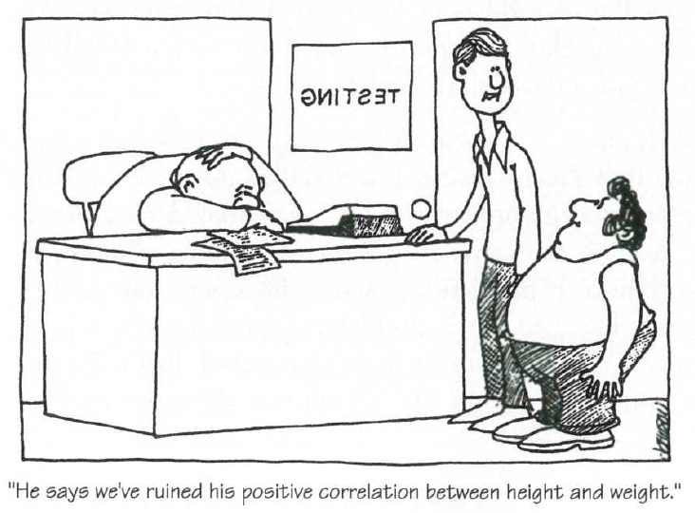

Slide 41
Homework
Pages 160 – 167
3,5,6,8,10,11,12,13,
16,18,25,27,28,
33,35, 36

