Slide 1
Statistics 6
The Normal Model

Slide 2
Update
Box plots
Our book has the whiskers extend to 1.5 times the IQR when there is an outlier. Most other resources have the whiskers extend to the largest data point within the 1.5 bounds even when there is an outlier.

Slide 3
The Standard Deviation as a Ruler
The trick in comparing very different-looking values is to use standard deviations as our rulers.
The standard deviation tells us how the whole collection of values varies, so it’s a natural ruler for comparing an individual to a group.
As the most common measure of variation, the standard deviation plays a crucial role in how we look at data.

Slide 4
Standardizing with z-scores
We compare individual data values to their mean, relative to their standard deviation using the following formula:
We call the resulting values standardized values, denoted as z. They can also be called z-scores.

Slide 5
Standardizing with z-scores
Standardized values have no units.
z-scores measure the distance of each data value from the mean in standard deviations.
A negative z-score tells us that the data value is below the mean, while a positive z-score tells us that the data value is above the mean.

Slide 6
Benefits of Standardizing
Standardized values have been converted from their original units to the standard statistical unit of standard deviations from the mean.
Thus, we can compare values that are measured on different scales, with different units, or from different populations.

Slide 7
Shifting Data
Shifting data:
Adding (or subtracting) a constant amount to each value just adds (or subtracts) the same constant to (from) the mean. This is true for the median and other measures of position too.
In general, adding a constant to every data value adds the same constant to measures of center and percentiles, but leaves measures of spread unchanged.

Slide 8
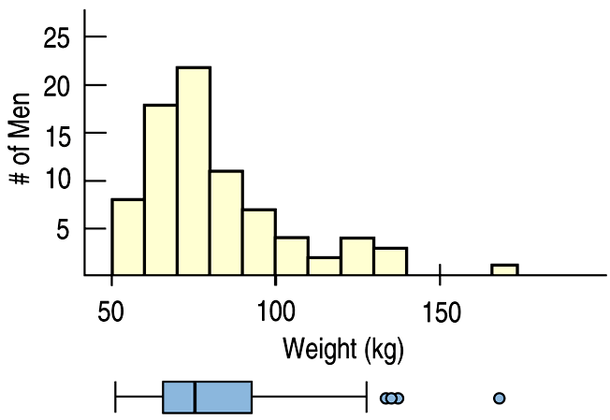
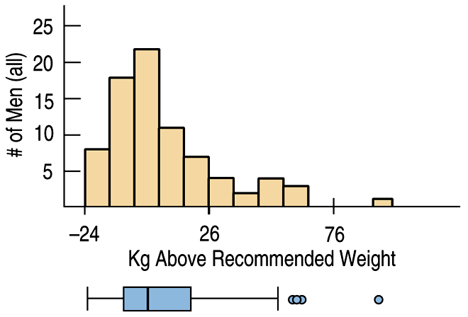
Shifting Data
The following histograms show a shift from men’s actual weights to kilograms above recommended weight:

Slide 9
Practice
A constant is added to all data points
How are the following affected?
Mean – Increases by constant
Median – Increases by constant
Standard Deviation – No Change

Slide 10
Rescaling Data
Rescaling data:
When we divide or multiply all the data values by any constant value, all measures of position (such as the mean, median and percentiles) and measures of spread (such as the range, IQR, and standard deviation) are divided and multiplied by that same constant value.

Slide 11
Rescaling Data
The men’s weight data set measured weights in kilograms. If we want to think about these weights in pounds, we would rescale the data:

Slide 12
Practice
A constant is multiplied by all data points
How are the following affected?
Mean – Increases by mult of constant
Median – Increases by mult of constant
Standard Deviation – Increases by mult of constant

Slide 13
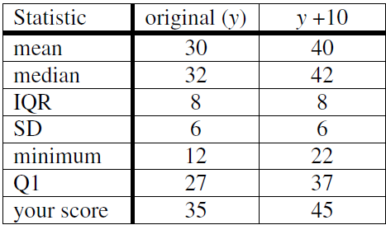
Example
Suppose the class took a 40-point quiz. Results show a mean score of 30, median 32, IQR 8, SD 6, min 12, and Q1 27. (Suppose YOU got a 35.) What happens to each of the statistics if…
I decide to weight the quiz as 50 points, and will add 10 points to every score. Your score is now 45.

Slide 14
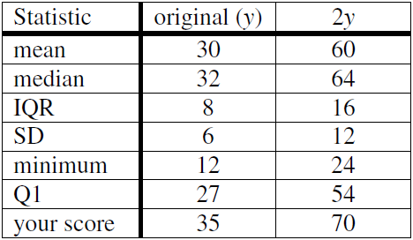
Example
Suppose the class took a 40-point quiz. Results show a mean score of 30, median 32, IQR 8, SD 6, min 12, and Q1 27. (Suppose YOU got a 35.) What happens to each of the statistics if…
I decide to weight the quiz as 80 points, and double each score. Your score is now 70.

Slide 15
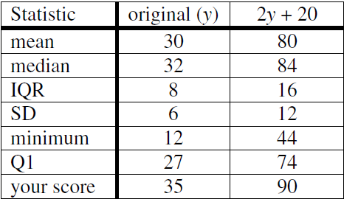
Example
Suppose the class took a 40-point quiz. Results show a mean score of 30, median 32, IQR 8, SD 6, min 12, and Q1 27. (Suppose YOU got a 35.) What happens to each of the statistics if…
I decide to count the quiz as 100 points; I’ll double each score and add 20 points. Your score is now 90.

Slide 16
Z-Scores
Utilizing the Normal Model

Slide 17
Back to z-scores
Standardizing data into z-scores shifts the data by subtracting the mean and rescales the values by dividing by their standard deviation.
Standardizing into z-scores does not change the shape of the distribution.
Standardizing into z-scores changes the center by making the mean 0.
Standardizing into z-scores changes the spread by making the standard deviation 1.

Slide 18
When Is a z-score BIG?
A z-score gives us an indication of how unusual a value is because it tells us how far it is from the mean.
A data value that sits right at the mean, has a z-score equal to 0.
A z-score of 1 means the data value is 1 standard deviation above the mean.
A z-score of –1 means the data value is 1 standard deviation below the mean.

Slide 19
When Is a z-score BIG?
How far from 0 does a z-score have to be to be interesting or unusual?
There is no universal standard, but the larger a z-score is (negative or positive), the more unusual it is.
Remember that a negative z-score tells us that the data value is below the mean, while a positive z-score tells us that the data value is above the mean.

Slide 20
When Is a z-score Big?
There is no universal standard for z-scores, but there is a model that shows up over and over in Statistics.
This model is called the Normal model (You may have heard of “bell-shaped curves.”).
Normal models are appropriate for distributions whose shapes are unimodal and roughly symmetric.
These distributions provide a measure of how extreme a z-score is.

Slide 21
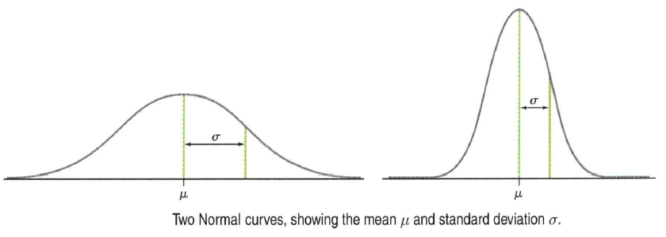
Normal Model

Slide 22
When Is a z-score Big?
There is a Normal model for every possible combination of mean and standard deviation.
We write N(μ,σ) to represent a Normal model with a mean of μ and a standard deviation of σ.
We use Greek letters because this mean and standard deviation are not numerical summaries of the data. They are part of the model. They don’t come from the data. They are numbers that we choose to help specify the model.
Such numbers are called parameters of the model.

Slide 23
When Is a z-score Big?
Summaries of data, like the sample mean and standard deviation, are written with Latin letters. Such summaries of data are called statistics.
When we standardize Normal data, we still call the standardized value a z-score, and we write

Slide 24
When Is a z-score Big?
Once we have standardized, we need only one model:
The N(0,1) model is called the standard Normal model (or the standard Normal distribution).
Be careful—don’t use a Normal model for just any data set, since standardizing does not change the shape of the distribution.

Slide 25
When Is a z-score Big?
When we use the Normal model, we are assuming the distribution is Normal.
We cannot check this assumption in practice, so we check the following condition:
Nearly Normal Condition: The shape of the data’s distribution is unimodal and symmetric.
This condition can be checked with a histogram or a Normal probability plot (to be explained later).

Slide 26
Practice
A constant is added to all data points
How are the following Z Scores affected?
Mean – Increases by constant
Median – Increases by constant
Standard Deviation – No Change

Slide 27
Practice
A constant is multiplied by all data points
How are the following Z Scores affected?
Mean – No Change
Median – No Change
Standard Deviation – Increases by mult of constant, could be a decrease

Slide 28
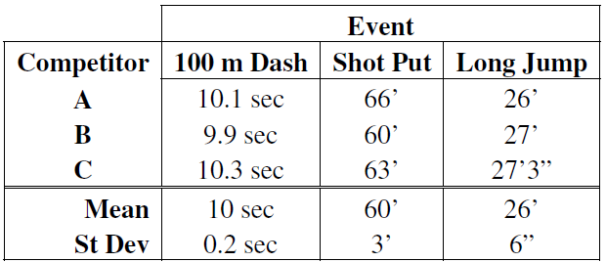
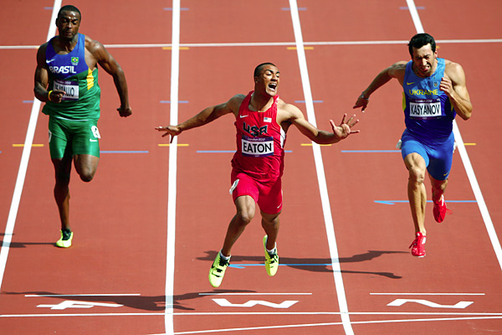
Example
Consider the three athletes’ performances shown below in a three event competition. Note that each placed first, second, and third in an event. Who gets the gold medal? Who turned in the most remarkable performance of the competition?

Slide 29
Example
We want to compare athletic performance across several different events, so we need some way to compare without units. We will compare z-scores from each event. Also, don’t forget that lower times are better in the 100-m dash!

Slide 30
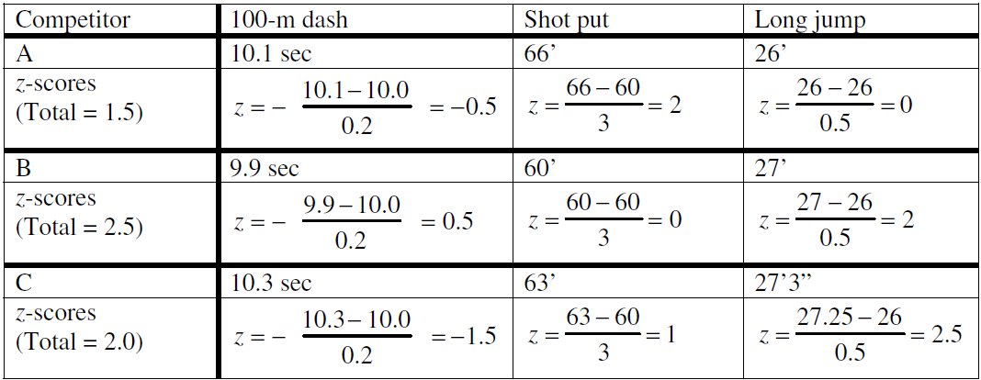
Example

Slide 31
Example
B was the winner, with a total of 2.5 standard deviations above the mean performance. C came in second and A third, with 2.0 and 1.5 standard deviations above the mean, respectively. And C’ long jump was the most startling feat: 2.5 standard deviations longer than average.

Slide 32
The 68-95-99.7 Rule
Normal models give us an idea of how extreme a value is by telling us how likely it is to find one that far from the mean.
We can find these numbers precisely, but until then we will use a simple rule that tells us a lot about the Normal model…

Slide 33
The 68-95-99.7 Rule
It turns out that in a Normal model:
about 68% of the values fall within one standard deviation of the mean;
about 95% of the values fall within two standard deviations of the mean; and,
about 99.7% (almost all!) of the values fall within three standard deviations of the mean.

Slide 34
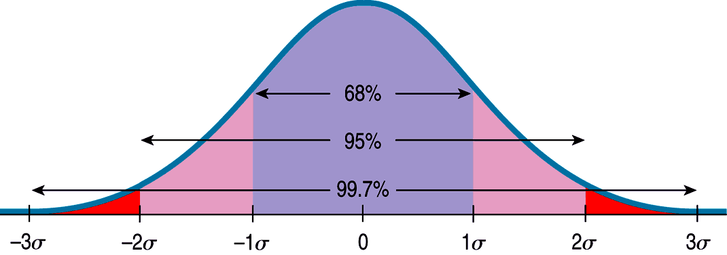
The 68-95-99.7 Rule
The following shows what the 68-95-99.7 Rule tells us:

Slide 35
The First Three Rules for Working with Normal Models
Make a picture.
Make a picture.
Make a picture.
And, when we have data, make a histogram to check the Nearly Normal Condition to make sure we can use the Normal model to model the distribution.

Slide 36
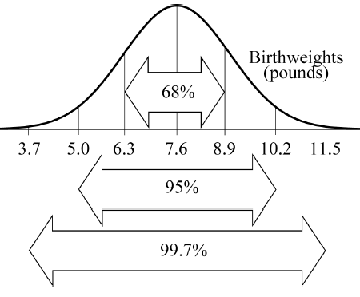
Example
Sketch Normal models using the
68-95-99.7 Rule:
Birth weights of babies, N(7.6 lb, 1.3 lb)
ACT scores at a certain college, N(21.2, 4.4)

Slide 37
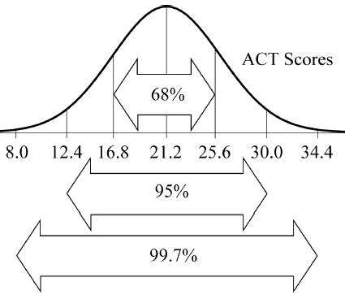
Example
Sketch Normal models using the
68-95-99.7 Rule:
Birth weights of babies, N(7.6 lb, 1.3 lb)
ACT scores at a certain college, N(21.2, 4.4)

Slide 38
Finding Normal Percentiles by Hand
When a data value doesn’t fall exactly 1, 2, or 3 standard deviations from the mean, we can look it up in a table of Normal percentiles.
Table Z in Appendix D provides us with normal percentiles, but many calculators and statistics computer packages provide these as well.

Slide 39
Finding Normal Percentiles by Hand
Table Z is the standard Normal table. We have to convert our data to z-scores before using the table.
The figure shows us how to find the area to the left when we have a z-score of 1.80:

Slide 40
Finding Normal Percentiles Using Technology
Many calculators and statistics programs have the ability to find normal percentiles for us.
The ActivStats Multimedia Assistant offers two methods for finding normal percentiles:
The “Normal Model Tool” makes it easy to see how areas under parts of the Normal model correspond to particular cut points.
There is also a Normal table in which the picture of the normal model is interactive.

Slide 41
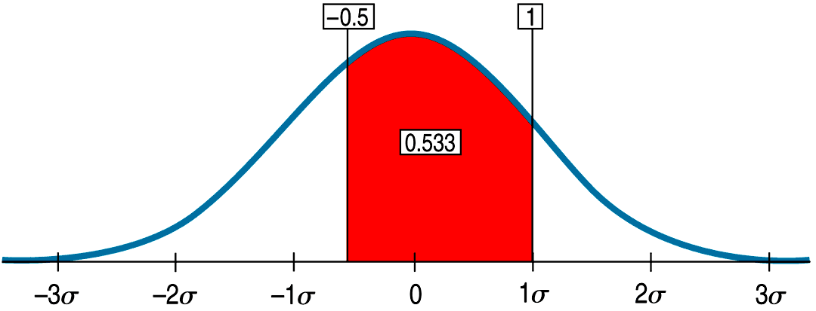
Finding Normal Percentiles Using Technology
The following was produced with the “Normal Model Tool” in ActivStats:

Slide 42
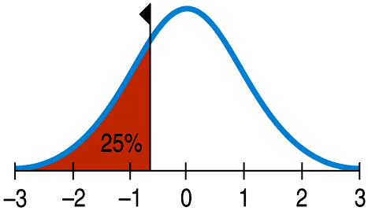
From Percentiles to Scores: z in Reverse
Sometimes we start with areas and need to find the corresponding z-score or even the original data value.
Example: What z-score represents the first quartile in a Normal model?

Slide 43
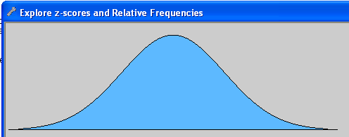
Practice
ActivStats 6.4

Slide 44
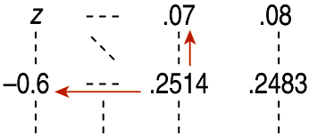
From Percentiles to Scores: z in Reverse
Look in Table Z for an area of 0.2500.
The exact area is not there, but 0.2514 is pretty close.
This figure is associated with z = –0.67, so the first quartile is 0.67 standard deviations below the mean.

Slide 45
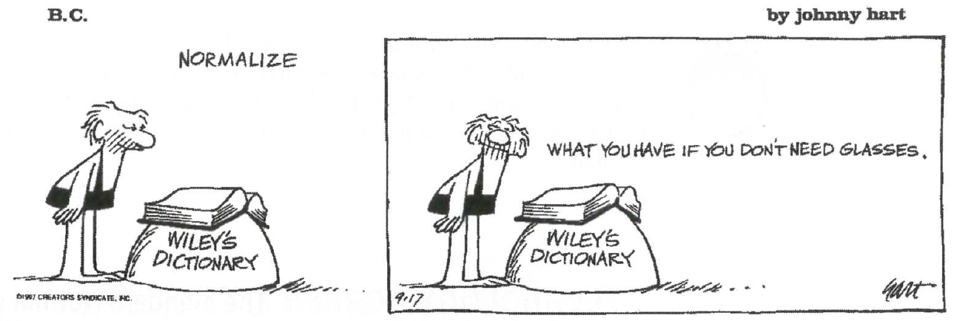

Slide 46
Normal Model
Practice and Calculator

Slide 47
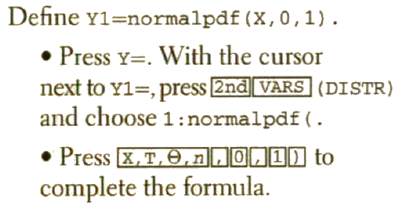
Working with Normal
Using your calculator with normal curves
To draw a normal curve
Turn off all statplots
Newer operating systems include the last step on a separate screen

Slide 48
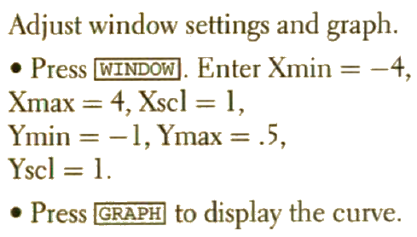
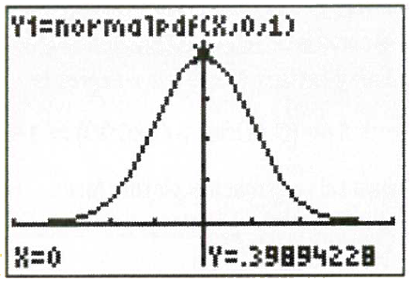
Working with Normal
To draw a normal curve

Slide 49
Working with Normal
Using your calculator with normal curves
To find area under the curve between limits

Slide 50
Working with Normal
Using your calculator with normal curves
To find area under the curve on the right end

Slide 51
Working with Normal
Using your calculator with normal curves
To find area under the curve on the left end

Slide 52
Working with Normal
Finding a Z-score
To find area under the curve on the left end

Slide 53
Working with Normal
Calculator Practice
Find the proportion of observations from a standard normal distribution that fall in each of the following regions. Use a sketch.
z < 1.39
z > -2.15
-0.56 < z < 1.81

Slide 54
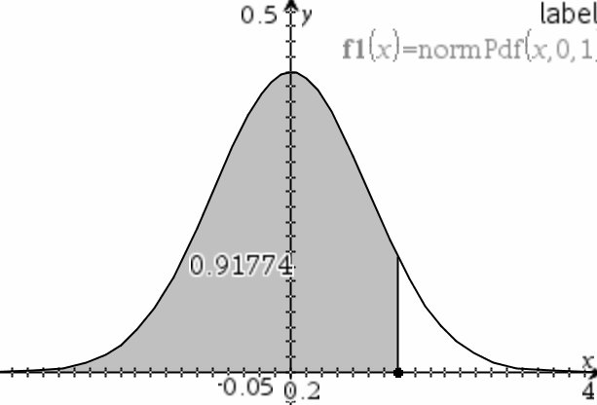
Working with Normal
Calculator Practice
z < 1.39
91.77%

Slide 55
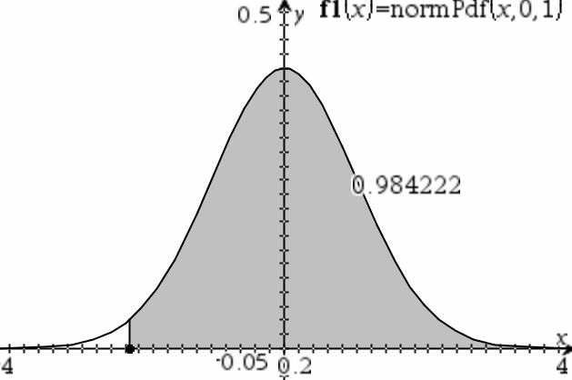
Working with Normal
Calculator Practice
z > -2.15
98.42%

Slide 56
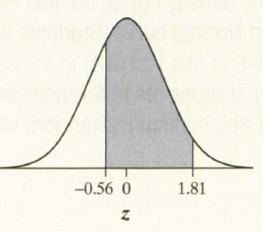
Working with Normal
Calculator Practice
-0.56 < z < 1.81
67.71%

Slide 57
Working with Normal
Calculator Practice
Use the invNorm function to find the associated Z-score for the following
The 20th percentile
45% of all observations are greater than z

Slide 58
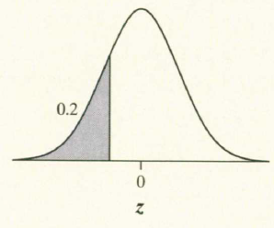
Working with Normal
Calculator Practice
The 20th percentile
z = -0.8416

Slide 59
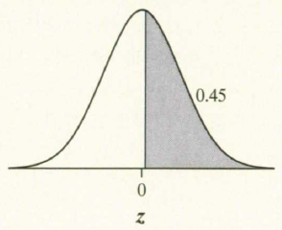
Working with Normal
Calculator Practice
45% of all observations are greater than z
z = 0.1257

Slide 60
Example
On the driving range, Tiger Woods practices his swing with a particular club by hitting many, many balls. When Tiger hits his driver, the distance the ball travels follows a Normal distribution with a mean 304 yards and standard deviation 8 yards. What percent of Tigers drives travel at least 290 yards?

Slide 61
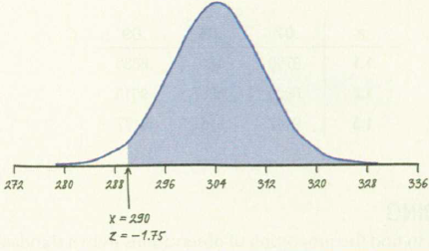
Example
On the driving range, Tiger Woods practices his swing with a particular club by hitting many, many balls. When Tiger hits his driver, the distance the ball travels follows a Normal distribution with a mean 304 yards and standard deviation 8 yards. What percent of Tigers drives travel at least 290 yards?
About 96% of Tiger Woods drives travel at least 290 yards

Slide 62
Example
On the driving range, Tiger Woods practices his swing with a particular club by hitting many, many balls. When Tiger hits his driver, the distance the ball travels follows a Normal distribution with a mean 304 yards and standard deviation 8 yards. What percent of Tigers drives travel at least 290 yards?

Slide 63
Example
Tiger’s drives have a mean 304 yards and standard deviation 8 yards
What percent of Tiger’s drives travel between 305 and 325 yards?

Slide 64
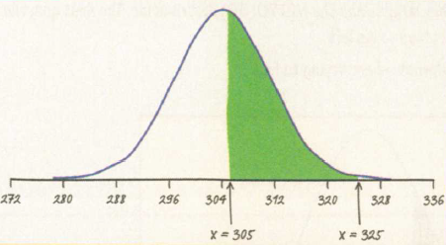
Example
What percent of Tiger’s drives travel between 305 and 325 yards?
About 44% of Tiger Woods drives travel between 305 and 325 yards

Slide 65
Example
What percent of Tiger’s drives travel between 305 and 325 yards?

Slide 66
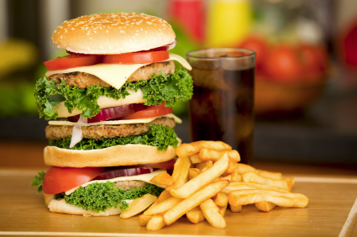
Example
High levels of cholesterol in the blood increase the risk of heart disease. For 14 year old boys, the distribution of blood cholesterol is approximately Normal with mean m= 170 milligrams of cholesterol per deciliter of blood (mg/dl) and standard deviation s = 30 mg/dl. What is the first quartile of the distribution of blood cholesterol?

Slide 67
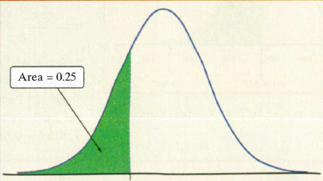
Example
High levels of cholesterol in the blood increase the risk of heart disease. For 14 year old boys, the distribution of blood cholesterol is approximately Normal with mean m= 170 milligrams of cholesterol per deciliter of blood (mg/dl) and standard deviation s = 30 mg/dl. What is the first quartile of the distribution of blood cholesterol?

Slide 68
Example
High levels of cholesterol in the blood increase the risk of heart disease. For 14 year old boys, the distribution of blood cholesterol is approximately Normal with mean m= 170 milligrams of cholesterol per deciliter of blood (mg/dl) and standard deviation s = 30 mg/dl. What is the first quartile of the distribution of blood cholesterol?
The first quartile of blood cholesterol levels in 14 year old boys is about 150 mg/dl

Slide 69
Practice
Suppose a Normal model describes the fuel efficiency of cars currently registered in your state. The mean is 24 mpg, with a standard deviation of 6 mpg.
Sketch the Normal model.

Slide 70
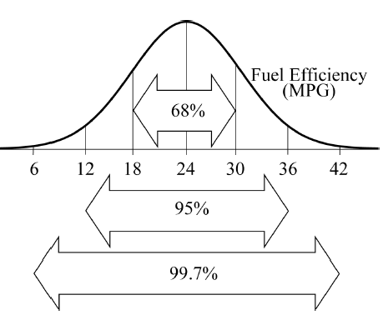
Practice
Suppose a Normal model describes the fuel efficiency of cars currently registered in your state. The mean is 24 mpg, with a standard deviation of 6 mpg.

Slide 71
Practice
Suppose a Normal model describes the fuel efficiency of cars currently registered in your state. The mean is 24 mpg, with a standard deviation of 6 mpg.
What percent of all cars get less than 15 mpg?

Slide 72
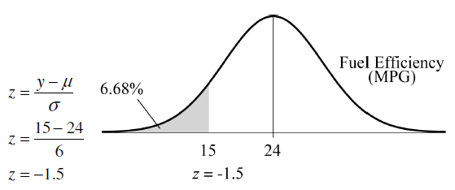
Practice
Suppose a Normal model describes the fuel efficiency of cars currently registered in your state. The mean is 24 mpg, with a standard deviation of 6 mpg.

Slide 73
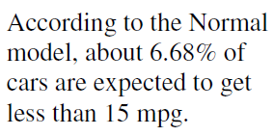
Practice
Suppose a Normal model describes the fuel efficiency of cars currently registered in your state. The mean is 24 mpg, with a standard deviation of 6 mpg.

Slide 74
Practice
Suppose a Normal model describes the fuel efficiency of cars currently registered in your state. The mean is 24 mpg, with a standard deviation of 6 mpg.
What percent of all cars get between 20 and 30 mpg?

Slide 75
Practice
Suppose a Normal model describes the fuel efficiency of cars currently registered in your state. The mean is 24 mpg, with a standard deviation of 6 mpg.

Slide 76
Practice
Suppose a Normal model describes the fuel efficiency of cars currently registered in your state. The mean is 24 mpg, with a standard deviation of 6 mpg.
According to the Normal model, about 58.89% of cars are expected to get between 20 and 30 mpg.

Slide 77
Practice
Suppose a Normal model describes the fuel efficiency of cars currently registered in your state. The mean is 24 mpg, with a standard deviation of 6 mpg.
What percent of cars get more than 40 mpg?

Slide 78
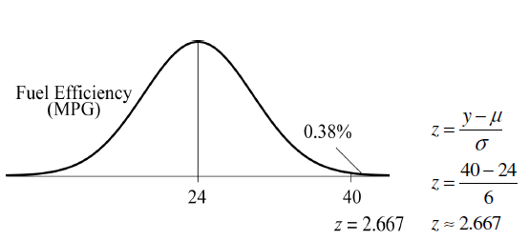
Practice
Suppose a Normal model describes the fuel efficiency of cars currently registered in your state. The mean is 24 mpg, with a standard deviation of 6 mpg.

Slide 79
Practice
Suppose a Normal model describes the fuel efficiency of cars currently registered in your state. The mean is 24 mpg, with a standard deviation of 6 mpg.
According to the Normal model, only about 0.38% of cars are expected to get more than 40 mpg.

Slide 80
Practice
Suppose a Normal model describes the fuel efficiency of cars currently registered in your state. The mean is 24 mpg, with a standard deviation of 6 mpg.
Describe the fuel efficiency of the worst 20% of all cars

Slide 81
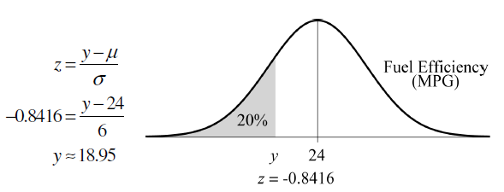
Practice
Suppose a Normal model describes the fuel efficiency of cars currently registered in your state. The mean is 24 mpg, with a standard deviation of 6 mpg.

Slide 82
Practice
Suppose a Normal model describes the fuel efficiency of cars currently registered in your state. The mean is 24 mpg, with a standard deviation of 6 mpg.
According to the Normal model, the worst 20% of cars have fuel efficiency less than about 18.95 mpg.

Slide 83
Practice
Suppose a Normal model describes the fuel efficiency of cars currently registered in your state. The mean is 24 mpg, with a standard deviation of 6 mpg.
What gas mileage represents the third quartile?

Slide 84
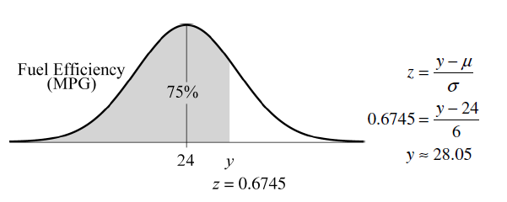
Practice
Suppose a Normal model describes the fuel efficiency of cars currently registered in your state. The mean is 24 mpg, with a standard deviation of 6 mpg.

Slide 85
Practice
Suppose a Normal model describes the fuel efficiency of cars currently registered in your state. The mean is 24 mpg, with a standard deviation of 6 mpg.
According to the Normal model, the third quartile of the distribution of fuel efficiency is about 28.05 mpg.

Slide 86
Practice
Suppose a Normal model describes the fuel efficiency of cars currently registered in your state. The mean is 24 mpg, with a standard deviation of 6 mpg.
Describe the gas mileage of the most efficient 5% of all cars.

Slide 87
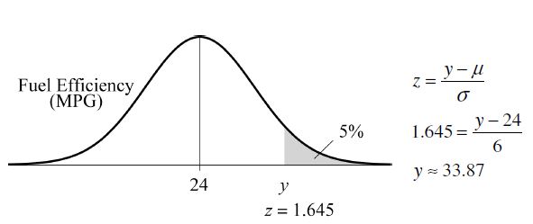
Practice
Suppose a Normal model describes the fuel efficiency of cars currently registered in your state. The mean is 24 mpg, with a standard deviation of 6 mpg.

Slide 88
Practice
Suppose a Normal model describes the fuel efficiency of cars currently registered in your state. The mean is 24 mpg, with a standard deviation of 6 mpg.
According to the Normal model, we can expect the most efficient 5% of cars to have fuel efficiency in excess of 33.87 mpg.

Slide 89
Practice
Suppose a Normal model describes the fuel efficiency of cars currently registered in your state. The mean is 24 mpg, with a standard deviation of 6 mpg.
What gas mileage would you consider unusual? Why?

Slide 90
Practice
Suppose a Normal model describes the fuel efficiency of cars currently registered in your state. The mean is 24 mpg, with a standard deviation of 6 mpg.
It depends on your definition of unusual. If ±2 standard deviations is considered unusual, then, according to the Normal model, any gas mileage below 12 mpg or above 36 mpg would be considered unusual. If ±3 standard deviations is considered unusual, then, according to the Normal model, any gas mileage below 6 mpg or above 42 mpg would be considered unusual.

Slide 91
Probability Plot
Probability Plot

Slide 92
Are You Normal? How Can You Tell?
When you actually have your own data, you must check to see whether a Normal model is reasonable.
Looking at a histogram of the data is a good way to check that the underlying distribution is roughly unimodal and symmetric.

Slide 93
Are You Normal? How Can You Tell?
A more specialized graphical display that can help you decide whether a Normal model is appropriate is the Normal probability plot.
If the distribution of the data is roughly Normal, the Normal probability plot approximates a diagonal straight line. Deviations from a straight line indicate that the distribution is not Normal.

Slide 94
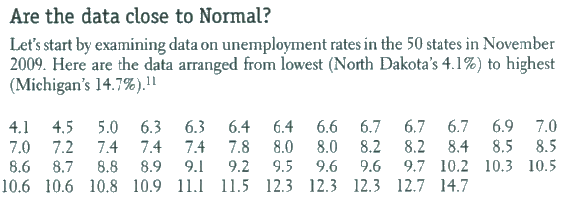
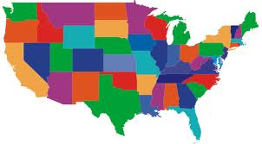
Is data Normal

Slide 95
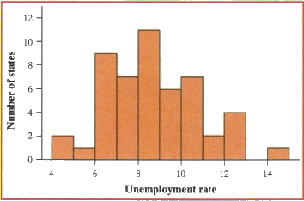
Is data Normal

Slide 96
Is data Normal

Slide 97
Is data Normal

Slide 98
Is data Normal
Check this data with a normal probability plot
Arrange the observed data values from smallest to largest. Record the percentile corresponding to each observation (but remember that there are several definitions of “percentile”) . For example, the smallest observation in a set of 50 values is at either the 0th percentile (since 0 out of 50 values are below this observation) or the 2nd percentile (since 1 out of 50 values are at or below this observation).

Slide 99
Is data Normal
Check this data with a normal probability plot
Technology usually “splits the difference,” declaring this minimum value to be at the (0 + 2)/2 = 1st percentile. By similar reasoning, the second smallest value is at the 3rd percentile, the third smallest value is at the 5th percentile, and so on. The maximum value is at the (98 + 100)/2 = 99th percentile.

Slide 100
Is data Normal
Check this data with a normal probability plot
Now – Use the standard normal distribution (invNorm) to find the z-scores at these same percentiles. For example, the 1st percentile of the standard normal distribution is z = -1.645. The 99th percentile is z = 2.326

Slide 101
Is data Normal
Check this data with a normal probability plot
Finally – Plot each observation x against the corresponding z. If the data distribution is close to Normal, the plotted points will lie close to some straight line.

Slide 102
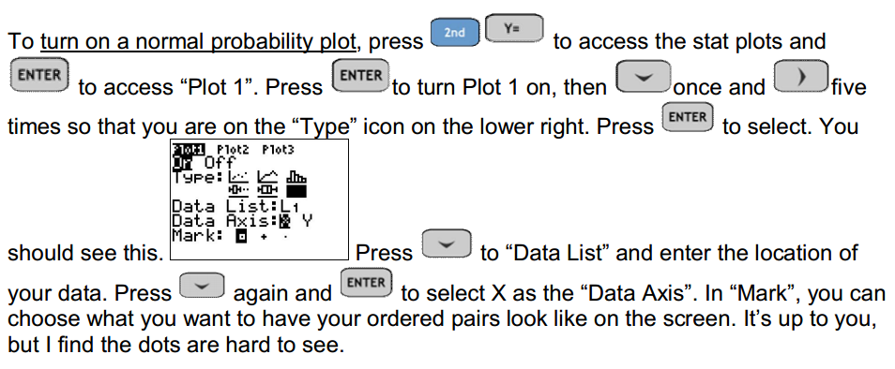
Is data Normal
Once this data is in a list, complete with TI-84

Slide 103
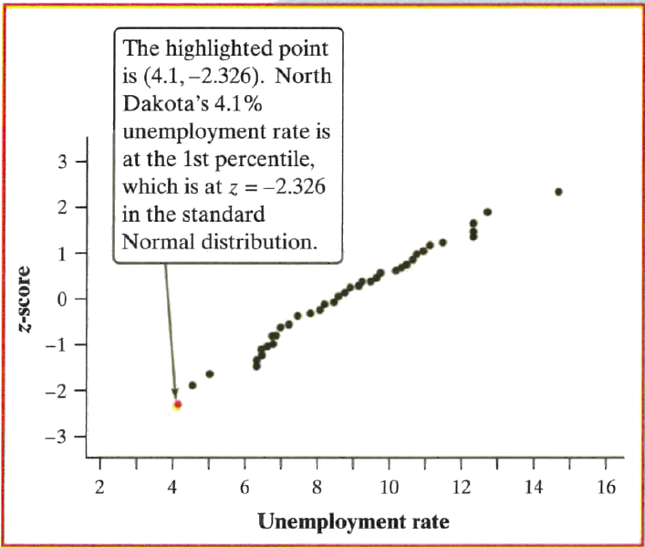
Is data Normal

Slide 104
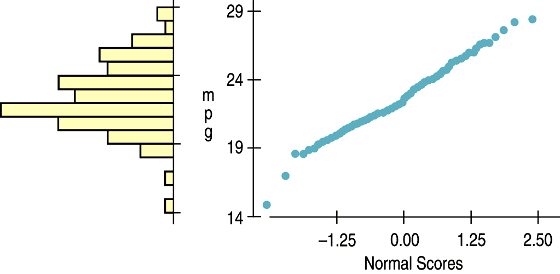
Are You Normal? How Can You Tell?
Nearly Normal data have a histogram and a Normal probability plot that look somewhat like this example:

Slide 105
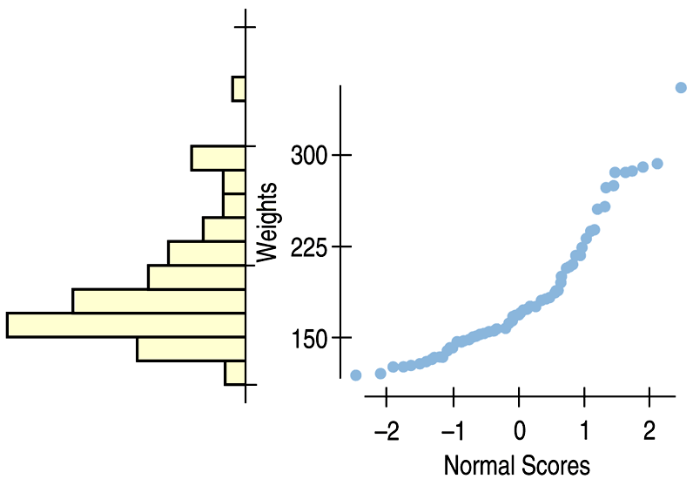
Are You Normal? How Can You Tell?
A skewed distribution might have a histogram and Normal probability plot like this:

Slide 107
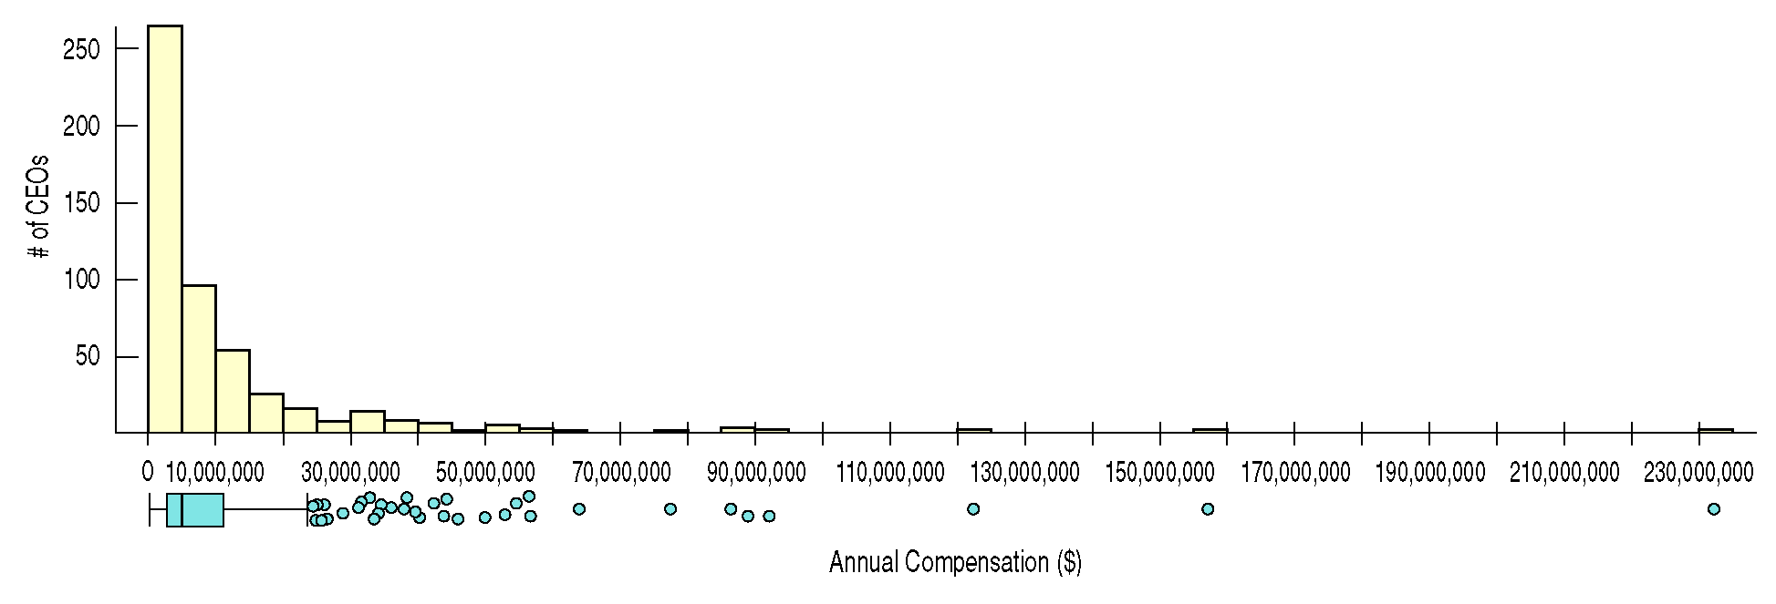
What Can Go Wrong?
Don’t use a Normal model when the distribution is not unimodal and symmetric.

Slide 108
What Can Go Wrong?
Don’t use the mean and standard deviation when outliers are present—the mean and standard deviation can both be distorted by outliers.
Don’t round off too soon.
Don’t round your results in the middle of a calculation.
Don’t worry about minor differences in results.

Slide 109
What have we learned?
The story data can tell may be easier to understand after shifting or rescaling the data.
Shifting data by adding or subtracting the same amount from each value affects measures of center and position but not measures of spread.
Rescaling data by multiplying or dividing every value by a constant changes all the summary statistics—center, position, and spread.

Slide 110
What have we learned?
We’ve learned the power of standardizing data.
Standardizing uses the SD as a ruler to measure distance from the mean (z-scores).
With z-scores, we can compare values from different distributions or values based on different units.
z-scores can identify unusual or surprising values among data.

Slide 111
What have we learned?
We’ve learned that the 68-95-99.7 Rule can be a useful rule of thumb for understanding distributions:
For data that are unimodal and symmetric, about 68% fall within 1 SD of the mean, 95% fall within 2 SDs of the mean, and 99.7% fall within 3 SDs of the mean.

Slide 112
What have we learned?
We see the importance of Thinking about whether a method will work:
Normality Assumption: We sometimes work with Normal tables (Table Z). These tables are based on the Normal model.
Data can’t be exactly Normal, so we check the Nearly Normal Condition by making a histogram (is it unimodal, symmetric and free of outliers?) or a normal probability plot (is it straight enough?).

Slide 113
Homework
Pages 123 – 128
2,3,4,9-11,14,
18,20,28
29-32,42,43,49

