Slide 1
Geometry 8-3
Proving Triangles Similar

Slide 2
Similarity Exploration
Get your supplies
- Protractor
- Ruler

Slide 3
Similarity Exploration
Draw any triangle ABC
A
B
C

Slide 4
Similarity Exploration
Draw a second triangle DEF with
D
A
E
F
B
C

Slide 5
Similarity Exploration
What is true of angles C and F?
They are congruent
D
A
E
F
B
C

Slide 6
Similarity Exploration
Measure the side lengths
D
A
Yes
E
F
B
C

Slide 7
A – A Similarity Postulate
If two angles of one triangle are congruent to two angles of another triangle, then the triangles are similar
D
A
E
F
B
C

Slide 8
SSS Similarity Theorem
If three sides of one triangle are proportional to three sides of another triangle, then the triangles are similar

Slide 9
SAS Similarity Theorem
If two sides of one triangle are proportional to two sides of another triangle, and the included angles are congruent, then the triangles are similar

Slide 10
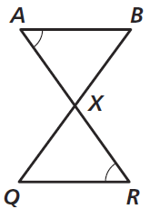
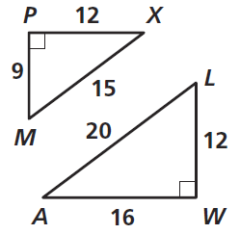
Practice

Slide 11
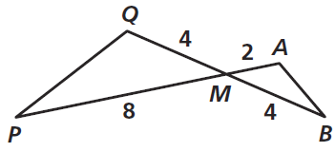
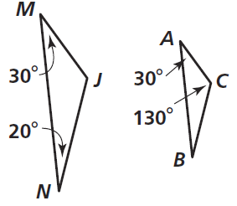
Practice

Slide 12
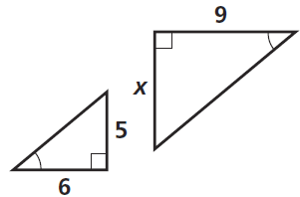
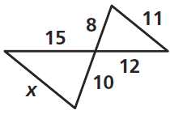
Practice

Slide 13
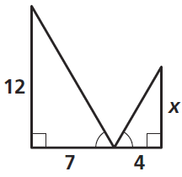
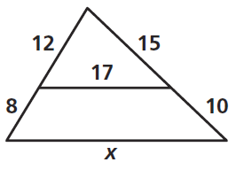
Practice

Slide 14
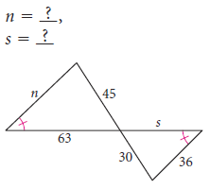
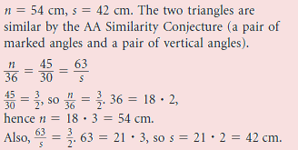

Slide 15
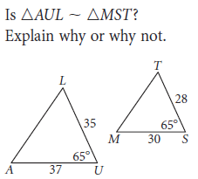

Slide 16
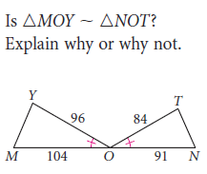
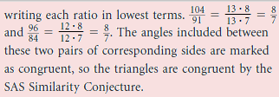

Slide 17
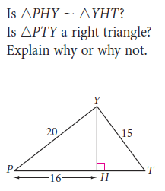
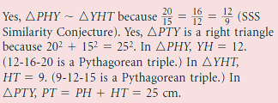

Slide 18
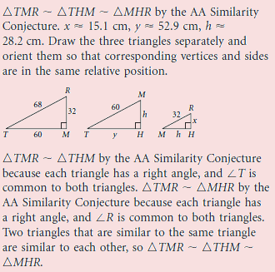
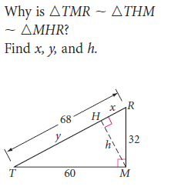
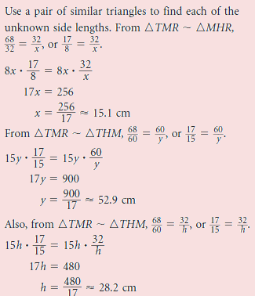

Slide 19
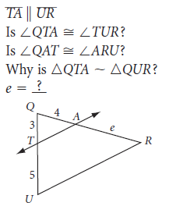
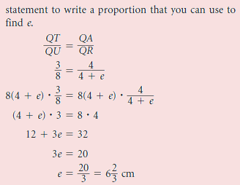

Slide 20
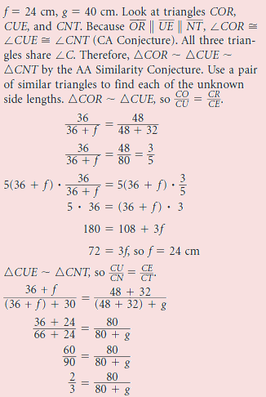
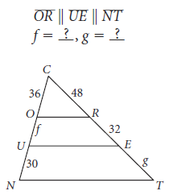
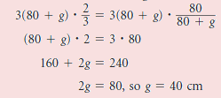

Slide 21
Homework
Pages 436 – 438
5 – 19 odd, 25, 27, 31, 33, 51, 53

Slide 22
Honors Homework
Pages 436 – 438
5 – 19 odd, 25, 27, 31, 33, 44, 51, 53

