Slide 1
Geometry 6-x
Star Polygon

Slide 2
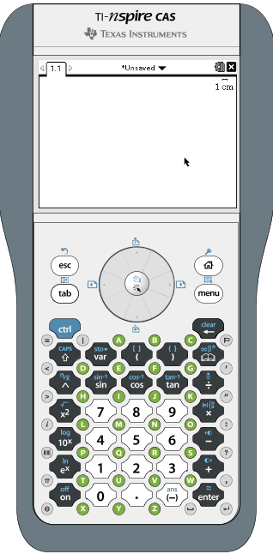
Star Polygon
Start a new Geometry file on your calculator
Home
1 > No > 3

Slide 3
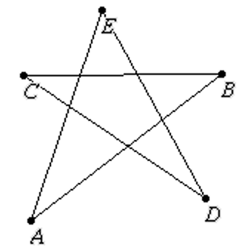
Star Polygon
Draw five line segments in a circular path to create a star as shown.
Menu > 7 > 5
To name a point, type a letter immediately after creating the point
Start each successive line at the same point where the previous line ended

Slide 4
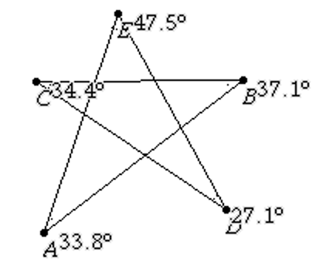
Star Polygon
Measure all of the angles of the points of the star
Menu > 8 > 4
Click through three points in order and the angle measurement will be automatically placed near the vertex

Slide 5
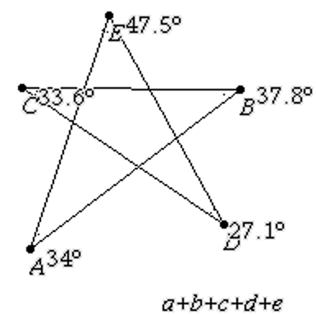
Star Polygon
Add the following text to the screen
a+b+c+d+e
Menu > 1 > 6

Slide 6
Star Polygon
Add up the five angle measures
Menu > 1 > 8
After selecting “8” calculate, select the text, then select each angle in succession as prompted on the screen

Slide 7
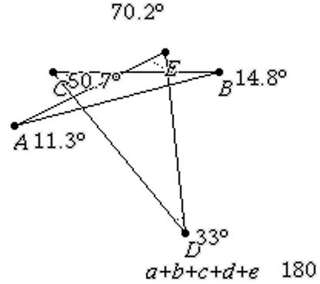
Star Polygon
Alter the shape of the star to see if the total changes

Slide 8
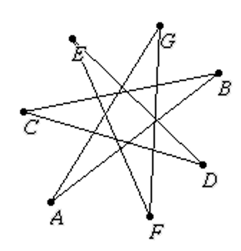
Star Polygon
Repeat the same steps to create a seven pointed star, and add up its angles

Slide 9
Star Polygon
Start a new Geometry page on your calculator
Cntrl Up arrow
Cntrl > Home > 4 > 2
Enter > Menu > 3

Slide 10
Star Polygon
Draw five line segments in a circular path to create a star as shown.
Menu > 7 > 5
To name a point, type a letter immediately after creating the point
Start each successive line at the same point where the previous line ended

Slide 11
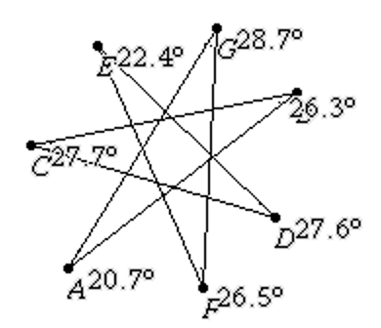
Star Polygon
Measure all of the angles of the points of the star
Menu > 8 > 4
Click through three points in order and the angle measurement will be automatically placed near the vertex

Slide 12
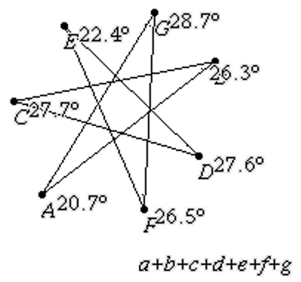
Star Polygon
Add the following text to the screen
a+b+c+d+e+f+g
Menu > 1 > 6

Slide 13
Star Polygon
Add up the five angle measures
Menu > 1 > 8
After selecting “8” calculate, select the text, then select each angle in succession as prompted on the screen

Slide 14
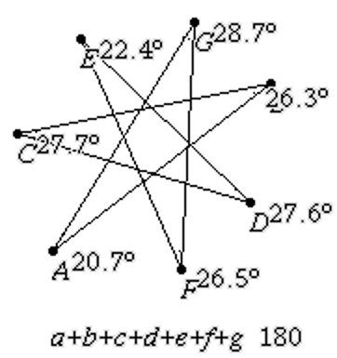
Star Polygon
Alter the shape of the star to see if the total changes

Slide 15
Star Polygon
What happens if you drag a vertex until you no longer have a star, but rather a concave polygon?

