Slide 1
Geometry 6-4
Special Parallelograms

Slide 3
Special Parallelograms
If two parallel lines are intersected by a second pair of parallel lines that are the same distance apart as the first set of parallel lines then the parallelogram formed is a rhombus.

Slide 4
Rhombus Investigation

Slide 5
Rhombus Diagonal Theorem
Diagonals of a rhombus are perpendicular and they are bisectors

Slide 6
Rhombus Investigation

Slide 7
Rhombus Angle Conjecture
The diagonals of a rhombus bisect the angles of a rhombus

Slide 8
Rectangle Investigation

Slide 9
Rectangle Diagonal Conjecture
The diagonals if a rectangle are congruent and bisectors
Rectangles are also parallelograms, so all parallelogram conjectures also apply

Slide 10
Combination
What figure combines the properties of a rectangle and a rhombus?
Square
So, combine all the diagonal properties

Slide 11
Square Diagonal Conjecture
The diagonals of a square are congruent, perpendicular and bisectors

Slide 12
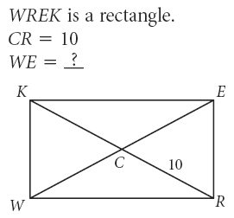
Sample Problems

Slide 13
Sample Problems

Slide 14
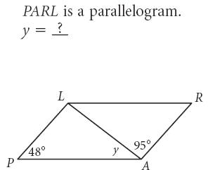
Sample Problems

Slide 15
Sample Problems

Slide 16
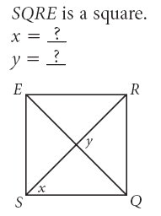
Sample Problems

Slide 17
Sample Problems

Slide 18
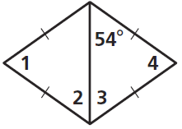
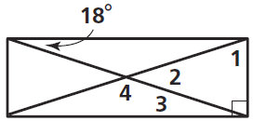
Practice

Slide 19
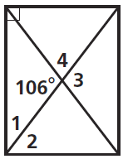
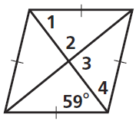
Practice

Slide 20
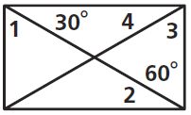
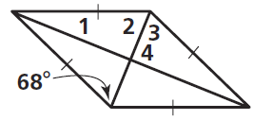
Practice

Slide 21
Practice

Slide 22
Practice

Slide 23
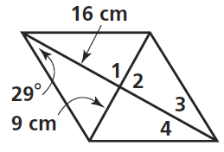
Practice

Slide 24
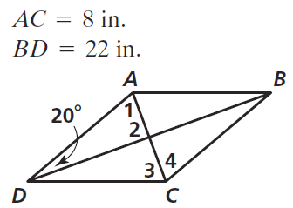
Practice

Slide 25
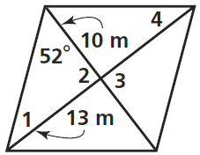
Practice

Slide 26
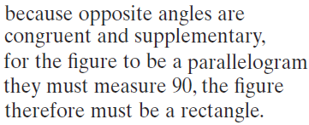
Practice

Slide 27
Homework
Pages 315 – 317
7 – 12, 16 – 21, 25 - 37

Slide 28
Honors Homework
Pages 315 – 317
7 – 12, 16 – 21, 25 – 37, 54

