Slide 1
Geometry 2-4
Reasoning in Algebra

Slide 2
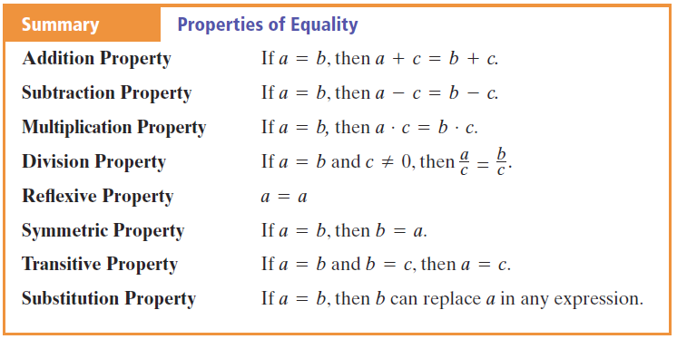
Reasoning in Algebra

Slide 3
Reasoning in Algebra

Slide 4
Reasoning in Algebra

Slide 5
Reasoning in Algebra

Slide 6
Reasoning in Algebra

Slide 7
Reasoning in Algebra

Slide 8
Reasoning in Algebra

Slide 9
Reasoning in Algebra

Slide 10
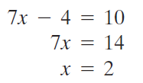
Reasoning in Algebra - Practice

Slide 11
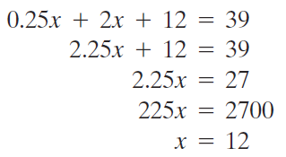
Reasoning in Algebra - Practice

Slide 12
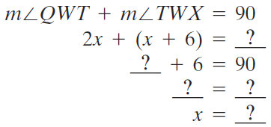
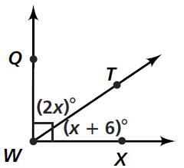
Reasoning in Algebra - Practice

Slide 13
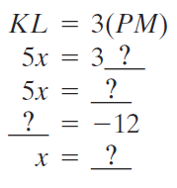
Reasoning in Algebra - Practice

Slide 14
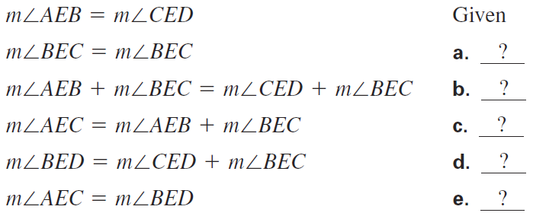
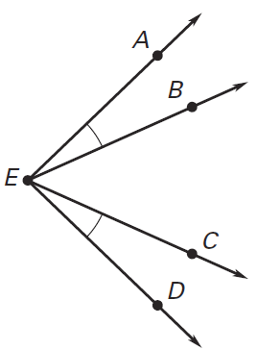
Reasoning in Algebra - Practice

Slide 15
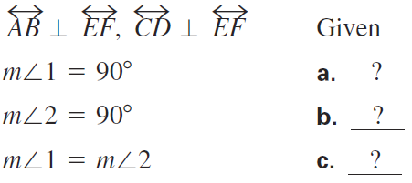
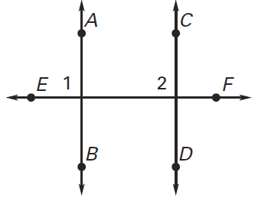
Reasoning in Algebra - Practice

Slide 16
Homework
Pages 92 – 94
3, 4, 18, 19, 20, 23, 29, 31, 45-48

