Slide 1
Geometry 7-5
Areas of Regular Polygons

Slide 2
Review

Slide 3
Areas

Slide 4
Area
Area of a Triangle

Slide 5
Theorem
The Pythagorean theorem
In a right triangle, the sum of the squares of the legs of the triangle equals the square of the hypotenuse of the triangle
B
c
a
C
A
b

Slide 6
Theorem
Converse of the Pythagorean theorem
If the square of the length of the longest side of a triangle is equal to the sum of the squares of the lengths of the other two sides, then the triangle is a right triangle.
B
c
a
C
A
b

Slide 7
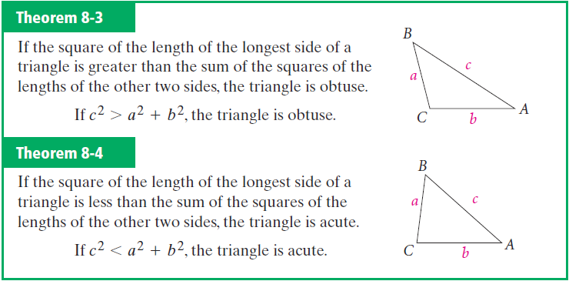
Converse of Pythagorean

Slide 8
Theorem
45° – 45° – 90° Triangle
In a 45° – 45° – 90° triangle the hypotenuse is the square root of two times as long as each leg

Slide 9
Theorem
30° – 60° – 90° Triangle
In a 30° – 60° – 90° triangle, the hypotenuse is twice as long as the shorter leg, and the longer leg is the square root of three times as long as the shorter leg

Slide 10
Area

Slide 11
New Material

Slide 12
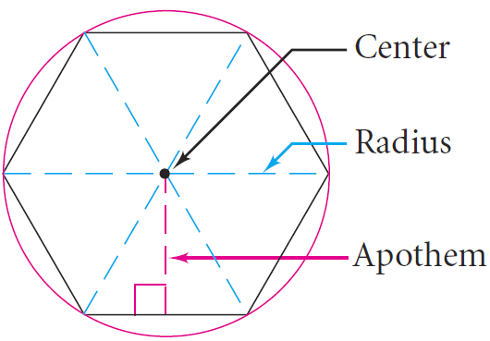
Vocabulary
Apothem – Line segment from the center of a regular polygon perpendicular to a side

Slide 13
Regular Polygon Investigation
Get your supplies
Handout

Slide 14
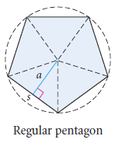
Regular Polygon Investigation
½ a s
5/2 a s

Slide 15
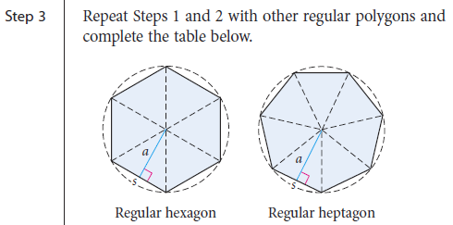
Regular Polygon Investigation
½ 5 a s
½ 6 a s
½ 7 a s
½ 8 a s
½ 9 a s
½ 10 a s
½ 12 a s
½ n a s
Regular Polygon Investigation

Slide 16
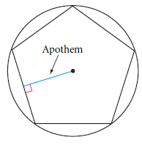
Regular Polygon Investigation
p = n s

Slide 17
Regular Polygon Area Conjecture
The area of a regular polygon is given by the formula A = ½ a n s or A = ½ a p Where A is the area, a is the apothem, n is the number of sides in the regular polygon, s is the length of each side and p is the perimeter of the regular polygon

Slide 18
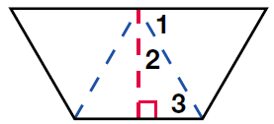
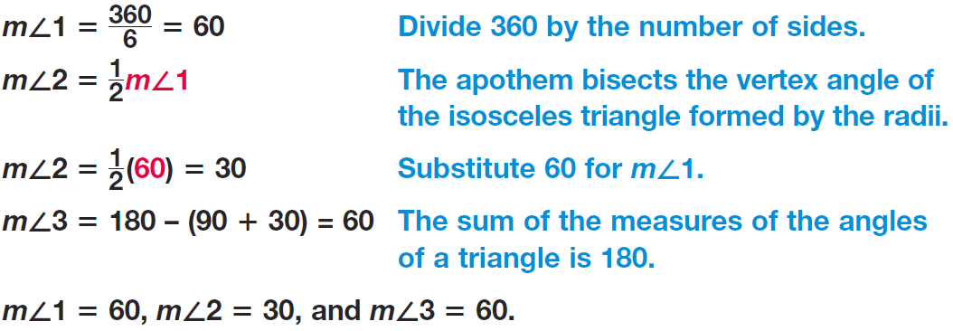
Example

Slide 19
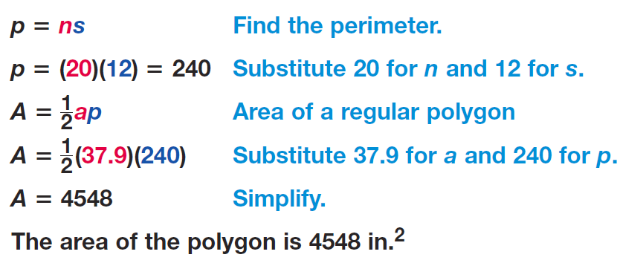
Example

Slide 20
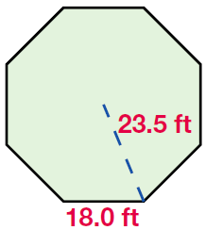
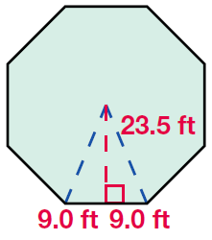
Example

Slide 21
Example

Slide 22
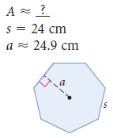
Sample Problems

Slide 23
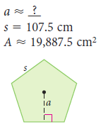
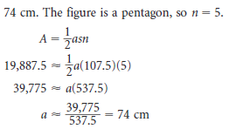
Sample Problems

Slide 24
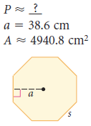
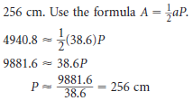
Sample Problems

Slide 25
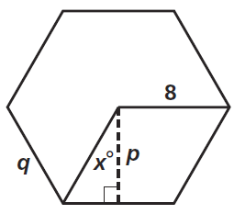
Practice

Slide 26
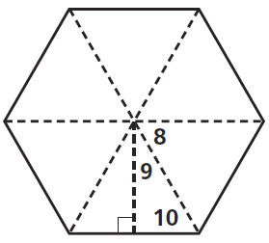
Practice

Slide 27
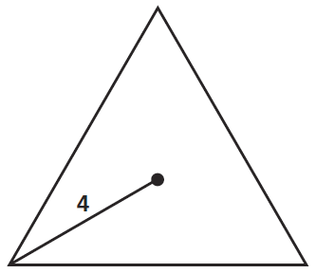
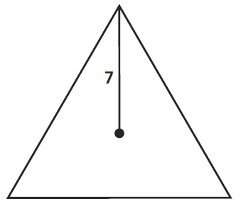
Practice

Slide 28
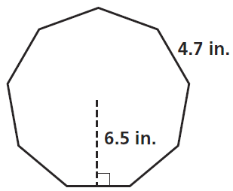
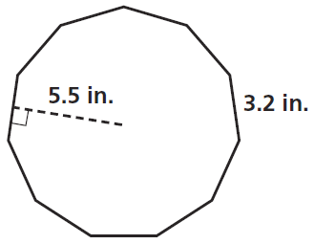
Practice

Slide 29
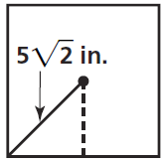
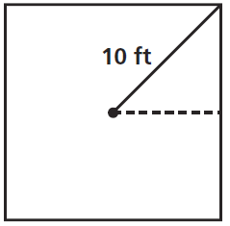
Practice

Slide 30
Homework
Pages 382 – 385
10 – 20 even, 30, 36 – 40 even, 51 - 53

Slide 31
Honors Homework
Pages 382 – 385
10 – 20 even, 30, 36 – 40 even, 44, 51 - 53

