Slide 1
Substitution Method for Solving Systems of Equations

Slide 2
Substitution Method
A System of equations may be solved exactly by using the substitution method. This method solves one equation so that a variable may be “substituted” in the other equation, which can then be solved for a variable.

Slide 3
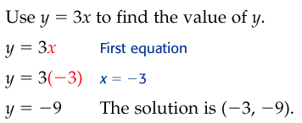
Substitution Method - Example
Y
Y = 3x
So, anywhere “y” occurs, it can be replaced by 3x

Slide 4
Substitution Method - Practice

Slide 5
Substitution Method - Example
This problem does not have something like “y=“ so we must solve for a variable before we can substitute
For which variable, from which equation, should we solve?
Solve for “x” in the first equation because it has a coefficient of one, and can be used easily for substitution
Y=1
Are we done with this work? No
What more must we do?
Substitute the value of y back into the OTHER equation

Slide 6
Substitution Method - Example

Slide 7
Substitution Method - Practice
Which variable did you solve for first, before substituting?
Y in the second equation, because it has a coefficient of one
Be careful that you solve for positive y, not negative y

Slide 8
Substitution Method - Example
Y equals more than one number, but the whole expression (3x + 2) can be substituted for y and then solved for x

Slide 9
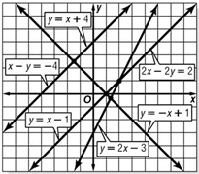
Homework Quiz

Slide 10
Substitution Method - Example
This is a weighted average problem that we solved last semester, here is another way to solve this problem

Slide 11
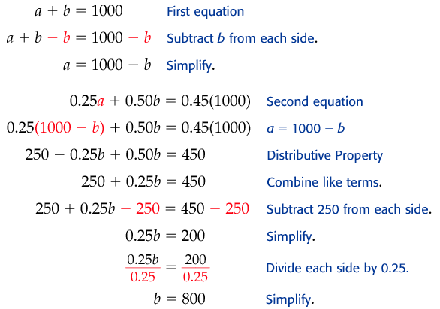
Substitution Method - Example

Slide 12
Substitution Method - Example

Slide 13
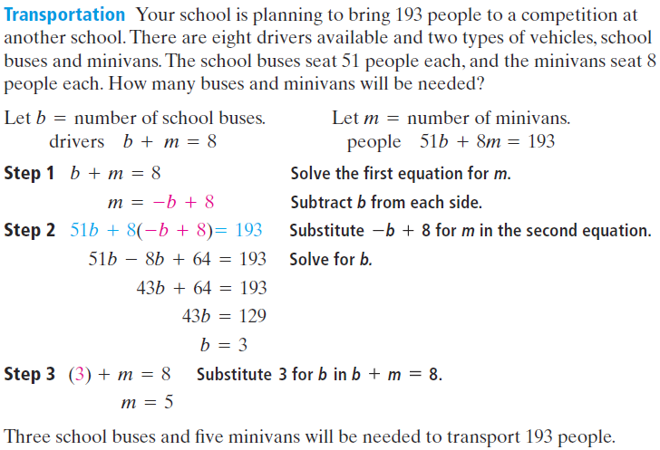
Substitution Method - Example
What are the variables in this problem?
Buses and minivans

Slide 14
Substitution Method - Practice

Slide 15
Substitution Method - Practice
When both equations are of the form “y=“ then just set them equal to each other

Slide 16
Substitution Method - Practice

Slide 17
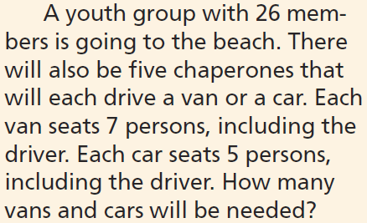
Substitution Method - Practice

Slide 18
Substitution Method - Practice
(-4,4)
(-9,-7)
All Real Numbers
Infinitely Many Solutions

Slide 19
Graphing Calculator Exploration
How to solve a systems problem, graphically with a graphing calculator
Everyone get a calculator

Slide 20
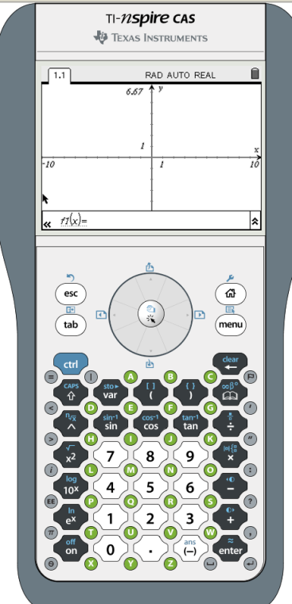
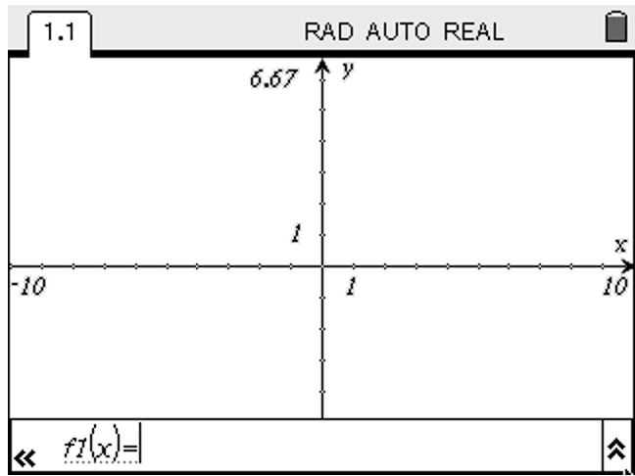
Graphing Calculator Exploration
Clear out old problems from the calculator
Home > 1 > no
Open a graphing calculator screen
2 “Graphs”

Slide 21
Graphing Calculator Exploration
Our goal is to find the solution to the following system of equations
2.93x + y = 6.08
8.32x – y = 4.11
First solve each of these equations for y, so the resulting equations can be entered into the calculator for f1(x) and f2(x)

Slide 22
Graphing Calculator Exploration
The= solved equations should be as follows
y = 6.08 – 2.93x
y = – 4.11 + 8.32x
Entered these into the calculator for f1(x) and f2(x)
Cntrl > G if enter line disappears

Slide 23
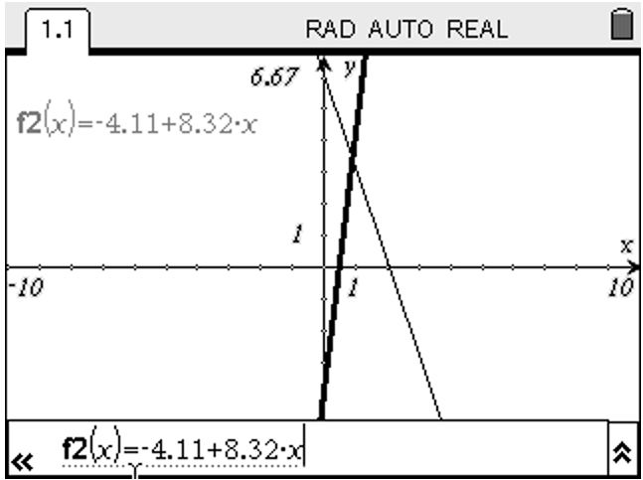
Graphing Calculator Exploration
Your screen should look like this

Slide 24
Graphing Calculator Exploration
There is one solution to our problem

Slide 25
Graphing Calculator Exploration
The solution to our problem is the point where the two lines intersect.
The calculator will help us find that point

Slide 26
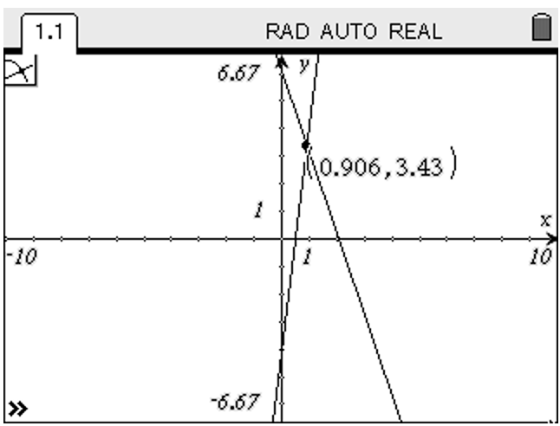
Graphing Calculator Exploration
Menu > 6 > 4
Use the navpad and the select to select each of the lines, one after the other
The intersecting point should be displayed on your screen

Slide 27
Graphing Calculator Exploration
The solution to this system is
x = 0.906, y = 3.43

Slide 28
Graphing Calculator Exploration
To start a new problem on the calculator
Home > (right arrow) > Enter (graphs)
Complete the problems on the next screen

Slide 29
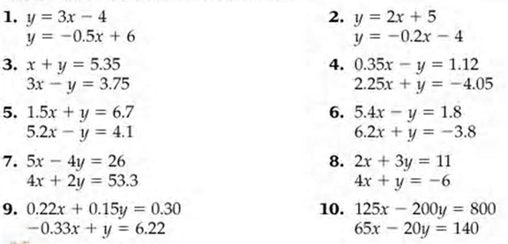
Graphing Calculator Exploration

Slide 30
Summary
Solving method for systems of equations when one variable is substituted in for another variable Substitution Method
When the substitution method can be used When a single variable can be solved, that is it has a coefficient of one

Slide 31
Summary
Two equations relating to the same variables System of Equations
System of Equations with parallel lines No Solution
System of Equations that are the same line Infinite Solutions
System of Equations that cross at one point That point is the solution to the system

Slide 32
Homework
7-2 Substitution Method (2 pages)
All Problems

