Slide 1
Factoring Activity

Slide 2
Factoring

Slide 3
Factoring Review
Write all possible factors (two terms) for the last term
Find two terms that add (or subtract) to the middle term in the original trinomial
Re-Write as four terms
Factor by grouping

Slide 4
Factoring - Signs
If the last term is positive
Both new middle terms have the same sign, and the sign is the same as the old middle term
If the last term is negative
The new middle terms have different signs, and the larger term has the same sign as the old middle term

Slide 5
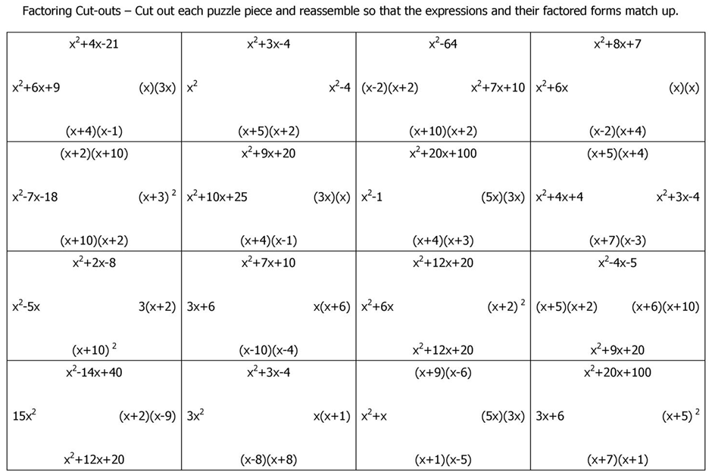
Activity

Slide 6
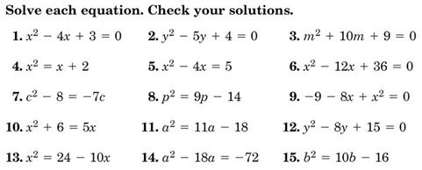
Homework Quiz

Slide 7
Homework
Worksheet
Practice 9-5 Factoring Trinomials
Prime Number

