Slide 1
Inverse Variation

Slide 2
Inverse Variation
Direct Variation – As one variable gets larger, the other variable gets larger
Inverse Variation – As one variable gets larger, the other variable gets smaller

Slide 3
Inverse Variation

Slide 4
Example 1-1a
Manufacturing The owner of Superfast Computer Company has calculated that the time t in hours that it takes to build a particular model of computer varies inversely with the number of people p working on the computer. The equation can be used to represent the people building a computer. Complete the table and draw a graph of the relation.
p | 2 | 4 | 6 | 8 | 10 | 12
t

Slide 5
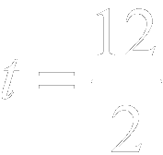
Example 1-1b
Solve for
Original equation
Replace p with 2.
Divide each side by 2.
Simplify.
Answer:
p | 2 | 4 | 6 | 8 | 10 | 12
t
6
3
2
1.5
1.2
1
Solve the equation for the other values of p.

Slide 6
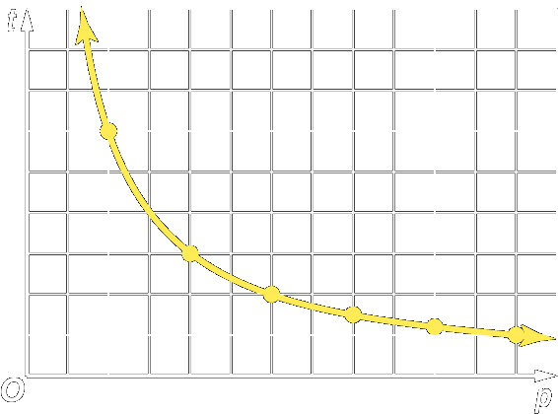
Example 1-1c
Graph the ordered pairs: (2, 6), (4, 3), (6, 2), (8, 1.5), (10, 1.2), and (12, 1).
Answer:
As the number of people p increases, the time t it takes to build a computer decreases.

Slide 7
Example 1-1d
Manufacturing The foreman of a package delivery company has found that the time t in hours that it takes to prepare packages for delivery varies inversely with the number of people p that are preparing them. The equation can be used to represent the people preparing the packages. Complete the table and draw a graph of the relation.
Answer:
p | 2 | 4 | 6 | 8 | 10 | 12
t
p | 2 | 4 | 6 | 8 | 10 | 12
t | 18 | 9 | 6 | 4.5 | 3.6 | 3

Slide 8
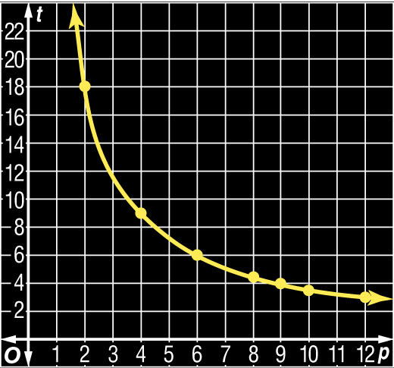
Example 1-1e
Answer:

Slide 9
Example 1-2a
Graph an inverse variation in which y varies inversely as x and
Solve for k.
Inverse variation equation
The constant of variation is 4.

Slide 10
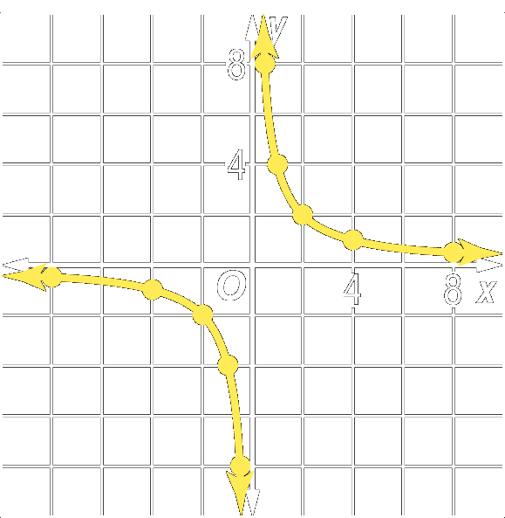
Example 1-2b
Choose values for x and y whose product is 4.
x | y
–4 | –1
–2 | –2
–1 | –4
0 | undefined
1 | 4
2 | 2
4 | 1

Slide 11
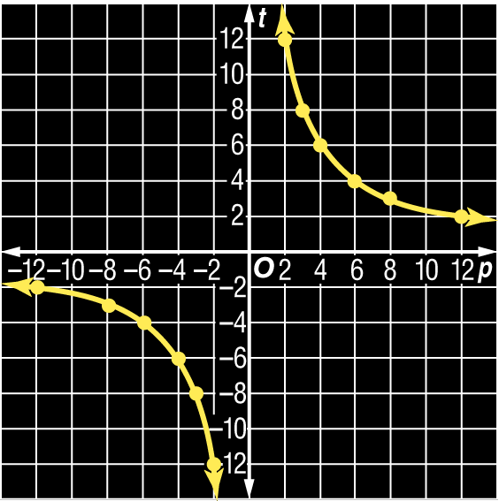
Example 1-2c
Graph an inverse variation in which y varies inversely as x and
Answer:

Slide 12
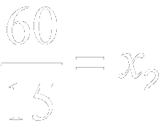
Example 1-3a
If y varies inversely as x and find x when
Method 1 Use the product rule.
Product rule for inverse variations
Divide each side by 15.
Simplify.

Slide 13
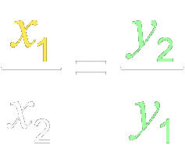
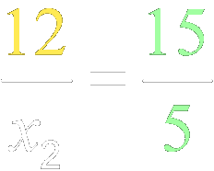
Example 1-3b
Method 2 Use a proportion.
Proportion rule for inverse variations
Cross multiply.
Divide each side by 15.
Answer: Both methods show that

Slide 14
Example 1-3c
If y varies inversely as x and find x when
Answer: 8

Slide 15
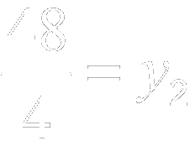
Example 1-4a
If y varies inversely as x and find y when
Use the product rule.
Product rule for inverse variations
Divide each side by 4.
Simplify.
Answer:

Slide 16
Example 1-4b
If y varies inversely as x and find y when
Answer: –25

Slide 17
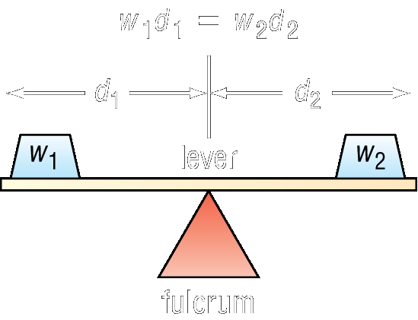
Example 1-5a
Physical Science When two objects are balanced on a lever, their distances from the fulcrum are inversely proportional to their weights. How far should a 2-kilogram weight be from the fulcrum if a 6-kilogram weight is 3.2 meters from the fulcrum?

Slide 18
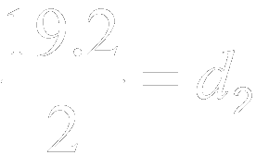
Example 1-5b
Original equation
Divide each side by 2.
Simplify.
Answer: The 2-kilogram weight should be 9.6 meters from the fulcrum.

Slide 19
Example 1-5c
Physical Science How far should a 10-kilogram weight be from the fulcrum if a 4 kilogram weight is 2.5 meters from the fulcrum?
Answer: 1 m

Slide 20
Homework
12-1 Inverse Variations
2 Pages, Even Problems

