Slide 1
Elimination using Addition and Subtraction

Slide 2
Review
Solving method for systems of equations when one variable is substituted in for another variable Substitution Method
When the substitution method can be used When a single variable can be solved, that is it has a coefficient of one

Slide 3
Review
Two equations relating to the same variables System of Equations
System of Equations with parallel lines No Solution
System of Equations that are the same line Infinite Solutions
System of Equations that cross at one point That point is the solution to the system

Slide 4
Review
Solved equations that result in a true statement with the variables eliminated Infinite Solutions / All Real Numbers
Solved equations that result in a false statement with the variables eliminated No Solution

Slide 5
Substitution Review

Slide 6
Substitution Review

Slide 7
Elimination Method
Sometimes by adding two equations together to create a third equation, one of the variables will be eliminated
A problem like this would be very difficult to solve with the substitution method

Slide 8
Elimination Method
We can create a new equation by adding both of the original equations together

Slide 9
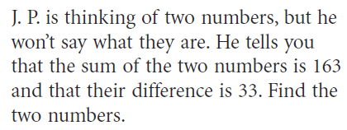
Elimination Method - Example

Slide 10
Elimination Method - Example

Slide 11
Elimination Method - Example

Slide 12
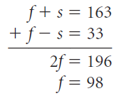
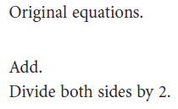
Elimination Method - Example

Slide 13
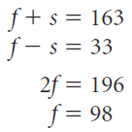
Elimination Method - Example

Slide 14
Elimination Method - Example

Slide 15
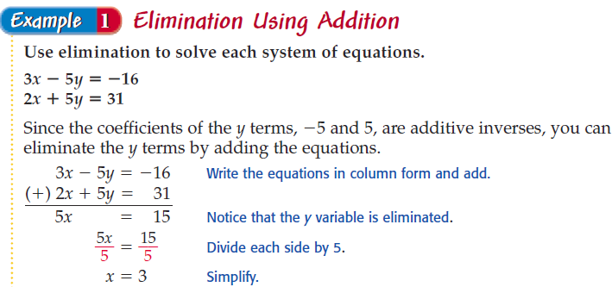
Elimination Method - Example

Slide 16
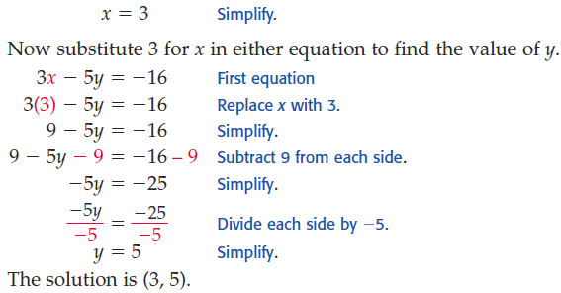
Elimination Method - Example

Slide 17
Elimination Method - Practice

Slide 18
Elimination Method - Practice

Slide 19
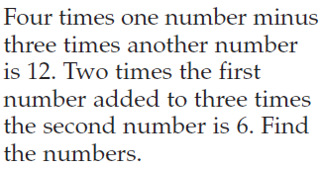
Elimination Method - Practice

Slide 21
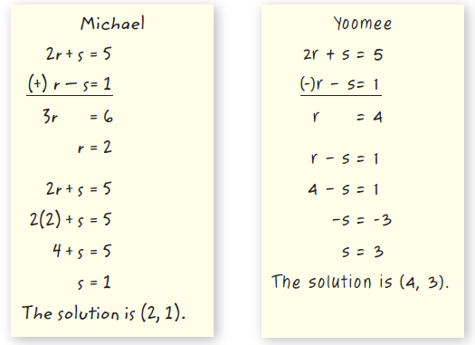
Elimination Method
Michael is correct,
Yoomee subtracted one variable but not the second
Lesson Learned – It is better to negate all terms then add than to subtract

Slide 22
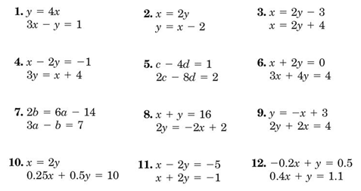
Homework Quiz

Slide 23
Elimination - Practice
Deion Sanders earned $ 6.2 Million
Troy Aikman earned $ 6.667 Million

Slide 24
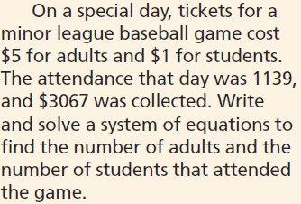
Elimination - Practice

Slide 25
Summary
In a system of equations, when the same variable in different equations has the same value for a coefficient, how is it solved? Elimination Method
If two equations have variables with the same value and different signs, how is elimination completed? Reverse the signs on one of the equations then add both equations

Slide 26
Review
Solving method for systems of equations when one variable is substituted in for another variable Substitution Method
When the substitution method can be used When a single variable can be solved, that is it has a coefficient of one

Slide 27
Review
Two equations relating to the same variables System of Equations
System of Equations with parallel lines No Solution
System of Equations that are the same line Infinite Solutions
System of Equations that cross at one point That point is the solution to the system

Slide 28
Review
Solved equations that result in a true statement with the variables eliminated Infinite Solutions / All Real Numbers
Solved equations that result in a false statement with the variables eliminated No Solution

Slide 29
Homework
7-3 Elimination using Addition and Subtraction
Work on separate paper, showing work
Even Problems

