Slide 1
Writing Equations Solving Addition and Subtraction problems

Slide 2
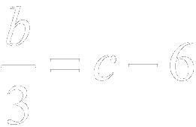
Example 1-1a
Translate this sentence into an equation.
A number b divided by three is equal to six less than c.
b divided by three is equal to six less than c.
Answer: The equation is .

Slide 3
Example 1-1b
Translate this sentence into an equation.
Fifteen more than z times six is y times two minus eleven.
Fifteen more than z times six is y times two minus eleven.
15
z
6
y
2
11
Answer: The equation is .

Slide 4
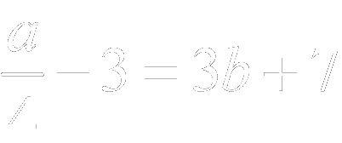
Example 1-1c
Translate each sentence into an equation.
a. A number c multiplied by six is equal to two more than d.
Answer: The equation is .
b. Three less than a number a divided by four is seven more than 3 times b.
Answer: The equation is .

Slide 5
Example 1-2a
Jellybeans A popular jellybean manufacturer produces 1,250,000 jellybeans per hour. How many hours does it take them to produce 10,000,000 jellybeans?
Explore You know that 1,250,000 jellybeans are produced each hour. You want to know how many hours it will take to produce 10,000,000 jellybeans.

Slide 6
Example 1-2b
Plan Write an equation to represent the situation. Let h represent the number of hours needed to produce the jellybeans.
1,250,000 times hours equals 10,000,000.
1,2500,000
h
10,000,000
Solve
Find h mentally by asking, “What number times 125 equals 1000?”
h = 8
Answer: It will take 8 hours to produce 10,000,000 jellybeans.

Slide 7
Examine If 1,250,000 jellybeans are produced in one hour, then 1,250,000 x 8 or 10,000,000 jellybeans are produced in 8 hours. The answer makes sense.

Slide 8
Example 1-2d
A person at the KeyTronic World Invitational
Type-Off typed 148 words per minute. How
many minutes would it take to type 3552
words?
Answer: It would take 24 minutes.

Slide 9
Example 1-3a
Translate the sentence into a formula.
The perimeter of a square equals four times the length of the side.
Words Perimeter equals four times the length of the side.
Variables Let P = perimeter and s = length of a side.
Perimeter equals four times the length of a side.
P
4s
Answer: The formula is .

Slide 10
Example 1-3b
Translate the sentence into a formula.
The area of a circle equals the product of π and the square of the radius r.
Answer: The formula is .

Slide 11
Example 1-4a
Translate this equation into a verbal sentence.
12 2x 5
Twelve minus two times X equals negative five.
Answer: Twelve minus two times x equals negative five.

Slide 12
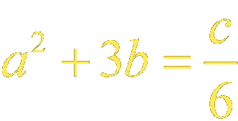
Example 1-4b
Translate this equation into a verbal sentence.
a² 3b
a squared plus three times b equals c divided by six.
Answer: a squared plus three times b equals c divided by six.

Slide 13
Example 1-4c
Translate each equation into a verbal sentence.
1.
Answer: Twelve divided by b minus four equals negative one.
2.
Answer: Five times a equals b squared plus one.

Slide 14
Example 1-5a
Write a problem based on the given information.
f = cost of fries
f + 1.50 = cost of a burger
4( f + 1.50) – f = 8.25
Answer: The cost of a burger is $1.50 more than the cost of fries. Four times the cost of a burger minus the cost of fries equals $8.25. How much do fries cost?

Slide 15
Example 1-5b
Write a problem based on the given information.
h = Tiana’s height in inches
h – 3 = Consuelo’s height in inches
3h(h – 3) = 8262
Answer: Consuelo is 3 inches shorter than Tiana. The product of Consuelo’s height and three times Tiana’s is 8262. How tall is Tiana?

Slide 16
Group Work – Complete steps 1-6

Slide 17
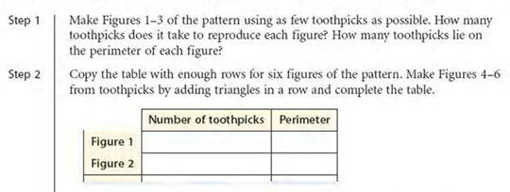
Group Work – Complete steps 1-6

Slide 18
Group Work – Complete steps 1-6

Slide 19
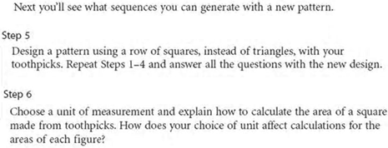
Group Work – Complete steps 1-6

Slide 20
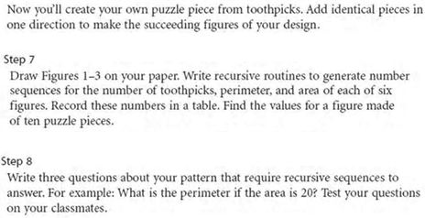
Group Work

Slide 21
Solving Equations
With Additions and Subtraction

Slide 22
Properties
Addition Property of Equality
If a = b, then a + c = b + c
If an equation is true, and the same number is added to each side, the resulting equation is true
Subtraction Property of Equality
If a = b, then a – c = b – c
If an equation is true and the same number is subtracted from each side, the resulting equation is true.

Slide 23
Example 2-1a
Solve . Then check your solution.
Original equation
Add 12 to each side.
Answer:
and
To check that –15 is the solution, substitute –15 for h in the original equation.

Slide 24
Example 2-1b
Solve . Then check your solution.
Answer: 40
Check:

Slide 25
Example 2-2a
Solve . Then check your solution.
Original equation
Add –63 to each side.
Answer:
and
To check that 29 is the solution, substitute 29 for k in the original equation.

Slide 26
Example 2-2b
Solve . Then check your solution.
Answer: –61
Check:

Slide 27
Example 2-3a
Solve . Then check your solution.
Original equation
Subtract 102 from each side.
Answer:
and
To check that –66 is the solution, substitute –66 for c in the original equation.

Slide 28
Example 2-3b
Solve . Then check your solution.
Answer: –171
Check:

Slide 29
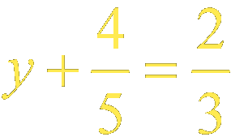
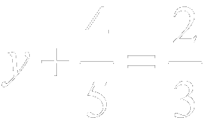
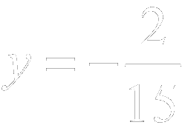
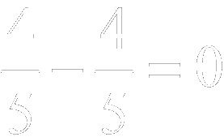
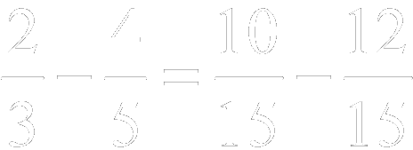
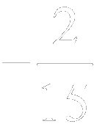
Example 2-4a
Solve in two ways.
Method 1 Use the Subtraction Property of Equality.
Original equation
Subtract from each side.
Answer:
and
or

Slide 30
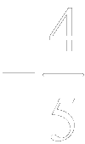
Example 2-4b
Method 2 Use the Addition Property of Equality.
Original equation
Add to each side.
Answer:
and
or

Slide 31
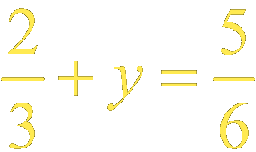
Example 2-4c
Solve .
Answer:

Slide 32
Example 2-5a
Write an equation for the problem. Then solve the equation and check your solution.
Fourteen more than a number is equal to twenty-seven. Find this number.
Fourteen more than a number is equal to twenty-seven.
14
n
27
Original equation
Subtract 14 from each side.

Slide 33
Example 2-5b
Answer:
and
To check that 13 is the solution, substitute 13 for n in the original equation. The solution is 13.

Slide 34
Example 2-5c
Twelve less than a number is equal to negative twenty-five. Find the number.
Answer: –13

Slide 35
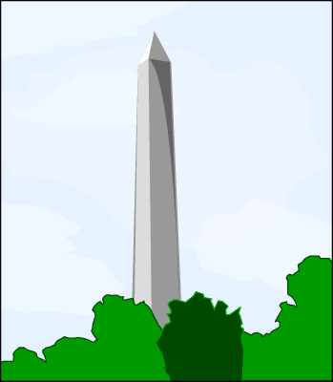
Example 2-6a
History The Washington Monument in Washington, D.C., was built in two phases. From 1848–1854, the monument was built to a height of 152 feet. From 1854 until 1878, no work was done. Then from 1878 to 1888, the additional construction resulted in its final height of 555 feet. How much of the monument was added during the second construction phase?

Slide 36
Example 2-6b
Words The first height plus the additional height equals 555 feet.
Variables Let a = the additional height.
The first height plus the additional height equals 555.
152
a
555
Original equation
Subtract 152 from each side.
and
Answer: There were 403 feet added to the Washington Monument from 1878 to 1888.

Slide 37
Example 2-6c
The Sears Tower was built in 1974. The height to the Sky Deck is 1353 feet. The actual recorded height is 1450 feet. In 1982, they added twin antenna towers, which does not count for the record, for a total structure height of 1707 feet. How tall are the twin antenna towers?
Answer: 257 feet

Slide 38
Write this in your planner Homework
Workbooks
3-1 all
3-2 all
Four pages total

