Slide 1
Test Review

Slide 2
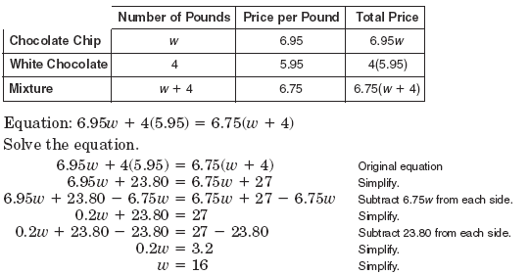
Test Review

Slide 3
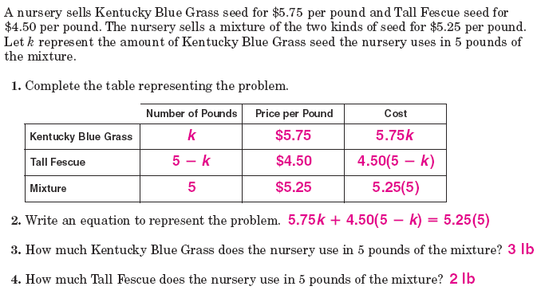
Test Review

Slide 4
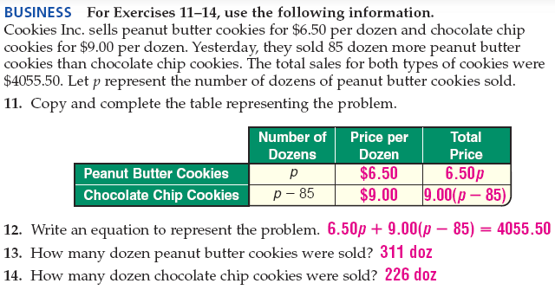
Test Review

Slide 5
Test Review

Slide 6
Test Review

Slide 7
Test Review

Slide 8
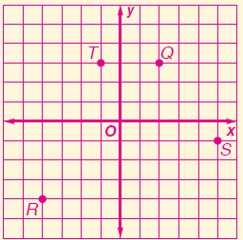
Test Review

Slide 9
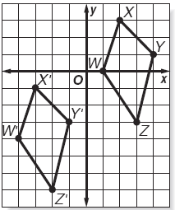
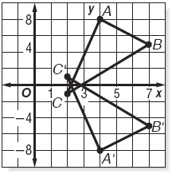
Test Review

Slide 10
Test Review

Slide 11
Test Review

Slide 12
Test Review

Slide 13
Test Review

Slide 14
Test Review

Slide 15
Test Review

Slide 16
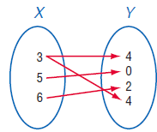
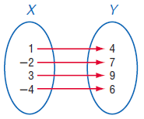
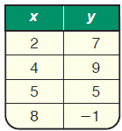
Test Review

Slide 17
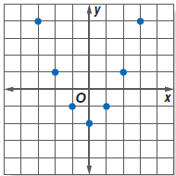
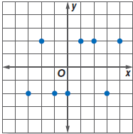
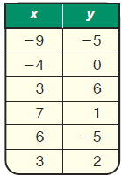
Test Review

Slide 18
Test Review

Slide 19
Test Review

Slide 20
Test Review

Slide 21
Test Review

Slide 22
Test Review

Slide 23
Test Review

Slide 24
Test Review

Slide 25
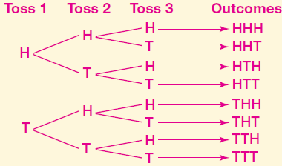
Test Review

Slide 26
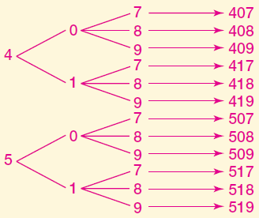
Test Review

Slide 27
Test Review

Slide 28
Test Review

Slide 29
Test Review

Slide 30
Test Review

Slide 31
Test Review

