Slide 1
Adding and Subtracting Rational Numbers

Slide 2
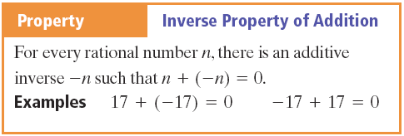
Properties

Slide 3
Vocabulary
Additive Inverse – The opposite of a number

Slide 4
Addition - Example

Slide 5
Addition - Practice

Slide 6
Additional Rules

Slide 7
Addition - Example

Slide 8
Addition - Practice

Slide 9
Addition in Equations - Example

Slide 10
Addition in Equations - Practice

Slide 11
Addition in Equations - Example

Slide 12
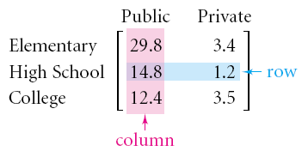
Vocabulary
Matrix – A rectangular arrangement of numbers in columns and rows
Element – Each item in a matrix

Slide 13
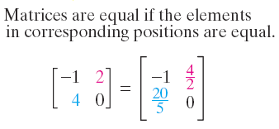
Matrices

Slide 14
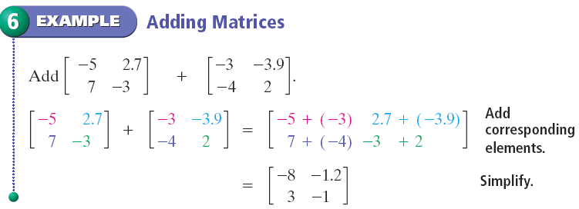
Addition - Matrices

Slide 15
Addition – Matrices - Practice

Slide 16
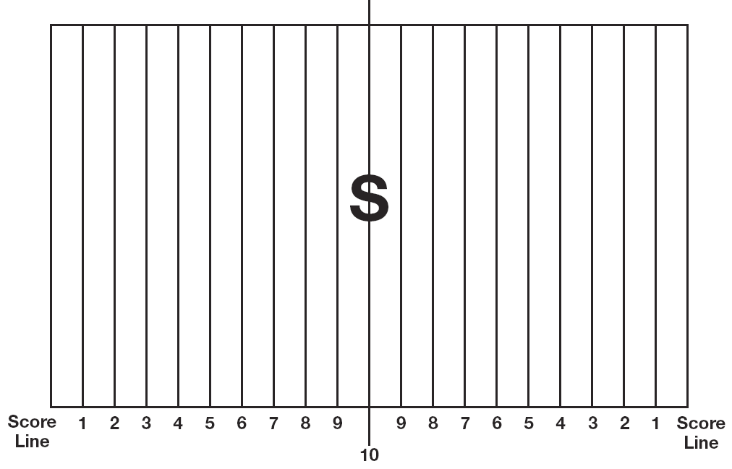
Subtraction – Group Work
Integer football - In your handout – Get Dice

Slide 17
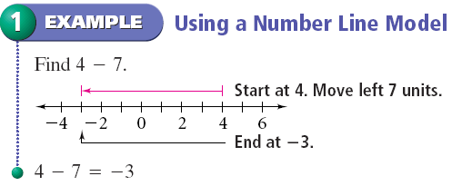
Subtraction - Example

Slide 18
Subtraction - Practice

Slide 19
Subtraction – with tiles

Slide 20
Subtraction - Rule

Slide 21
Subtraction - Example

Slide 22
Subtraction - Practice

Slide 23
Subtraction – Absolute Value

Slide 24
Subtraction – Absolute Value

Slide 25
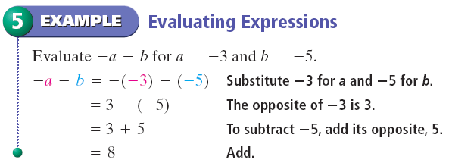
Subtraction - Example

Slide 26
Subtraction - Practice

Slide 27
Homework
Handout – Not in workbook
Practice 2-1
Practice 2-2
Even Problems

