Slide 1
Point Slope Formula

Slide 3
Point Slope Formula

Slide 4
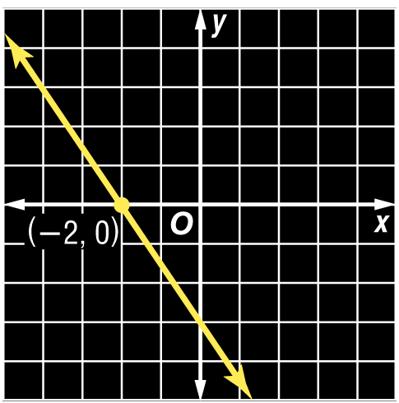
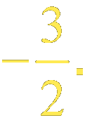
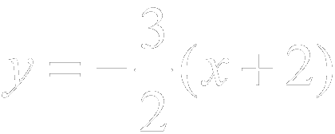
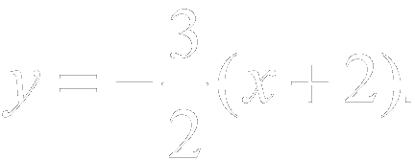
Example 5-1a
Write the point-slope form of an equation for a line that passes through (–2, 0) with slope
Point-slope form
Simplify.
Answer: The equation is

Slide 5
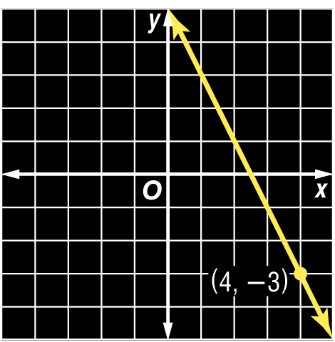
Example 5-1b
Write the point-slope form of an equation for a line that passes through (4, –3) with slope –2.
Answer:

Slide 6
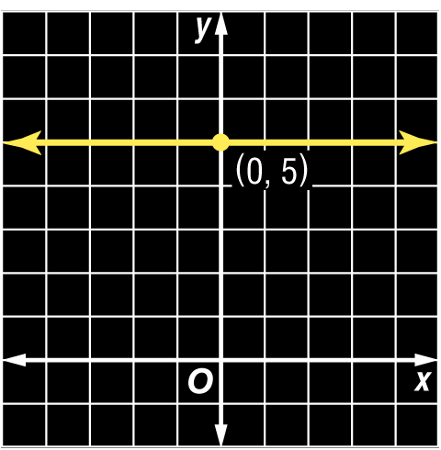
Example 5-2a
Write the point-slope form of an equation for a horizontal line that passes through (0, 5).
Point-slope form
Simplify.
Answer: The equation is

Slide 7
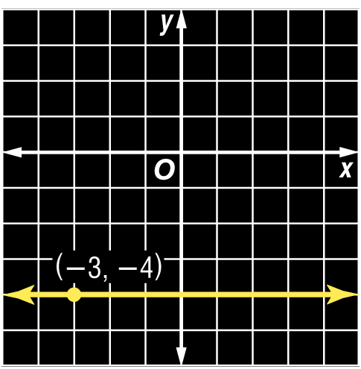
Example 5-2b
Write the point-slope form of an equation for a horizontal line that passes through (–3, –4).
Answer:

Slide 8
Linear Equation Forms

Slide 9
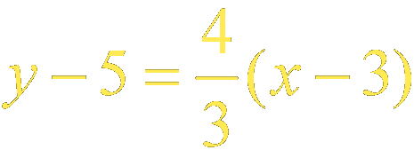
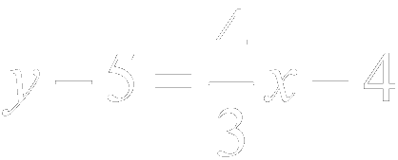
Example 5-4a
Write in slope-intercept form.
In slope-intercept form, y is on the left side of the equation. The constant and x are on the right side.
Original equation
Distributive Property
Add 5 to each side.

Slide 10
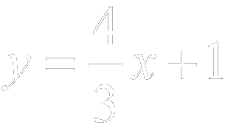
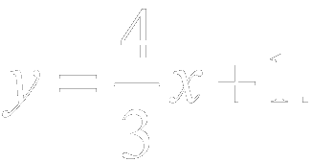
Example 5-4b
Simplify.
Answer: The slope-intercept form of the equation is

Slide 11
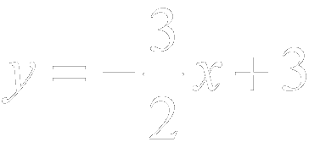
Example 5-4c
Write in slope-intercept form.
Answer:

Slide 12
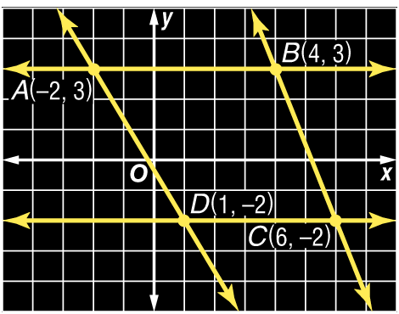
Example 5-5a
The figure shows trapezoid ABCD with bases and
Write the point-slope form of the lines containing the bases of the trapezoid.

Slide 13
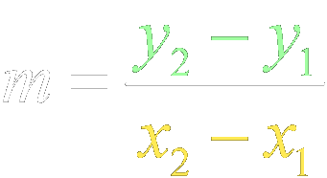
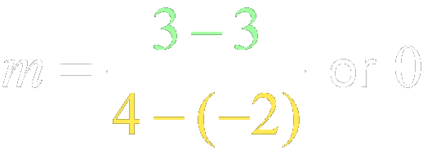
Example 5-5b
Step 1 First find the slopes of and
Slope formula
Slope formula

Slide 14
Example 5-5c
Step 2 You can use either point for (x₁, y₁) in the point-slope form.
Method 1 Use (–2, 3).
Method 2 Use (4, 3).

Slide 15
Example 5-5d
Method 1 Use (1, –2).
Method 2 Use (6, –2).
Answer: The point-slope form of the equation containing The point-slope form of the equation containing

Slide 16
Example 5-5e
Write each equation in standard form.
Original equation
Add 3 to each side.
Answer:
Simplify.
Original equation
Subtract 2 from each side.
Answer:
Simplify.

Slide 17
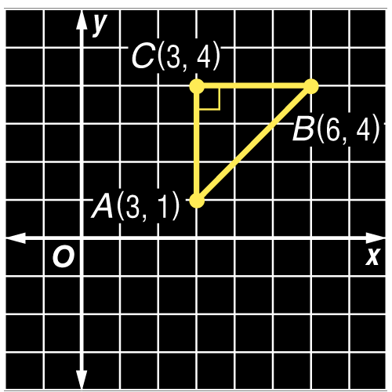
Example 5-5f
The figure shows right triangle ABC.
a. Write the point-slope form of the line containing the hypotenuse
b. Write the equation in standard form.
Answer:
Answer:

Slide 18
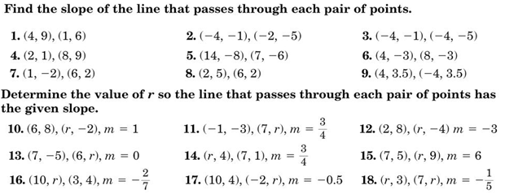
Homework Quiz

Slide 19
Spaghetti Beam Exploration

Slide 20
Exploration
Copy the following chart into your notes
Spaghetti Strands | Pennies

Slide 22
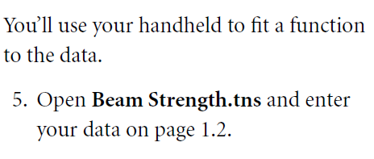
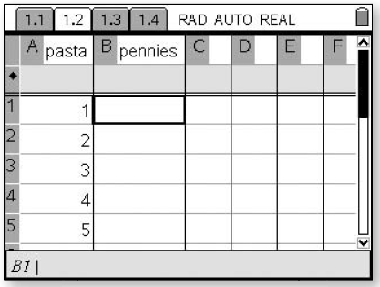
Exploration

Slide 23
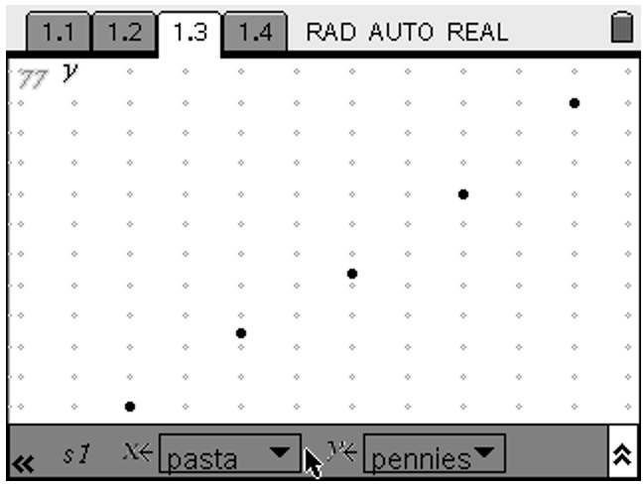
Exploration

Slide 24
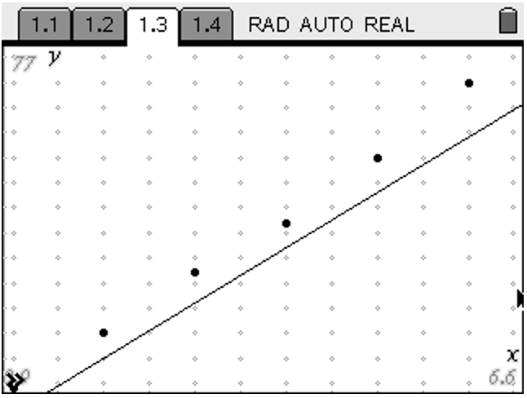
Exploration

Slide 25
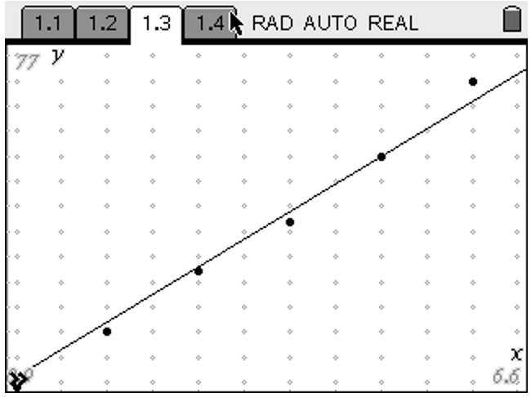
Exploration

Slide 26
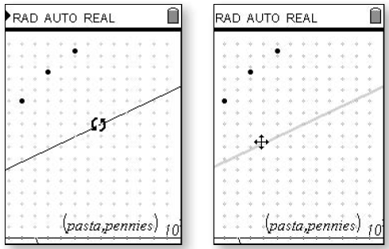
Exploration

Slide 27
Exploration

Slide 28
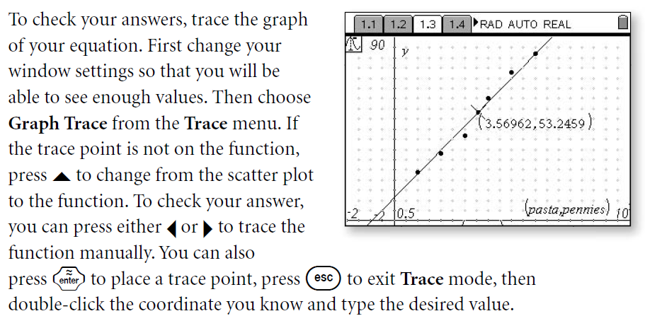
Exploration

Slide 29
Exploration

Slide 30
Homework
5-5 Writing Equations in Point Slope Form
Two Pages
All Problems

