Slide 1
Solving Equations
Variable on Both Sides

Slide 2
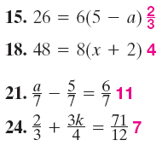
Warm Up Problems

Slide 3
Warm Up Answers

Slide 4
Warm Up Answers

Slide 5
New Material

Slide 6
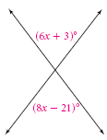
Example

Slide 7
Practice

Slide 8
Example

Slide 9
Practice

Slide 10
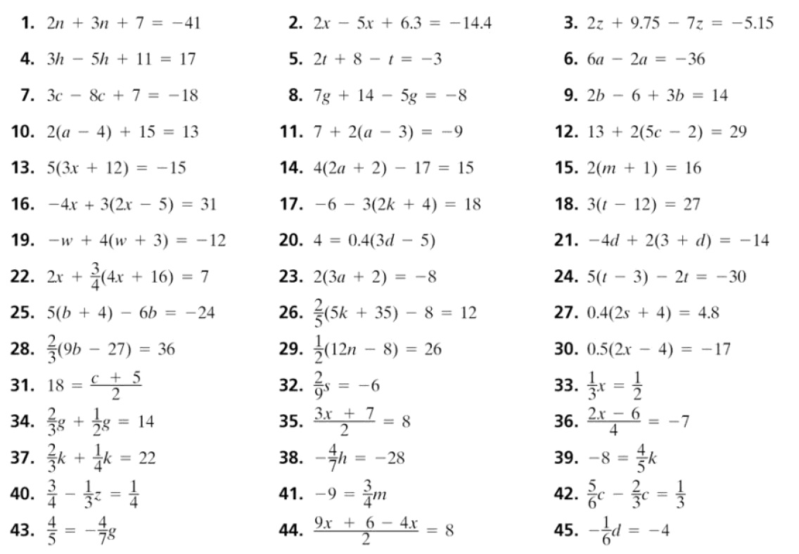
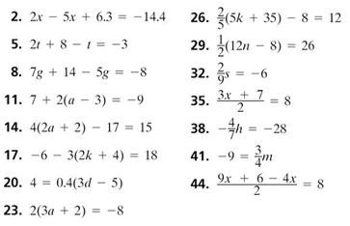
Homework Quiz

Slide 11
Calculator Exploration
6

Slide 12
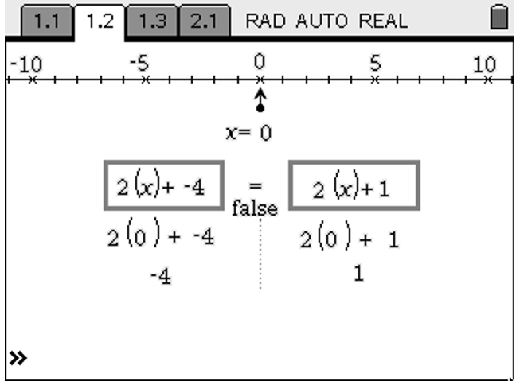
Calculator Exploration
Values in Expressions
False,
The expressions never equal

Slide 13
Calculator Exploration
The right is always five greater

Slide 14
Calculator Exploration
Could you find a solution to the equation
No, the expression on the right will ALWAYS be five more than the expression on the left

Slide 15
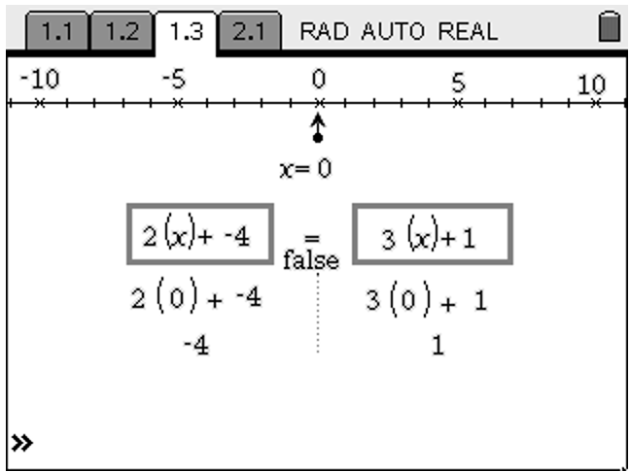
Calculator Exploration

Slide 16
Calculator Exploration
X = 3

Slide 17
Calculator Exploration
X = -1

Slide 18
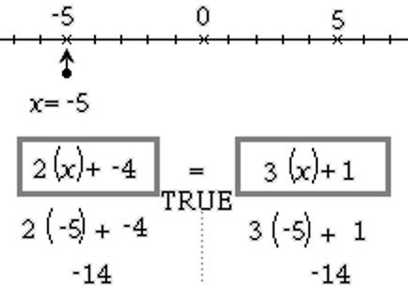
Calculator Exploration
Could you find a solution to the equation
X = -5

Slide 19
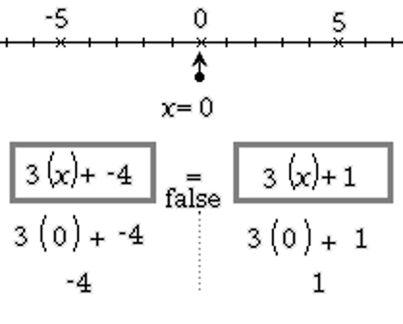
Calculator Exploration

Slide 20
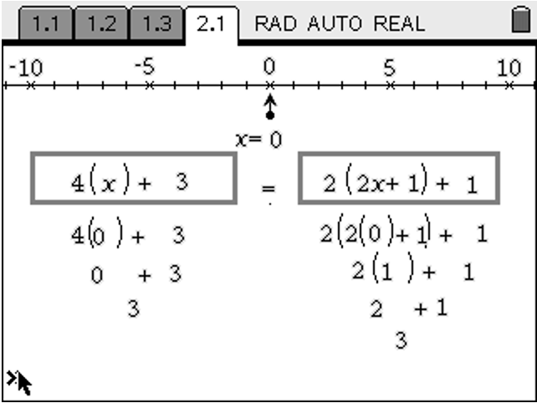
Calculator Exploration

Slide 21
Calculator Exploration
Expressions change, the totals are always the same

Slide 22
Calculator Exploration
Infinite

Slide 23
Calculator Exploration
Simplify the equation on the right with the distributive property and combining like terms
Does this justify the infinite answer?
Yes, both equations are exactly the same

Slide 24
Calculator Exploration - Summary
Describe the characteristics of an equation that would have each of the possible solution sets.
No Solution
One Solution
Infinite Solutions
Variables have same coefficients, but different constants in the equations
Variables have different coefficients
Expressions on each side are identical when simplified

Slide 25
Vocabulary
No solution – When no value for the variable will make the equation true
Identity – When every value for the variable will make the equation true

Slide 26
Example

Slide 27
Example

Slide 28
Practice

Slide 29
Practice

Slide 30
Practice

Slide 31
Practice

Slide 32
Homework – Write in your planner
3-5 in your workbook
Even problems

