Slide 1
Graphing Systems of Inequalities

Slide 2
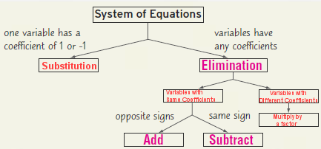
Review - Summary
Variables with same coefficients
Variables with different coefficients
Multiply by a factor

Slide 3
Graphing an inequality
Determine the graph of the line
If it is < or > graph it with a dashed line
If it is ≤ or ≥ it with a solid line
Shade everything on one side of the line
If the sign is >, shade “above” the line
If the sign is <, shade “below” the line

Slide 4
Graphing a system
of inequalities
Graph each inequality separately, then the result is where BOTH are shaded

Slide 5
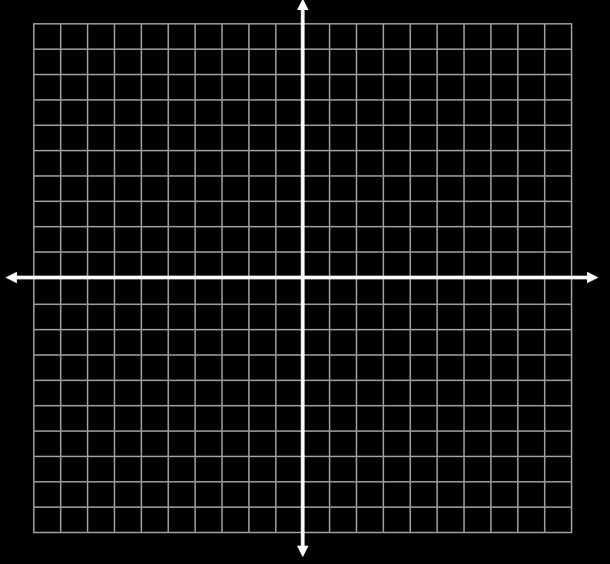
Example
y < -x + 3 y ≤ 2x + 2

Slide 6
Example
y < -x + 3 y ≤ 2x + 2

Slide 7
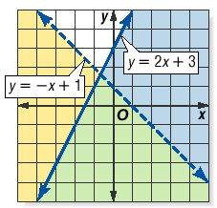
Graphing Inequalities

Slide 8
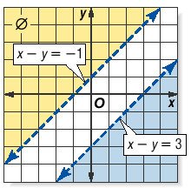
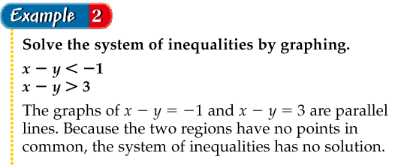
Graphing Inequalities

Slide 9
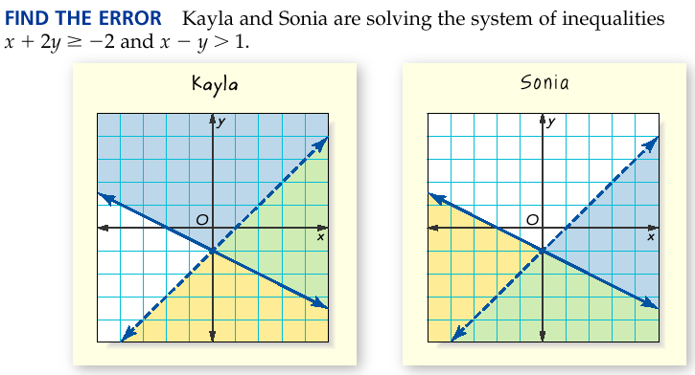
Graphing Inequalities

Slide 10
Graphing Inequalities - Practice
y > x + 2
y ≤ -2x – 1

Slide 11
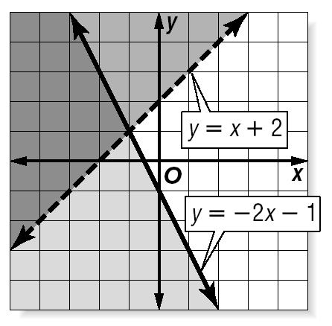

Slide 12
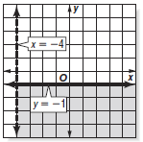
Graphing Inequalities - Practice

Slide 13
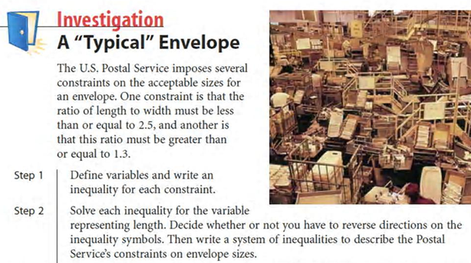
Investigation – Work with a partner

Slide 14
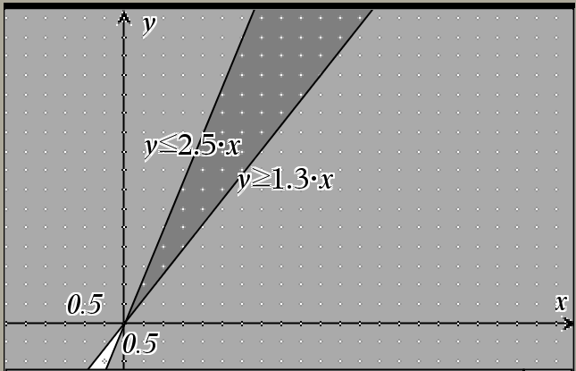
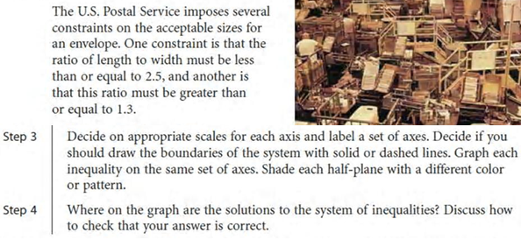
Investigation – Work with a partner

Slide 15
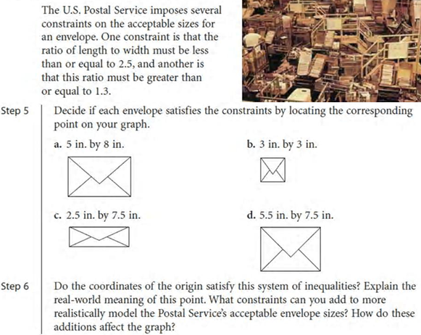
Investigation – Work with a partner
Yes
No
No
No

Slide 17
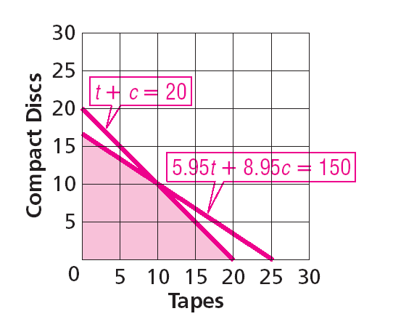

Slide 18
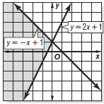
Graphing Inequalities - Practice

Slide 19
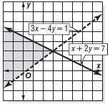
Graphing Inequalities - Practice

Slide 22
Review
How many solutions are there to a system of inequalities
If there is an answer, it includes an infinite region
How do we solve a system of inequalities
Shade each individual equation (after solving for y). Shade above the line for “>” and below the line for “<“. The one area of the graph that was shaded twice is the region of possible answers

Slide 23
Homework
Workbook
7-5 Graphing Systems of Inequalities
All Problems
7-5 Worksheet
Even Problems

