Slide 1
Transformations on the coordinate plane

Slide 2
Vocabulary
Transformations – Movements of geometric figures
Pre-image – The position of the image before the transformation
Image – The position after the transformation

Slide 3
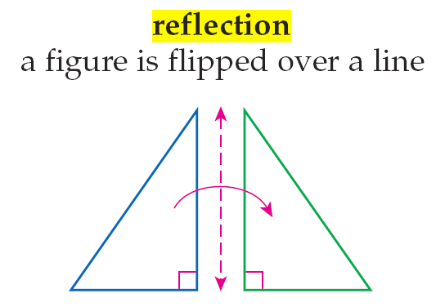
Vocabulary

Slide 4
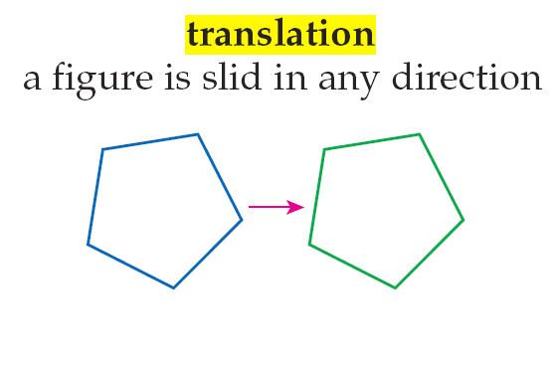
Vocabulary

Slide 5
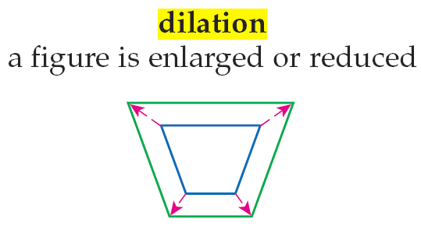
Vocabulary

Slide 6
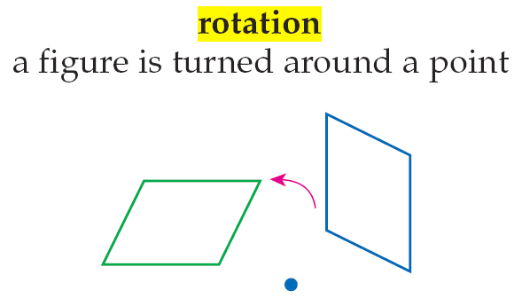
Vocabulary

Slide 7
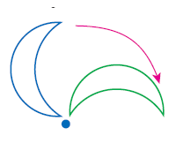
Examples

Slide 8
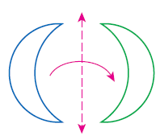
Examples

Slide 9
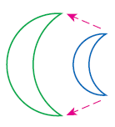
Examples

Slide 10
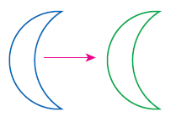
Examples

Slide 11
Transformation in the coordinate plane

Slide 12
Transformation in the coordinate plane

Slide 13
Transformation in the coordinate plane

Slide 14
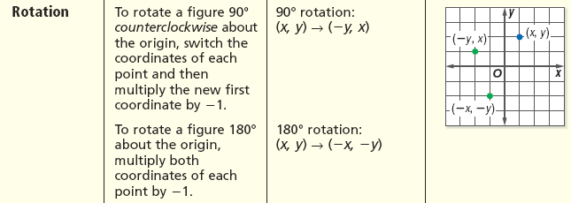
Transformation in the coordinate plane

Slide 15
Example 2-1a
Identify the transformation as a reflection, translation, dilation, or rotation.
Answer: The figure has been increased in size. This is a dilation.

Slide 16
Example 2-1b
Identify the transformation as a reflection, translation, dilation, or rotation.
Answer: The figure has been shifted horizontally to the right. This is a translation.

Slide 17
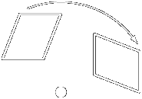
Example 2-1c
Identify the transformation as a reflection, translation, dilation, or rotation.
Answer: The figure has been turned around a point. This is a rotation.

Slide 18
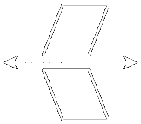
Example 2-1d
Identify the transformation as a reflection, translation, dilation, or rotation.
Answer: The figure has been flipped over a line. This is a reflection.

Slide 19
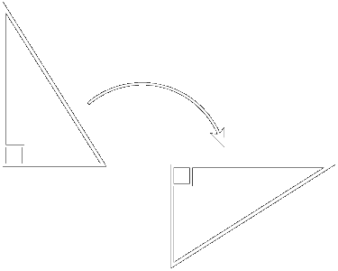
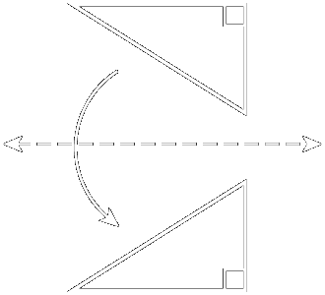
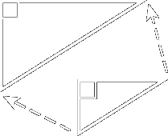
Example 2-1e
Identify each transformation as a reflection, translation, dilation, or rotation.
a.
b.
Answer: rotation
Answer: reflection
d.
c.
Answer: dilation
Answer: translation

Slide 20
Example 2-2a
A trapezoid has vertices W(–1, 4), X(4, 4), Y(4, 1) and Z(–3, 1).
Trapezoid WXYZ is reflected over the y-axis. Find the coordinates of the vertices of the image.
To reflect the figure over the y-axis, multiply each x-coordinate by –1.
(x, y) (–x, y)
Answer: The coordinates of the vertices of the image are W′(1, 4), X′(–4, 4), Y′(–4, 1), and Z′(3, 1).
W(–1, 4) (1, 4)
X(4, 4) (–4, 4)
Y(4, 1) (–4, 1)
Z(–3, 1) (3, 1)

Slide 21
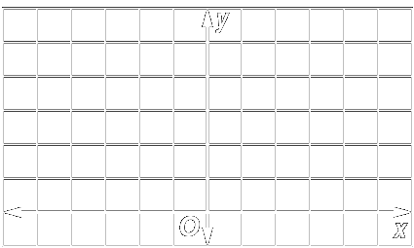
Example 2-2b
A trapezoid has vertices W(–1, 4), X(4, 4), Y(4, 1), and Z(–3, 1).
Graph trapezoid WXYZ and its image W′ X′ Y′ Z′.
Answer:
Graph each vertex of the trapezoid WXYZ. Connect the points.
X′
W
W′
X
Graph each vertex of the reflected image W′ X′ Y′ Z′. Connect the points.
Y′
Z
Z′
Y

Slide 22
Example 2-2c
A parallelogram has vertices A(–4, 7), B(2, 7), C(0, 4) and D(–2, 4).
a. Parallelogram ABCD is reflected over the x-axis. Find the coordinates of the vertices of the image.
Answer: A′(–4, –7), B′(2, –7), C′(0, –4), D′(–2, –4)

Slide 23
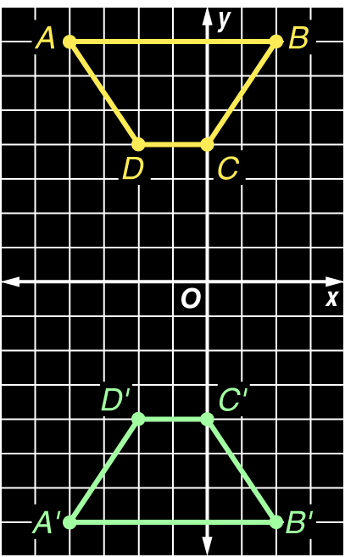
Example 2-2c
b. Graph parallelogram ABCD and its image A′ B′ C′ D′.
Answer:

Slide 24
Example 2-3a
Triangle ABC has vertices A(–2, 1), B(2, 4), and C(1, 1).
Find the coordinates of the vertices of the image if it is translated 3 units to the right and 5 units down.
To translate the triangle 3 units to the right, add 3 to the x-coordinate of each vertex. To translate the triangle 5 units down, add –5 to the y-coordinate of each vertex.
Answer: The coordinates of the vertices of the image are A′(1, –4), B′(5, –1), and C′(4, –4).

Slide 25
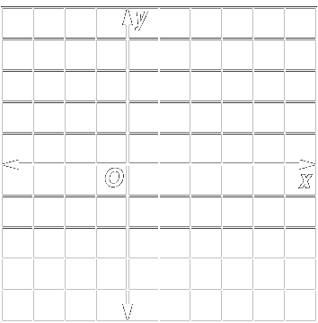
Example 2-3b
Graph triangle ABC and its image.
Answer:
B
The preimage is .
A
The translated image is
C
B′
A′
C′

Slide 26
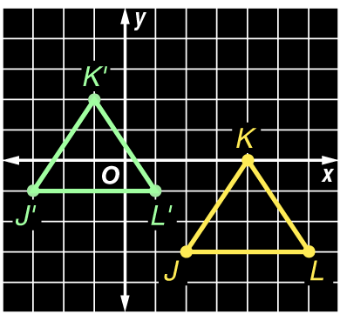
Example 2-3c
Triangle JKL has vertices J(2, –3), K(4, 0), and L(6, –3).
a. Find the coordinates of the vertices of the image if it is translated 5 units to the left and 2 units up.
b. Graph triangle JKL and its image.
Answer: J′(–3, –1), K′(–1, 2), L′(1, –1)
Answer:

Slide 27
Example 2-4a
A trapezoid has vertices E(–1, 2), F(2, 1), G(2, –1), and H(–1, –2).
Find the coordinates of the dilated trapezoid E′ F′ G′ H′ if the scale factor is 2.
To dilate the figure, multiply the coordinates of each vertex by 2.

Slide 28
Example 2-4a
Answer: The coordinates of the vertices of the image are E′(–2, 4), F′(4, 2), G′(4, –2), and H′(–2, –4).

Slide 29
Example 2-4b
Graph the preimage and its image.
Answer:
E′
The preimage is trapezoid EFGH.
E
F′
F
The image is trapezoid E′ F′ G′ H′ .
G
Notice that the image has sides that are twice the length of the sides of the original figure.
G′
H
H′

Slide 30
Example 2-4c
A trapezoid has vertices E(–4, 7), F(2, 7), G(0, 4), and H(–2, 4).
a. Find the coordinates of the dilated trapezoid E′ F′ G′ H′
if the scale factor is
Answer:

Slide 31
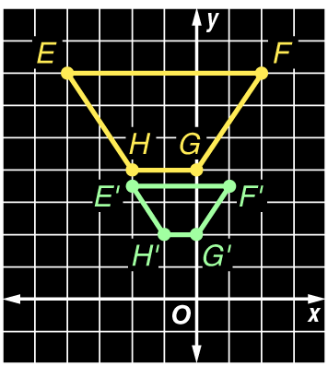
Example 2-4c
b. Graph the preimage and its image.
Answer:

Slide 32
Example 2-5a
Triangle ABC has vertices A(1, –3), B(3, 1), and C(5, –2).
Find the coordinates of the image of ΔABC after it is rotated 180° about the origin.
To find the coordinates of the image of ΔABC after a 180° rotation, multiply both coordinates of each point by –1.
Answer: The coordinates of the vertices of the image are A′(–1, 3), B′(–3, –1), and C′(–5, 2).

Slide 33
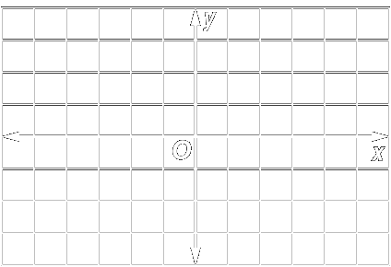
Example 2-5b
Graph the preimage and its image.
Answer:
A′
The preimage is .
C′
B
The translated image is
B′
C
A

Slide 34
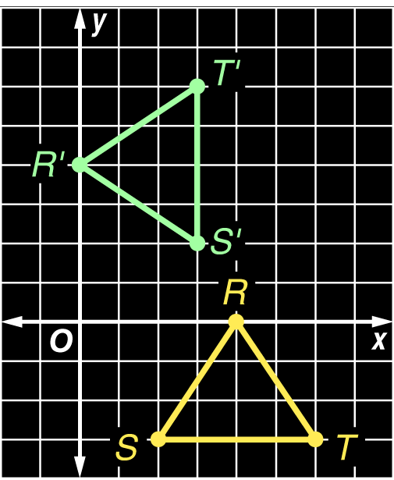
Example 2-5c
Triangle RST has vertices R(4, 0), S(2, –3), and T(6, –3).
a. Find the coordinates of the image of ΔRST after it is rotated 90° counterclockwise about the origin.
b. Graph the preimage and the image.
Answer: R′(0, 4), S′(3, 2), T ′(3, 6)
Answer:

Slide 35
Group Exercise
On a blank piece of paper
Fold it in half (hot dog)
While folded, fold in thirds to end with six boxes on the paper
Number the boxes 1 through 6
In box 2, put your name

Slide 36
Group Exercise
In box number 1, draw a simple line drawing of a cartoon or something simple

Slide 37
Group Exercise
Pass the drawing to a different student
Add your name to box number 2
In box number 3, draw a reflected version of the drawing in box number 1
A reflected drawing does not need to be about the vertical axis

Slide 38
Group Exercise
Pass the drawing to a different student
Add your name to box number 2
In box number 4, draw a dilated version of the drawing in box number 1

Slide 39
Group Exercise
Pass the drawing to a different student
Add your name to box number 2
In box number 5, draw a translated version of the drawing in box number 1
A translated drawing stretches along a given spot in the drawing or graph

Slide 40
Group Exercise
Pass the drawing to a different student
Add your name to box number 2
In box number 6, draw a rotated version of the drawing in box number 1

Slide 41
Group Exercise
Turn in papers

Slide 42
Homework Quiz

Slide 43
Homework
4-2 Transformations
All

