Slide 1
Polynomials Addition and Subtraction of Polynomials

Slide 2
Monomials Review
A monomial is a number, a variable, or a product of a number and one or more variables. An expression involving the division of variables is NOT a monomial. Monomials that are real numbers are called constants.

Slide 3
Polynomial Vocabulary
Binomial – sum or difference of two monomials
Trinomial – sum or difference of three or more monomials
Monomial Degree – Sum of exponents
Polynomial degree – Greatest monomial degree in expression

Slide 4
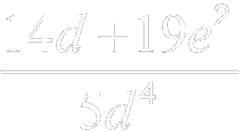
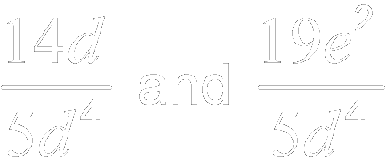
Example 4-1a
State whether each expression is a polynomial. If it is a polynomial, identify it as a monomial, binomial, or trinomial.
Expression
Polynomial?
Monomial, Binomial, or Trinomial
Yes, is the difference of two real numbers.
binomial
a.
Yes, is the sum and difference of three monomials.
trinomial
b.
No. are not monomials.
none of these
c.
d.
Yes, has one term.
monomial

Slide 5
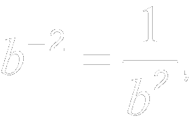
Example 4-1b
State whether each expression is a polynomial. If it is a polynomial, identify it as a monomial, binomial, or trinomial.
Expression
Polynomial?
Monomial, Binomial, or Trinomial
Yes, is the sum of three monomials.
trinomial
a.
No. which is not a monomial.
none of these
b.
Yes, The expression is the sum of two monomials.
binomial
c.
d.
Yes, has one term.
monomial

Slide 6
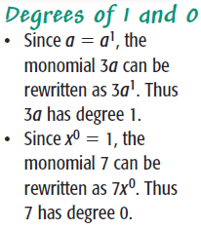
Convention
Polynomials are typically written in descending order of degrees.

Slide 7
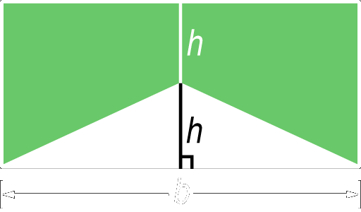
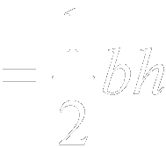
Example 4-2a
Write a polynomial to represent the area of the green shaded region.
Words The area of the shaded region is the area of the rectangle minus the area of the triangle.
Variables area of the shaded region height of rectangle area of rectangle triangle area

Slide 8
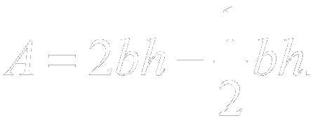
Example 4-2b
Equation
A
A
Answer: The polynomial representing the area of the shaded region is

Slide 9
Example 4-2c
Write a polynomial to represent the area of the green shaded region.
Answer:

Slide 10
Example 4-3a
Find the degree of each polynomial.
Polynomial
Terms
Degree of Each Term
Degree of Polynomial
a.
0, 1, 2, 3
3
b.
2, 1, 0
2
c.
8
8

Slide 11
Example 4-3b
Find the degree of each polynomial.
Polynomial
Terms
Degree of Each Term
Degree of Polynomial
a.
2, 1, 3, 0
3
b.
2, 4, 3
4
c.
7, 6
7

Slide 12
Example 4-4a
Arrange the terms of so that the powers of x are in ascending order.
Answer:

Slide 13
Example 4-4b
Arrange the terms of so that the powers of x are in ascending order.
Answer:

Slide 14
Example

Slide 15
Example 4-4c
Arrange the terms of each polynomial so that the powers of x are in ascending order.
a.
b.
Answer:
Answer:

Slide 16
Example 4-5a
Arrange the terms of so that the powers of x are in descending order.
Answer:

Slide 17
Example 4-5b
Arrange the terms of so that the powers of x are in descending order.
Answer:

Slide 18
Example

Slide 19
Example 4-5c
Arrange the terms of each polynomial so that the powers of x are in descending order.
a.
b.
Answer:
Answer:

Slide 20
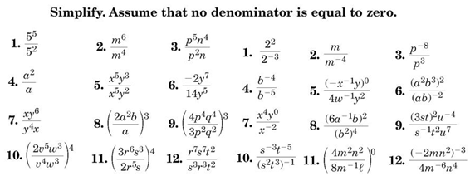
Homework Quiz

Slide 21
Scientific Notation
Investigation

Slide 22
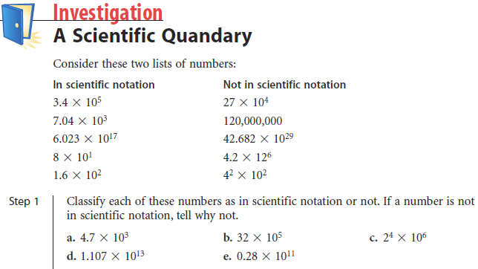
YES
NO
NO
YES
NO

Slide 23
Representation of a number as the product of a number between 1 and 10 and a power of 10

Slide 24
Using our calculators, add an “EE” and 1 to any number, and it will be displayed in scientific notation

Slide 25
Make a table of your answers

Slide 26
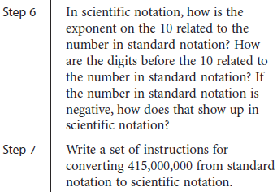

Slide 27
Addition and Subtraction of Polynomials

Slide 28
Adding Like Terms - Review
3x + 4 – 2x +x -6 = 6
3x + 4 – 2x +x -6 = 6
2x = 8
X = 4

Slide 29
Adding Like Terms - Polynomials
All variables must have the same exponent.

Slide 30
Which of the following are like terms?
x² 3x
3 2x
¼ x 180x
-xy² +x²y
13y -y
⅞ -529
No, different exponents
No, different exponents
Yes
No, different exponents
Yes
Yes

Slide 31
Example 5-1a
Find
Method 1 Horizontal
Group like terms together.
Associative and Commutative Properties
Add like terms.

Slide 32
Example 5-1b
Method 2 Vertical
Align the like terms in columns and add.
Notice that terms are in descending order with like terms aligned.
Answer:

Slide 33
Example 5-1c
Find
Answer:

Slide 34
Example 5-2a
Find
Method 1 Horizontal
Subtract by adding its additive inverse.
The additive inverse of is
Group like terms.
Add like terms.

Slide 35
Example 5-2b
Method 2 Vertical
Align like terms in columns and subtract by adding the additive inverse.
Add the opposite.
Answer: or

Slide 36
Example 5-2c
Find
Answer:

Slide 37
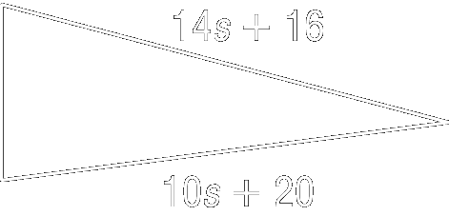
Example 5-3a
Geometry The measure of the perimeter of the triangle shown is
Find the polynomial that represents the third side of the triangle.
Let a = length of side 1, b = the length of side 2, and c = the length of the third side.
You can find a polynomial for the third side by subtracting side a and side b from the polynomial for the perimeter.

Slide 38
Example 5-3b
To subtract, add the additive inverses.

Slide 39
Example 5-3c
Group the like terms.
Add like terms.
Answer: The polynomial for the third side is

Slide 40
Example 5-3d
Find the length of the third side if the triangle if
The length of the third side is
Simplify.
Answer: 45 units

Slide 41
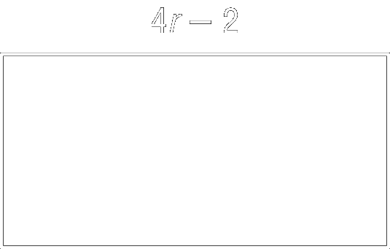
Example 5-3e
Geometry The measure of the perimeter of the rectangle shown is
a. Find a polynomial that represents width of the rectangle.
Answer:
b. Find the width of the rectangle if
Answer: 3 units

Slide 43
Homework
8-4 Polynomials
8-5 Adding and Subtracting Polynomials
Four pages
Even Problems

