Slide 1
Solving Using the Quadratic Formula

Slide 2
Quadratic Formula
Solving quadratics with completing the square is the most accurate method
We follow the same process each time
Where is the shortcut??

Slide 3
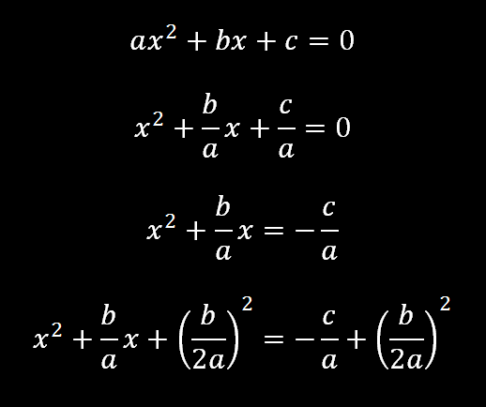
Quadratic Formula - Derivation

Slide 4
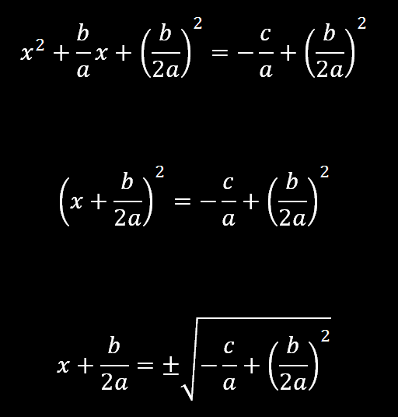
Quadratic Formula - Derivation

Slide 5
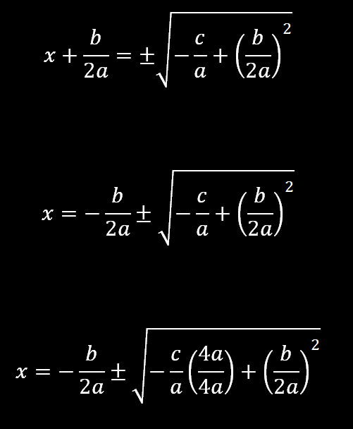
Quadratic Formula - Derivation

Slide 6
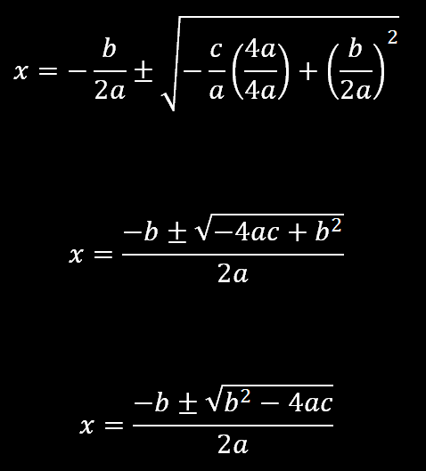
Quadratic Formula - Derivation

Slide 7
Quadratic Formula
And now we sing

Slide 8
Example 4-1a
Use two methods to solve
Method 1 Factoring
Original equation
Factor
or
Zero Product Property
Solve for x.

Slide 9
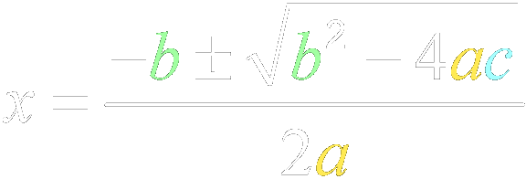
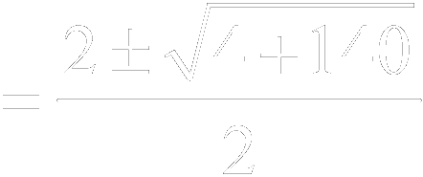
Example 4-1b
Method 2 Quadratic Formula
For this equation,
Quadratic Formula
Multiply.

Slide 10
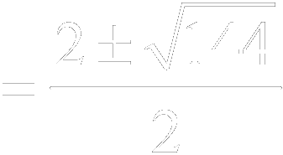
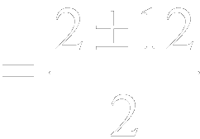
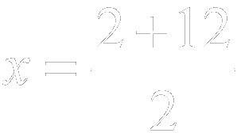
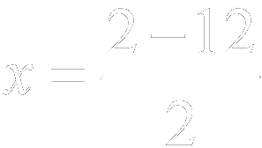
Example 4-1c
Add.
Simplify.
or
Answer: The solution set is {–5, 7}.

Slide 11
Example 4-1d
Solve
Answer: {–6, 5}

Slide 12
Example 4-2a
Solve by using the Quadratic Formula. Round to the nearest tenth if necessary.
Step 1 Rewrite the equation in standard form.
Original equation
Subtract 4 from each side.
Simplify.

Slide 13
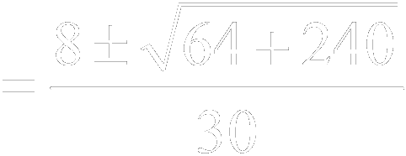
Example 4-2b
Step 2 Apply the Quadratic Formula.
Quadratic Formula
and
Multiply.

Slide 14
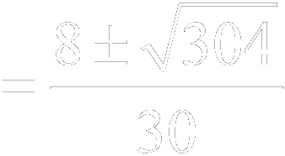
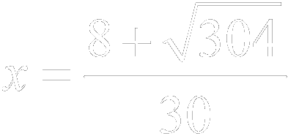
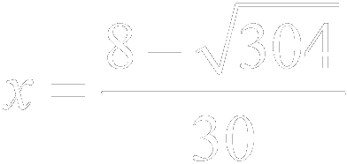
Example 4-2c
Add.
or

Slide 15
Example 4-2e
Solve by using the Quadratic Formula. Round to the nearest tenth if necessary.
Answer: {–0.5, 0.7}

Slide 16
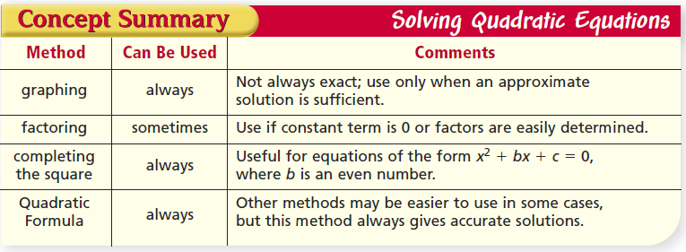
Summary

Slide 17
Vocabulary
Discriminant – The expression under the radical sign in the quadratic formula

Slide 18
Discriminant

Slide 19
Discriminant Examples

Slide 20
Discriminant Examples

Slide 21
Example 4-4a
State the value of the discriminant for . Then determine the number of real roots of the equation.
and
Simplify.
Answer: The discriminant is –220. Since the discriminant is negative, the equation has no real roots.

Slide 22
Example 4-4b
State the value of the discriminant for . Then determine the number of real roots of the equation.
Step 1 Rewrite the equation in standard form.
Original equation
Add 144 to each side.
Simplify.

Slide 23
Example 4-4c
Step 2 Find the discriminant.
and
Simplify.
Answer: The discriminant is 0. Since the discriminant is 0, the equation has one real root.

Slide 24
Example 4-4d
State the value of the discriminant for . Then determine the number of real roots of the equation.
Step 1 Rewrite the equation in standard form.
Original equation
Subtract 12 from each side.
Simplify.

Slide 25
Example 4-4e
Step 2 Find the discriminant.
and
Simplify.
Answer: The discriminant is 244. Since the discriminant is positive, the equation has two real roots.

Slide 26
Example 4-4f
State the value of the discriminant for each equation. Then determine the number of real roots for the equation.
a.
b.
c.
Answer: –4; no real roots
Answer: 0; 1 real root
Answer: 120; 2 real root

Slide 27
Homework
10-4 Solving with Quadratic Formula
Front Page - First Column
Back Page - Evens

