Slide 1
ECA Practice 1

Slide 2
General Information
1 session with calculator, 1 without
27 questions on each session
55 minutes allowed for each session

Slide 3
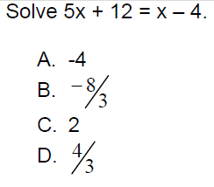
ECA Practice

Slide 4
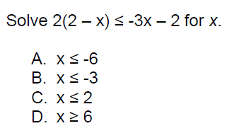
ECA Practice

Slide 5
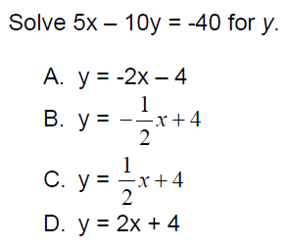
ECA Practice

Slide 6
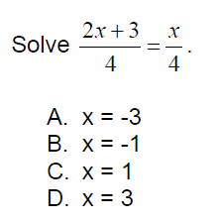
ECA Practice

Slide 7
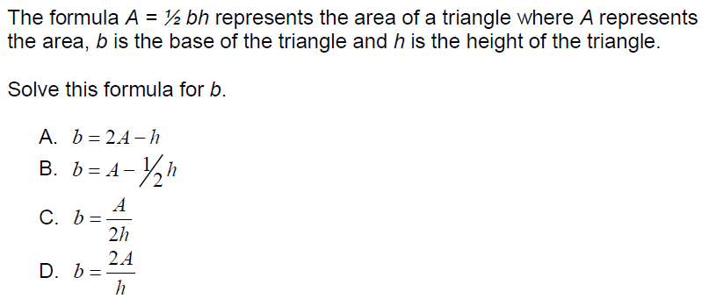
ECA Practice

Slide 8
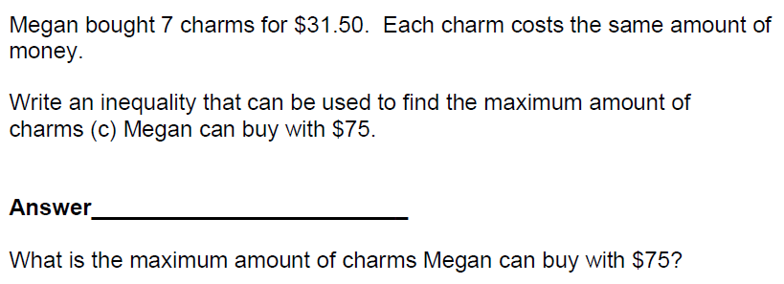
ECA Practice

Slide 9
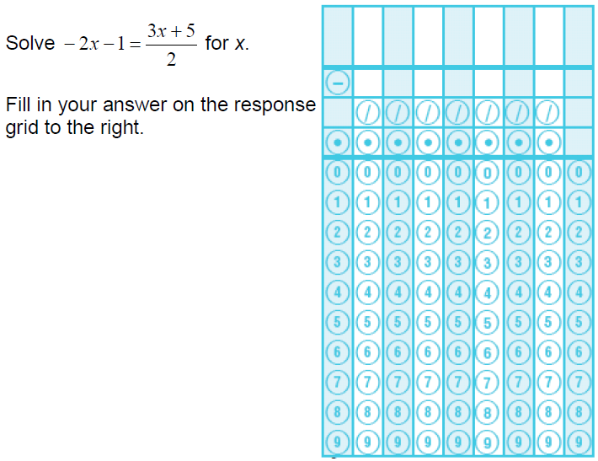
ECA Practice

Slide 10
ECA Practice

Slide 11
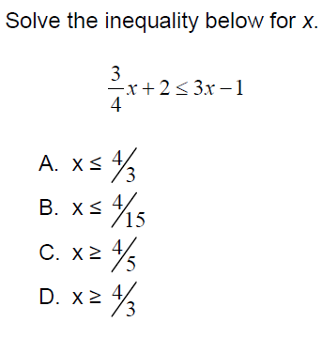
ECA Practice

Slide 12
ECA Practice

Slide 13
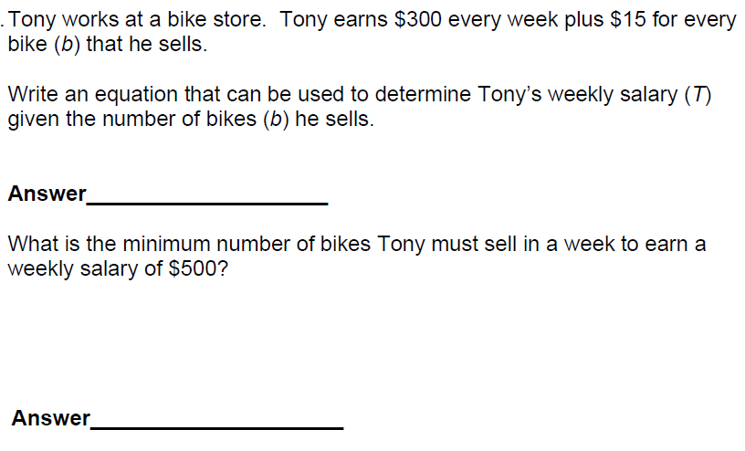
ECA Practice

Slide 14
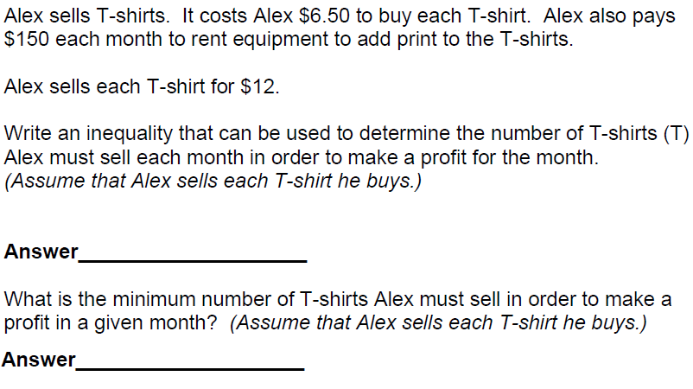
ECA Practice

Slide 15
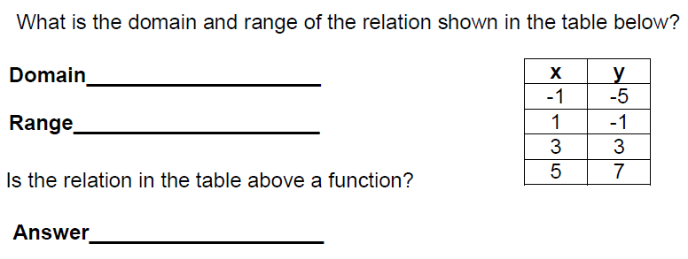
ECA Practice

Slide 16
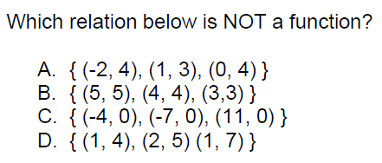
ECA Practice

Slide 17
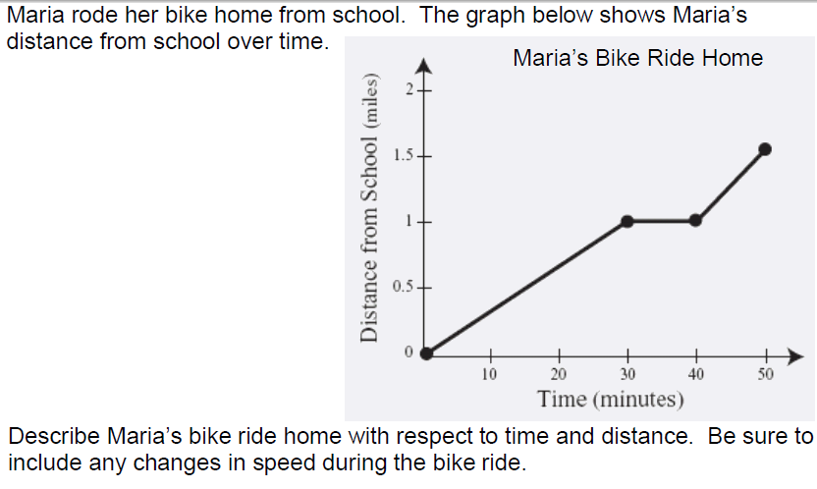
ECA Practice

Slide 18
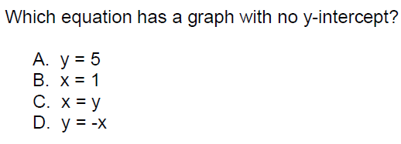
ECA Practice

Slide 19
ECA Practice

Slide 20
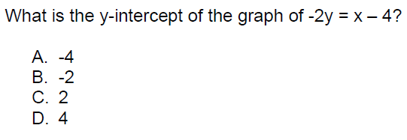
ECA Practice

Slide 21
ECA Practice

Slide 22
ECA Practice

Slide 23
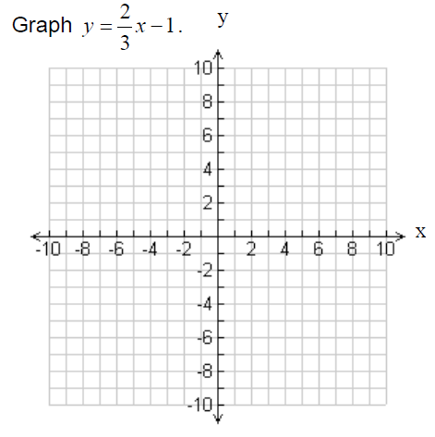
ECA Practice

Slide 24
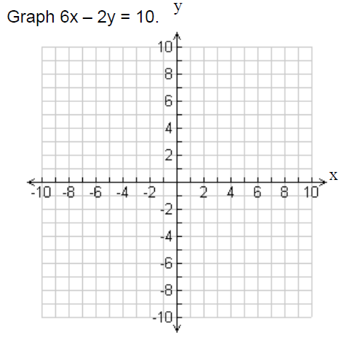
ECA Practice

Slide 25
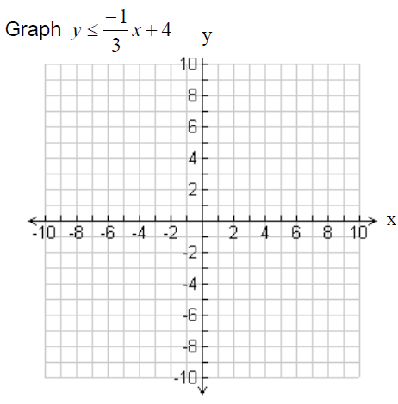
ECA Practice

Slide 26
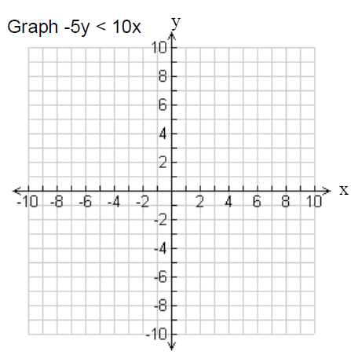
ECA Practice

Slide 27
ECA Practice

Slide 28
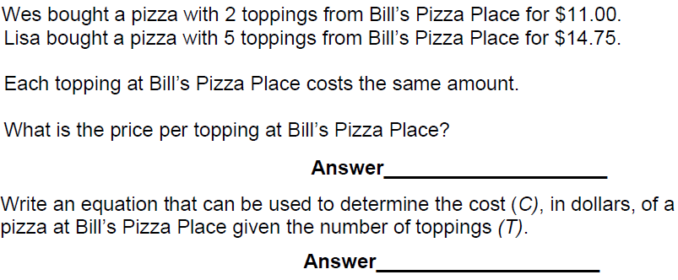
ECA Practice

Slide 29
ECA Practice

Slide 30
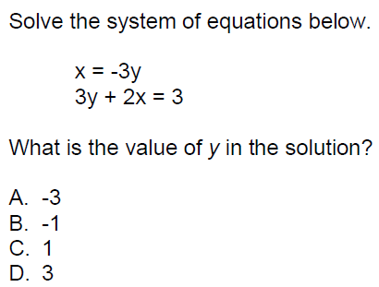
ECA Practice

Slide 31
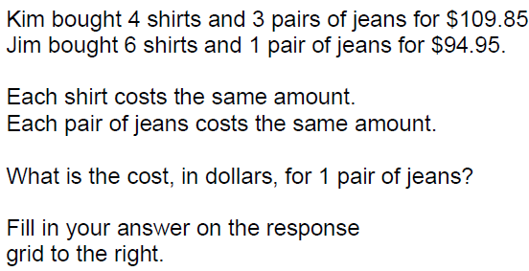
ECA Practice

Slide 32
ECA Practice

Slide 33
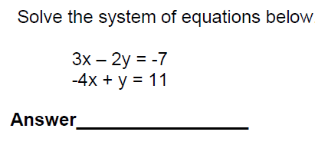
ECA Practice

Slide 34
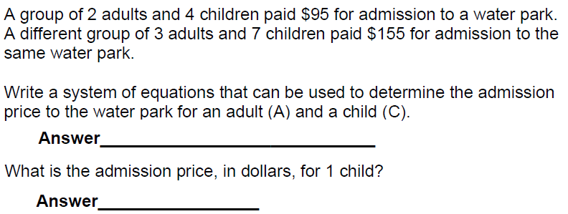
ECA Practice

Slide 35
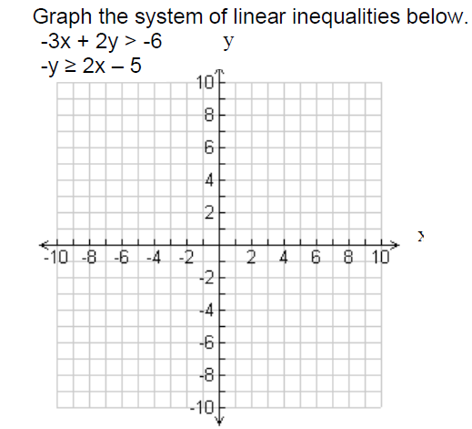
ECA Practice

Slide 36
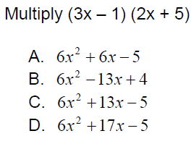
ECA Practice

Slide 37
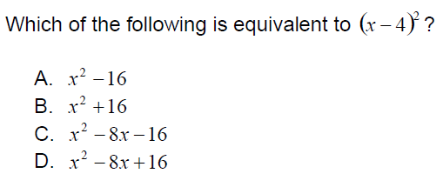
ECA Practice

Slide 38
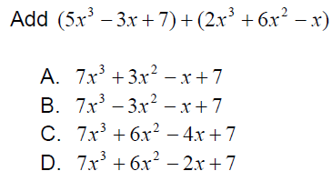
ECA Practice

Slide 39
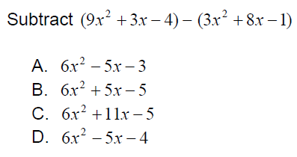
ECA Practice

Slide 40
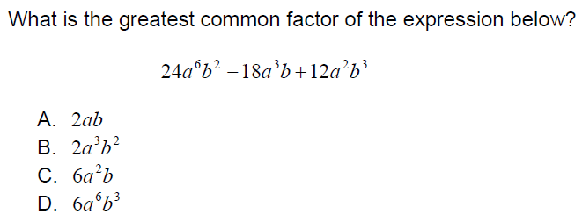
ECA Practice

Slide 41
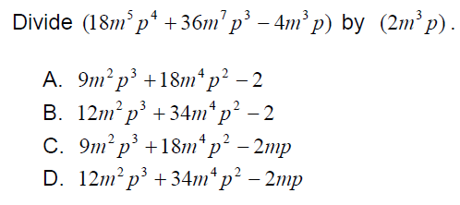
ECA Practice

Slide 42
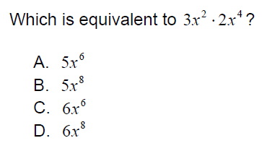
ECA Practice

Slide 43
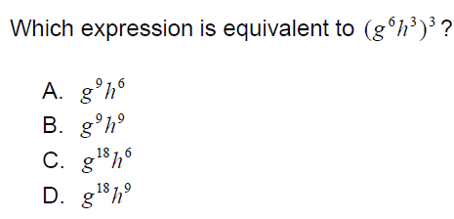
ECA Practice

Slide 44
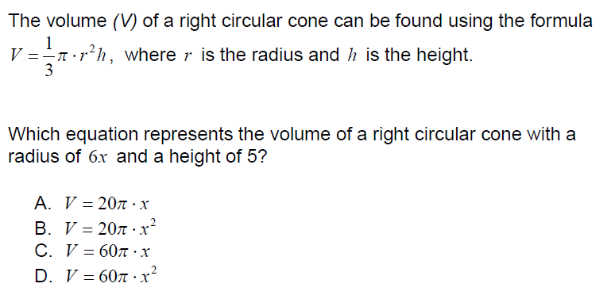
ECA Practice

Slide 45
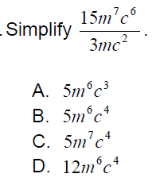
ECA Practice

Slide 46
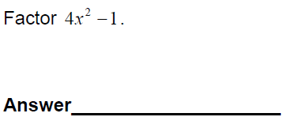
ECA Practice

Slide 47
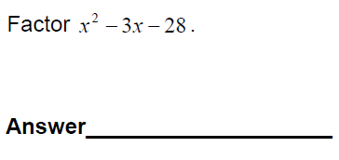
ECA Practice

Slide 48
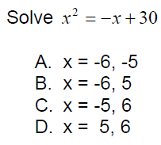
ECA Practice

Slide 49
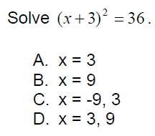
ECA Practice

Slide 50
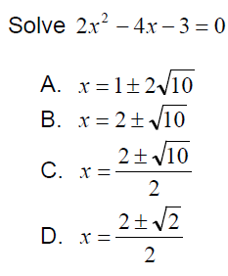
ECA Practice

Slide 51
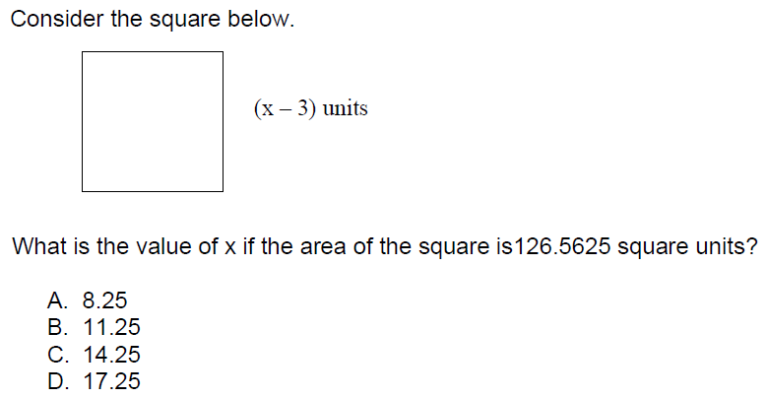
ECA Practice

Slide 52
ECA Practice

Slide 53
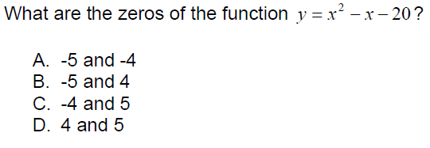
ECA Practice

Slide 54
ECA Practice

Slide 55
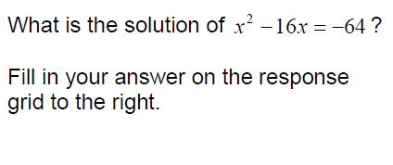
ECA Practice

Slide 56
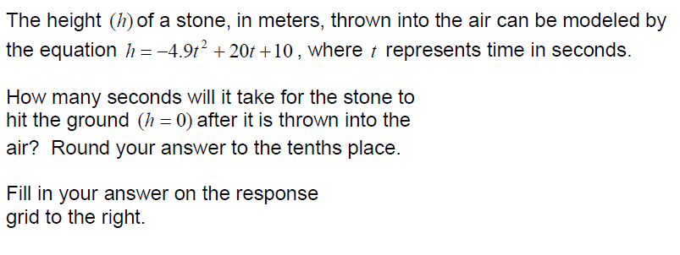
ECA Practice

Slide 57
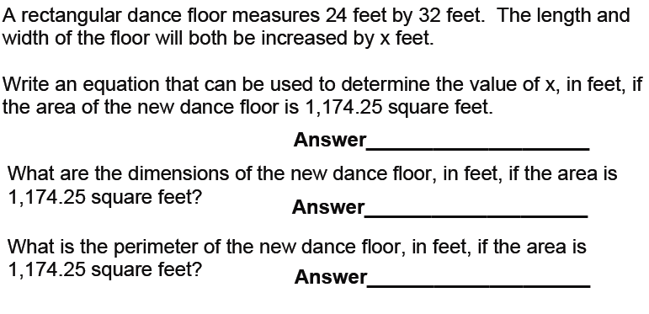
ECA Practice

Slide 58
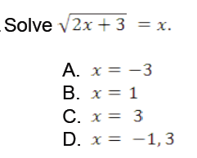
ECA Practice

Slide 59
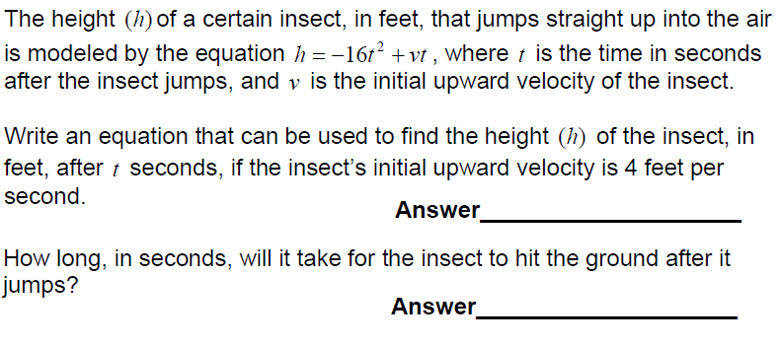
ECA Practice

Slide 60
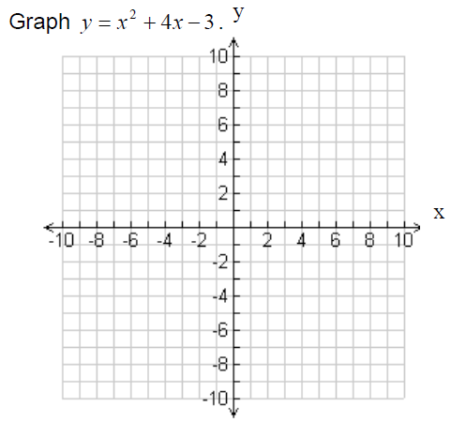
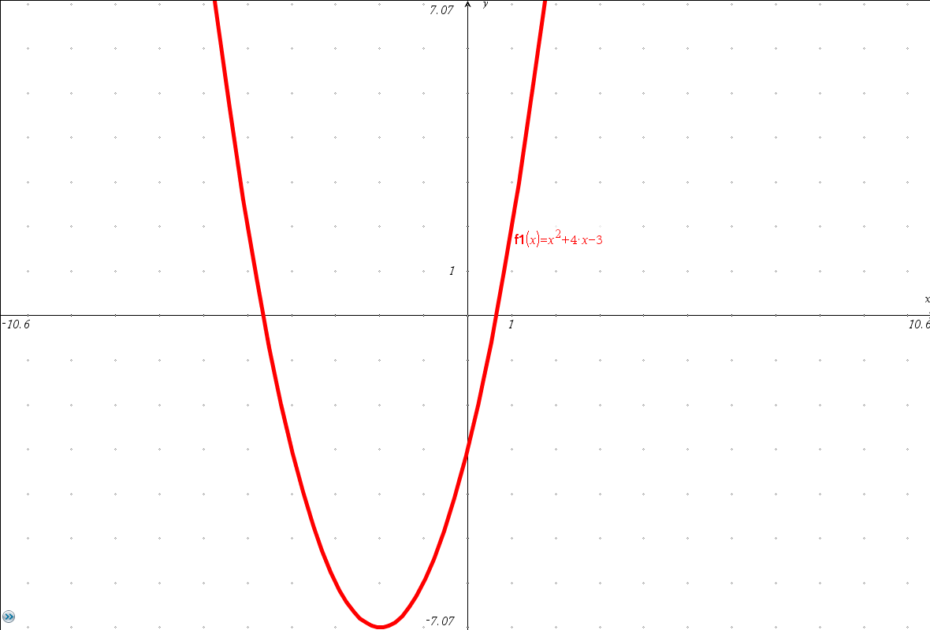
ECA Practice

Slide 61
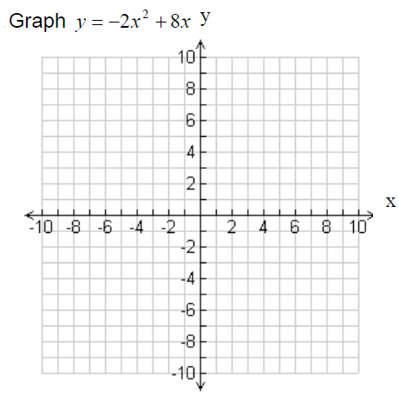
ECA Practice

