Slide 1
Operations with Radical Expressions

Slide 2
Review

Slide 3
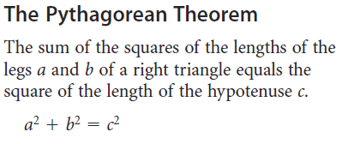
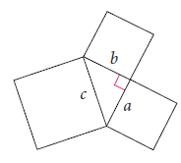
Pythagorean Theorem

Slide 4
Operations with Radicals
Know your perfect squares
1, 4, 9, 16, 25, 36, 49, 64, 81, 100, 121, 144

Slide 5
Operations with Radicals
Find two perfect squares that add up to 13, and draw a right triangle on graph paper

Slide 6
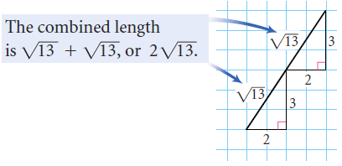
Operations with Radicals

Slide 7
Investigation
Work with a partner
Everyone needs a sheet of graph paper
Write your name on the graph paper

Slide 8
Investigation

Slide 9
Investigation

Slide 10
Investigation

Slide 11
Investigation

Slide 12
Investigation

Slide 13
Investigation

Slide 14
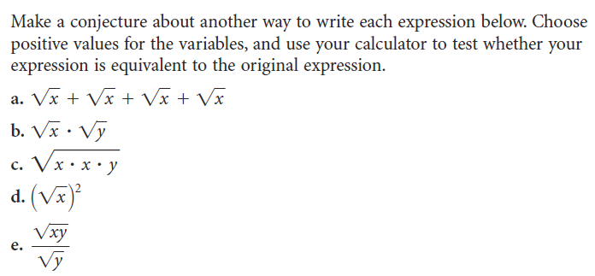
Investigation

Slide 15
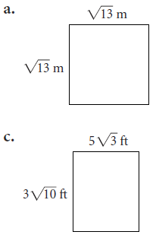
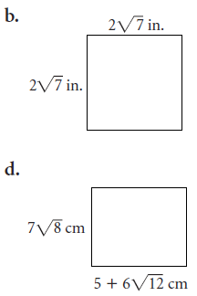
Investigation
28
13

Slide 17
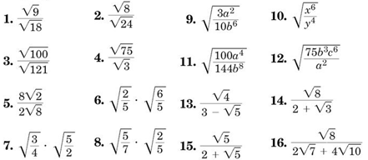
Homework Quiz

Slide 18
Operations with Radicals Example

Slide 19
Example 2-1a
Simplify .
Distributive Property
Answer:
Simplify.

Slide 20
Example 2-1b
Simplify .
Commutative Property
Distributive Property
Answer:
Simplify.

Slide 21
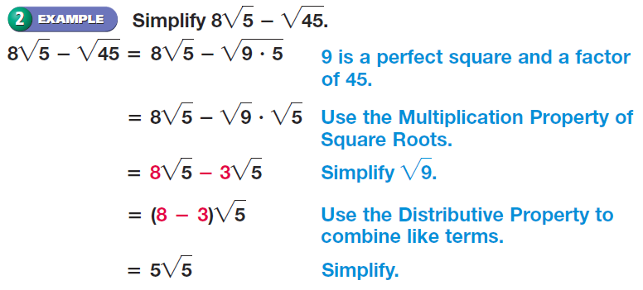
Operations with Radicals Example

Slide 22
Example 2-1c
Simplify
a.
b.
Answer:
Answer:

Slide 23
Example 2-2a
Simplify
Answer: The simplified form is

Slide 24
Example 2-2b
Simplify
Answer:

Slide 25
Operations with Radicals Example

Slide 26
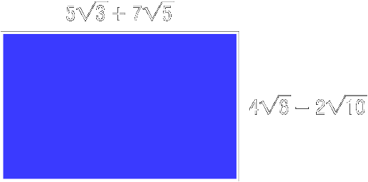
Example 2-3a
Find the area of a rectangle with a width of
and a length of
To find the area of the rectangle multiply the measures of the length and width.

Slide 27
Example 2-3a
First terms
Outer terms
Inner terms
Last terms
Multiply.
Prime factorization
Simplify.
Combine like terms.
Answer: The area of the rectangle is square units.

Slide 28
Example 2-3b
Find the area of a rectangle with a width of
and a length of
Answer:

Slide 29
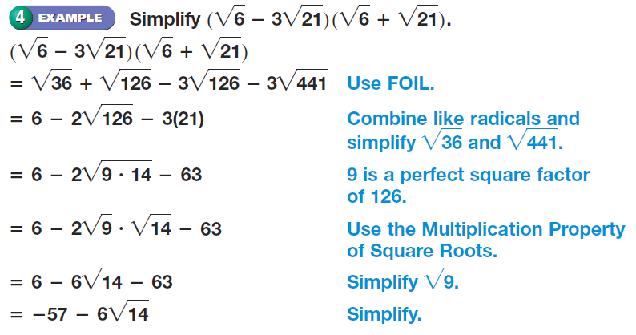
Operations with Radicals Example

Slide 30
Operations with Radicals Practice

Slide 31
Homework
11-2 Operations with Radical Expressions
2 Pages
Evens

