Slide 1
Bar Graphs Dot Plots

Slide 2
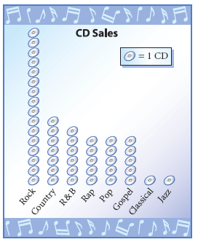
Vocabulary
Dot Plot– A display of data shown above the number line or horizontal axis
Range – The difference between the maximum and the minimum value in a set of data.

Slide 3
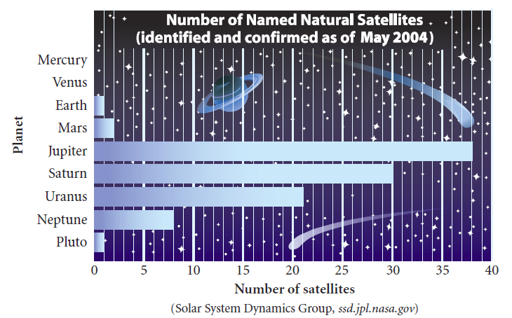
Vocabulary
Bar Graph – A graph that displays the data in bar with quantities grouped into categories.

Slide 4
Dot Plots

Slide 5
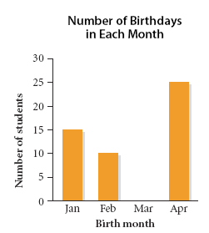
Dot Plots

Slide 6
Dot Plot - Investigation
Everyone take their pulse for 15 seconds
Record the result on the white board

Slide 7
Investigation
Based on our class data
What is the spread of the data?
Minimum
Maximum

Slide 8
Investigation
Construct a number line with the minimum value near the left end. Select a scale and label equal intervals until you reach the maximum.

Slide 9
Investigation
Put a dot above the number line for each data value. When a data value occurs more than once, stack the dots.

Slide 10
Investigation
Can we draw any conclusions from the look of the dot plot?
How could we do this again and get a different dot plot?

Slide 11
Homework Quiz

Slide 12
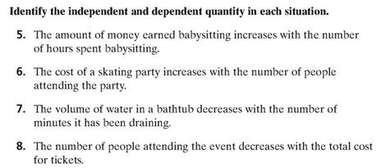
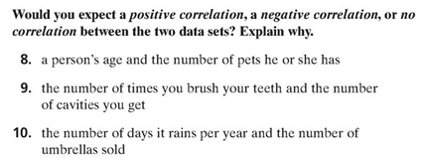

Slide 13
Homework
Lesson 1-1 Bar Graphs and Dot Plots
For problem #3, create a dot plot on a separate paper

