Slide 1
Algebra 2 6-3
Dividing Polynomials

Slide 2
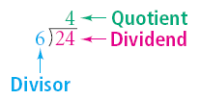
Long Division - Review

Slide 3
Polynomial Division – Example

Slide 4
Polynomial Division – Practice

Slide 5
Polynomial Division
If there is no remainder when dividing polynomials, then the divisor is a factor of the dividend

Slide 6
Polynomial Division – Example

Slide 7
Polynomial Division - Practice

Slide 8
Synthetic Division

Slide 9
Synthetic Division
Synthetic Division – Polynomial long division where all the variables and exponents are omitted, and the divisor sign is reversed, so that all steps are performed as addition

Slide 10
Synthetic Division - Example

Slide 11
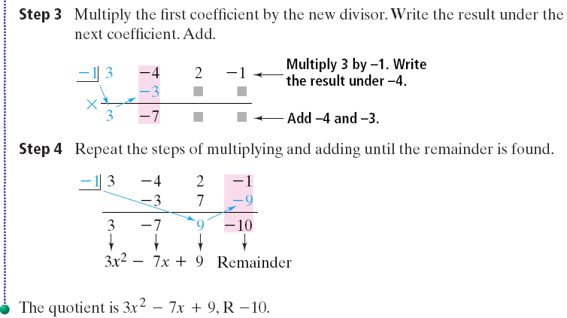
Synthetic Division - Example

Slide 12
Synthetic Division - Practice

Slide 13
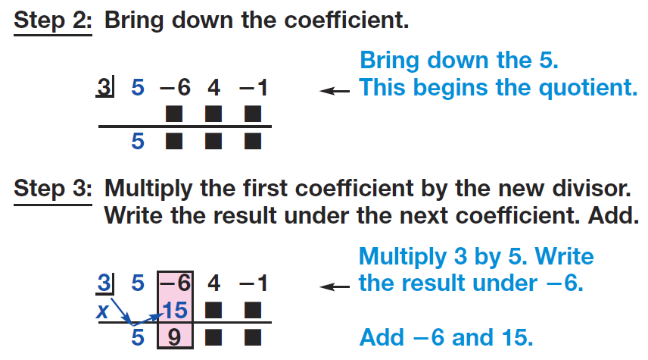
Synthetic Division - Practice

Slide 14
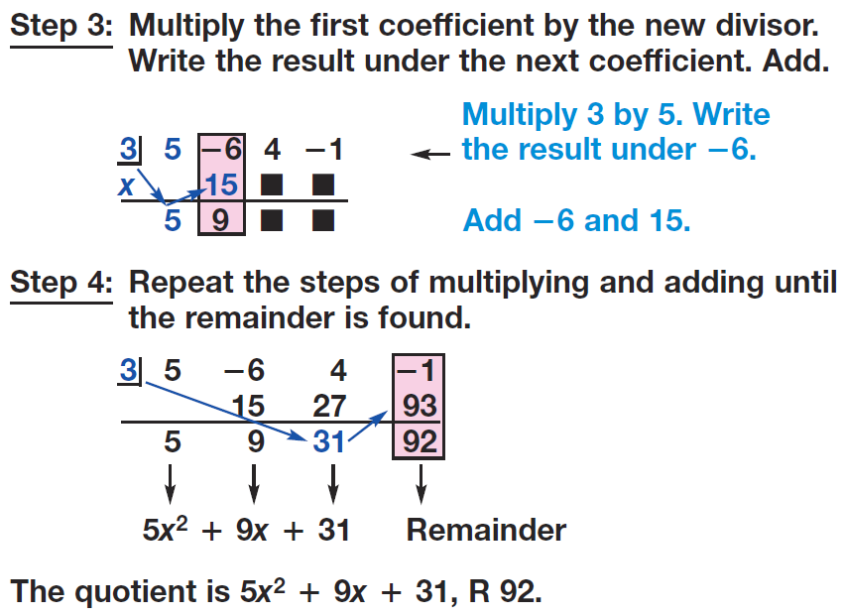
Synthetic Division - Practice

Slide 15
Synthetic Division - Practice

Slide 16
Synthetic Division - Practice

Slide 17
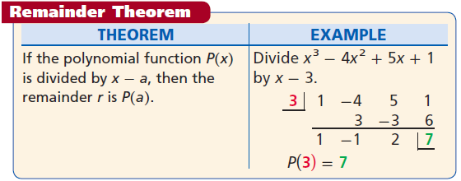
Remainder Theorem

Slide 18
Polynomial Division

Slide 19
Polynomial Division

Slide 20
Polynomial Division

Slide 21
Polynomial Division – Practice

Slide 22
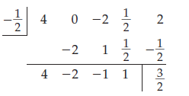
Polynomial Division

Slide 23
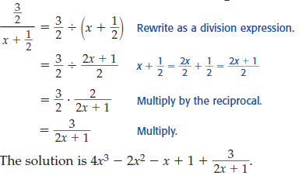
Polynomial Division

Slide 24
Polynomial Division – Practice

Slide 25
Homework
Pages 426 - 428
14-28 even, 32, 40, 46, 66

