Slide 1
Algebra 2 5-2
Graphing Quadratic Functions

Slide 2
Vocabulary
Quadratic Function – A function that can be modeled ax² + bx + c = 0 where a does not equal zero. The domain is all real numbers.

Slide 3
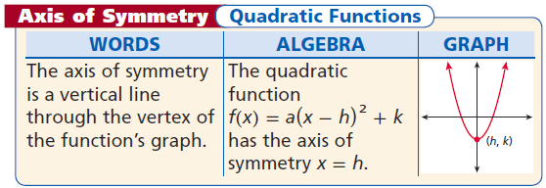
Quadratics

Slide 4
Properties

Slide 5
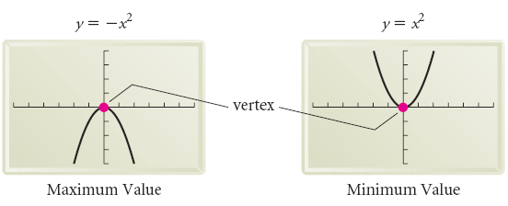
Vocabulary
Parabola – The graph of a quadratic function
Axis of Symmetry – The line that divides the parabola into two mirror images
Vertex of the parabola – The point at which the parabola intersects the axis of symmetry, this is the minimum or maximum of the graph

Slide 6
Vertex

Slide 7
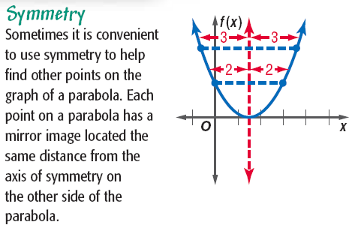
Parabola - Symmetry

Slide 8
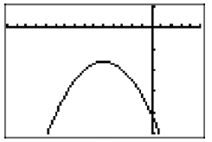
Example

Slide 9
Example

Slide 10
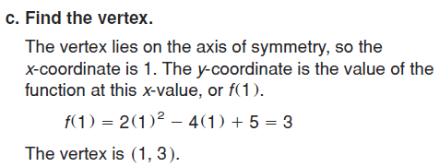
Example

Slide 11
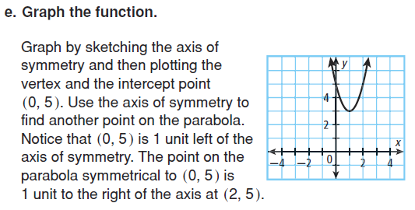
Example

Slide 12
Example

Slide 13
Example

Slide 14
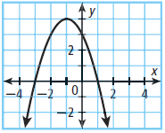
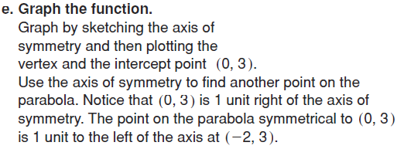
Example

Slide 15
Example

Slide 16
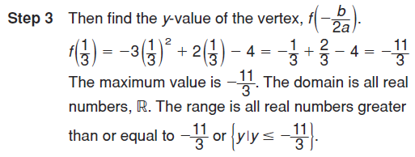
Example

Slide 17
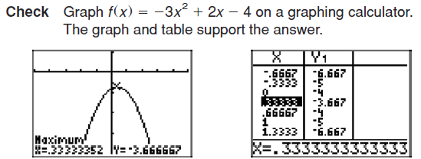
Example

Slide 18
Parabola - Example

Slide 19
Parabola - Example

Slide 20
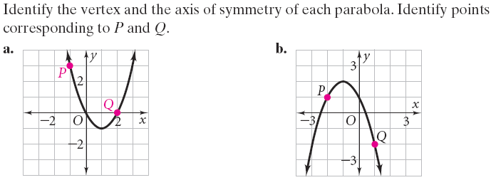
Parabola - Practice

Slide 22
Graphing Parabolas

Slide 25
Graphing - Example

Slide 26
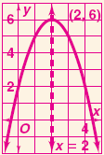
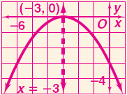
Graphing - Practice

Slide 29
Parabolas
The y coordinate of the vertex is either the maximum or the minimum value of the quadratic function

Slide 30
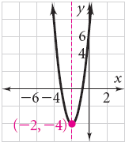
Finding a minimum - Example

Slide 32
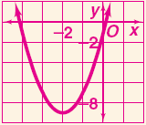
Finding a minimum - Practice

Slide 33
Homework
Page 328 – 330
16, 18, 22, 28, 34, 60, 62

