Slide 1
Algebra 2 8-R2
Unit 8b
Radical Functions
Review Problems

Slide 2
Review Problems
1

Slide 3
Review Problems
2

Slide 4
Review Problems
3

Slide 5
Review Problems
4

Slide 6
Review Problems
5

Slide 7
Review Problems
6

Slide 8
Review Problems
7

Slide 9
Review Problems
8

Slide 10
Review Problems
9

Slide 11
Review Problems
10

Slide 12
Review Problems
11

Slide 13
Review Problems
12

Slide 14
Review Problems
13

Slide 15
Review Problems
14

Slide 16
Review Problems
15

Slide 17
Review Problems
16

Slide 18
Review Problems
17

Slide 19
Review Problems
18

Slide 20
Review Problems
19

Slide 21
Review Problems
20

Slide 22
Review Problems
21

Slide 23
Review Problems
22

Slide 24
Review Problems
23

Slide 25
Review Problems
24

Slide 26
Review Problems
25

Slide 27
Review Problems
26

Slide 28
Review Problems
27

Slide 29
Review Problems
28

Slide 30
Review Problems
29

Slide 31
Review Problems
30

Slide 32
Review Problems
31

Slide 33
Review Problems
32

Slide 34
Review Problems
33

Slide 35
Review Problems
34

Slide 36
Review Problems
35

Slide 37
Review Problems
36

Slide 38
Review Problems
37

Slide 39
Review Problems
38

Slide 40
Review Problems
39

Slide 41
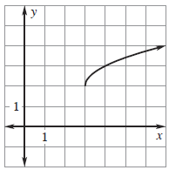
Review Problems
40

Slide 42
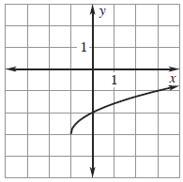
Review Problems
41

Slide 43
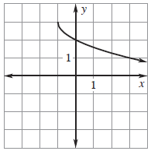
Review Problems
42

Slide 44
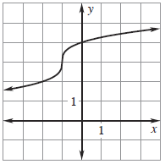
Review Problems
43

Slide 45
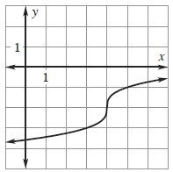
Review Problems
44

Slide 46
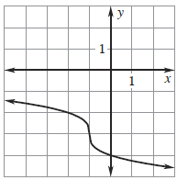
Review Problems
45

Slide 47
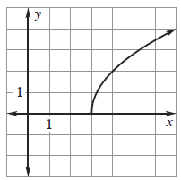
Review Problems
46

Slide 48
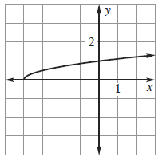
Review Problems
47

Slide 49
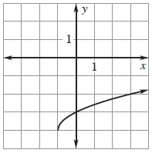
Review Problems
48

Slide 50
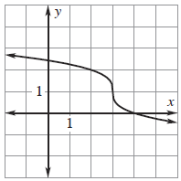
Review Problems
49

Slide 51
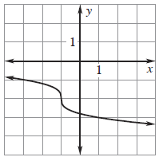
Review Problems
50

Slide 52
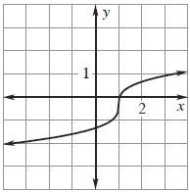
Review Problems
51

Slide 53
Answers

Slide 54
Answers

Slide 55
Answers

