Slide 1
Algebra 2 2-1
Solving Linear Equations

Slide 2
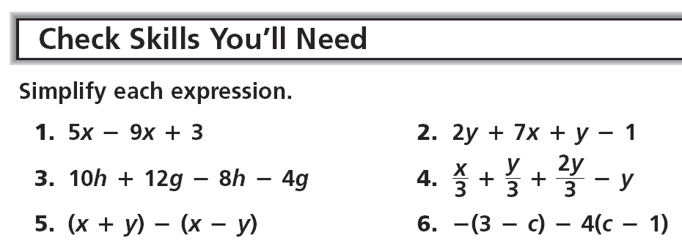
Warm Up

Slide 3
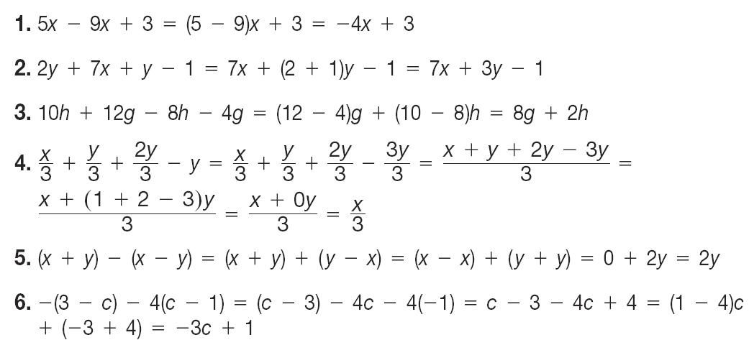
Warm Up - Answers

Slide 4
Vocabulary
Solution – A number that makes an equation true

Slide 5
Solving - Example

Slide 6
Solving - Practice

Slide 7
Solving - Example

Slide 8
Solving - Practice

Slide 9
Solving - Example

Slide 10
Solving - Example

Slide 11
Solving - Practice

Slide 12
Writing Equation - Example

Slide 13
Writing Equation - Practice

Slide 14
Practice

Slide 15
Practice

Slide 16
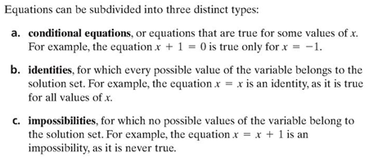
Exploration

Slide 17
Exploration

Slide 18
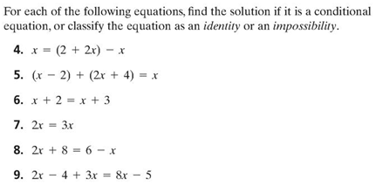
Exploration

Slide 19
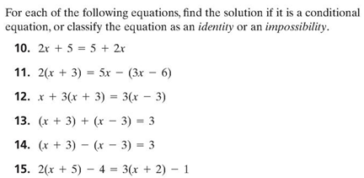
Exploration

Slide 20
Algebra 2 2-1
Solving Linear Inequalities

Slide 21
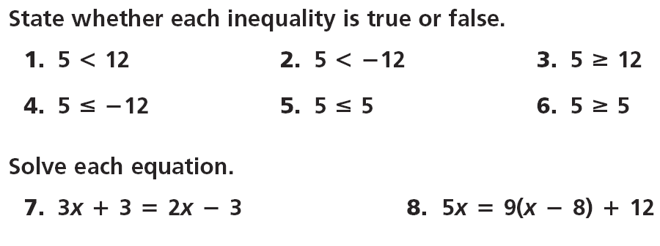
Warm up

Slide 22
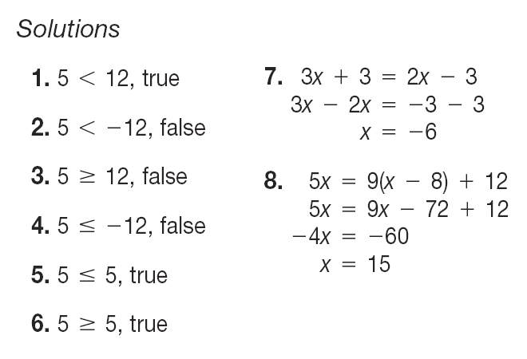
Answers

Slide 23
Inequalities
The solutions of an inequality are the numbers that make it true.
Solve and graph - 2x = 10

Slide 24
Inequalities
Open circle – when not “equal to”
Closed circle – when also “equal to”
Switch sign direction – when multiplying or dividing by a negative number

Slide 25
Inequalities – Property Summary

Slide 26
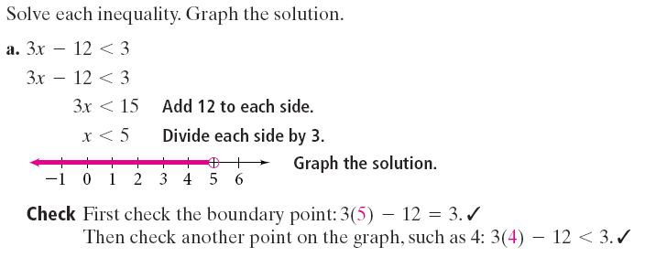
Inequalities - Example

Slide 27
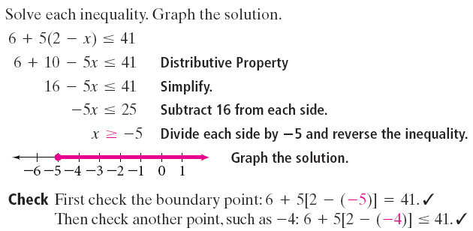
Inequalities - Example

Slide 28
Inequalities - Practice

Slide 29
Inequalities
Some inequalities have special solutions

Slide 30
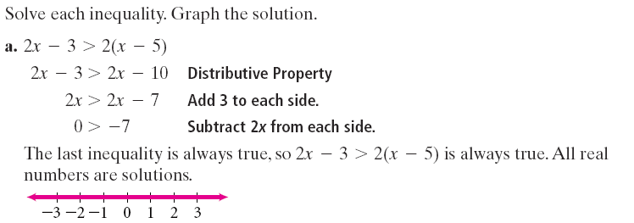
Inequalities - Example

Slide 31
Inequalities - Example

Slide 32
Inequalities - Practice

Slide 33
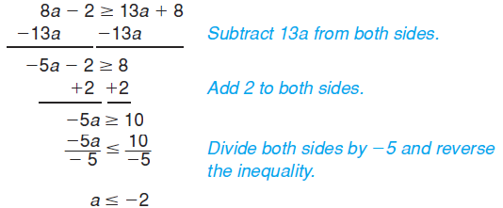
Practice

Slide 34
Practice

Slide 35
Practice

Slide 36
Homework
Pages 94 – 96
22 – 38 even, 41, 43, 46, 49, 62 – 68

