Slide 1
Algebra 2 3-4
Linear Programming

Slide 2
Minimum Value

Slide 3
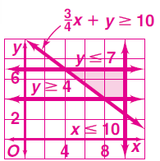
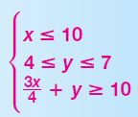
Minimum Value
Yes
No
Yes
Yes
Yes

Slide 4
Vocabulary
Linear Programming – A technique that identifies minimum and maximum values of some quantities
Objective Function – Model used for linear programming
Constraints – Limits on the variables in an objective function
Feasible Region – All the points that satisfy the constraints

Slide 5
Maximums and Minimums

Slide 6
Summary
Procedure
Define the variables
Write a system of inequalities
Graph the system of inequalities
Find the coordinates of the vertices
Write a function to be maximized or minimized
Substitute the coordinates of the vertices into the function
Select the greatest (or least) result

Slide 7
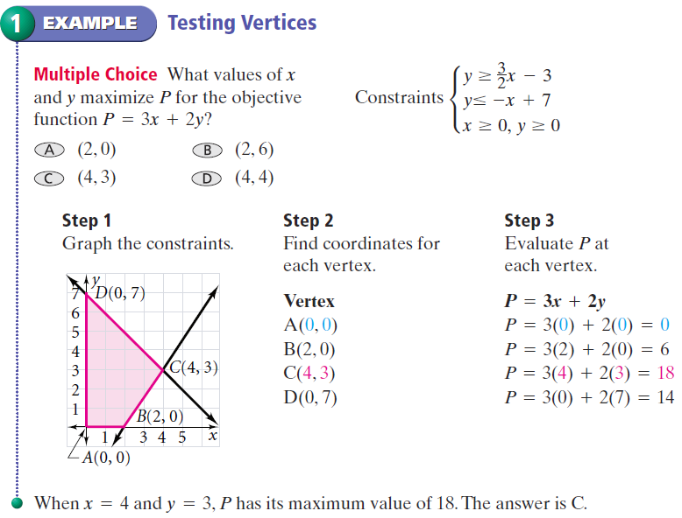
Testing Vertices - Example

Slide 8
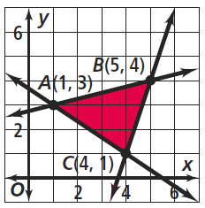
Testing Vertices - Practice

Slide 9
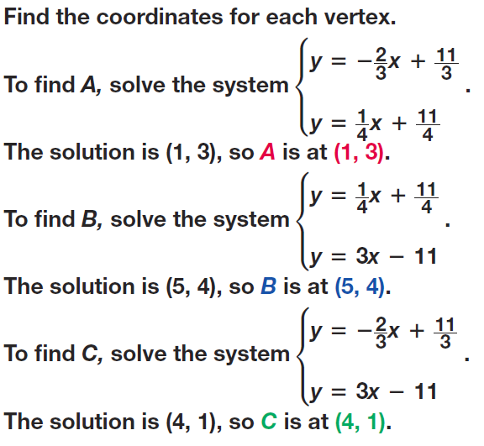
Testing Vertices - Practice

Slide 10
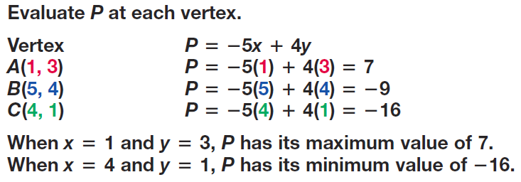
Testing Vertices - Practice

Slide 11
Testing Vertices - Practice

Slide 12
Quick Questions
How many different ways can a three line region look?
What if the inequality signs are switched?
Does an unbounded region still have vertices?

Slide 14
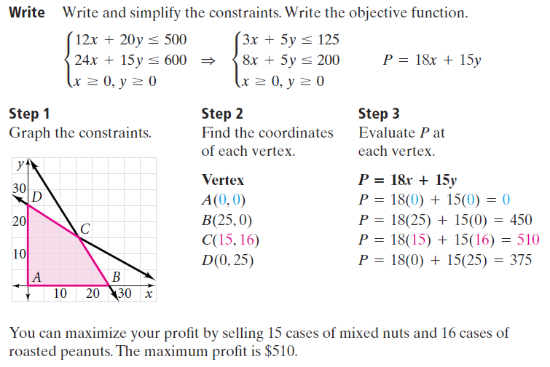

Slide 15
Practice

Slide 16
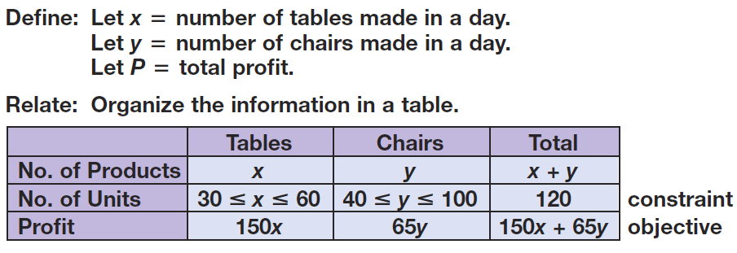
Practice

Slide 17
Practice

Slide 18
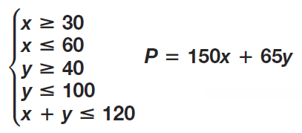
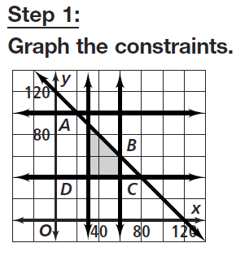
Practice

Slide 19
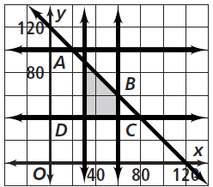
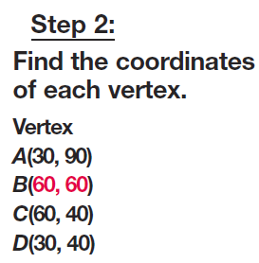
Practice

Slide 20
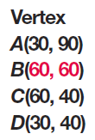
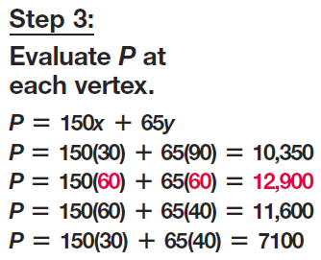
Practice

Slide 21
Homework
Pages 209 – 211
Use Graph Paper
3, 6, 8, 10, 13, 19, 21, 35

