Slide 1
Algebra 2 7-5
Exponential and Logarithmic Equations and Inequalities

Slide 2
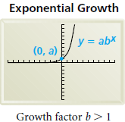
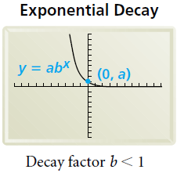
Vocabulary
Exponential Function–A function of the general form f(x) = ab^{x}
Growth Factor – b in the exponential function when b > 1
Decay Factor – b in the exponential function when b < 1

Slide 3
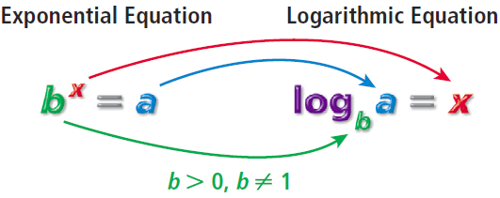
Logarithms

Slide 4
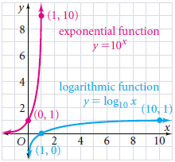

Slide 5
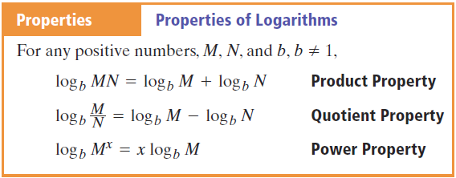
Logarithms

Slide 6
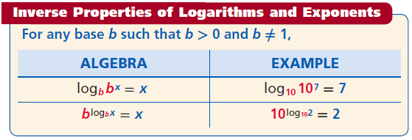
Logarithms

Slide 7
New Material

Slide 8
Common Logarithm

Slide 9
Example

Slide 10
Example

Slide 11
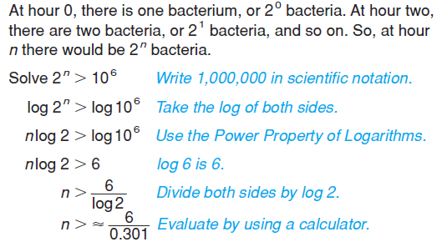
Example

Slide 12
Example

Slide 13
Example

Slide 14
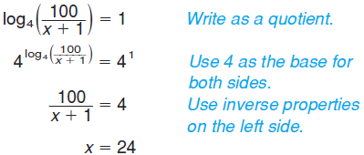
Example

Slide 15
Example

Slide 16
Example

Slide 17
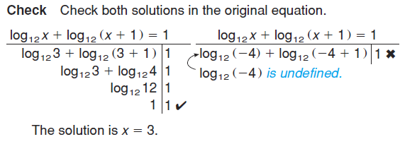
Example

Slide 18
Exp & Log Equations - Example

Slide 19
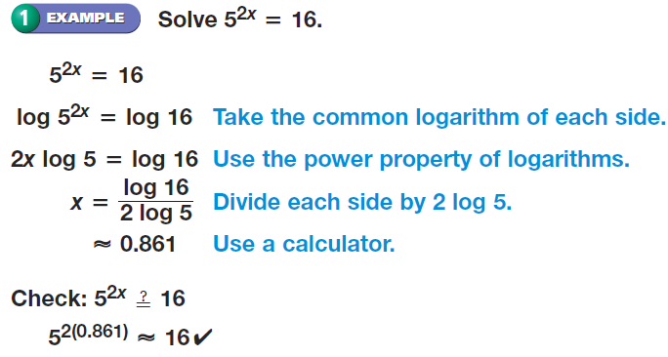
Exp & Log Equations - Example

Slide 20
Exp & Log Equations - Practice

Slide 21
Exp & Log Equations - Practice

Slide 22
Exp & Log Equations - Example

Slide 23
Exp & Log Equations - Practice

Slide 24
Exp & Log Equations - Example

Slide 25
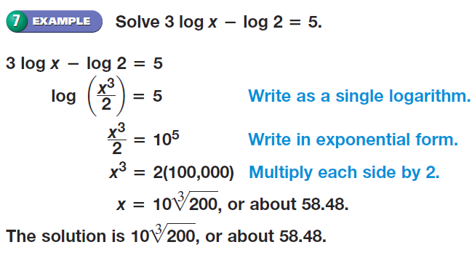
Exp & Log Equations - Example

Slide 26
Exp & Log Equations - Practice

Slide 27
Homework
Page 526 – 528
22 – 32 even, 37, 38, 41, 52, 62

