Slide 1
Algebra 2 5-1
Using Transformations to Graph Quadratic Functions

Slide 2
Vocabulary
Quadratic Function – A function that can be modeled ax² + bx + c = 0 where a does not equal zero. The domain is all real numbers.

Slide 3
Parabola - Example

Slide 4
Parent Functions

Slide 5
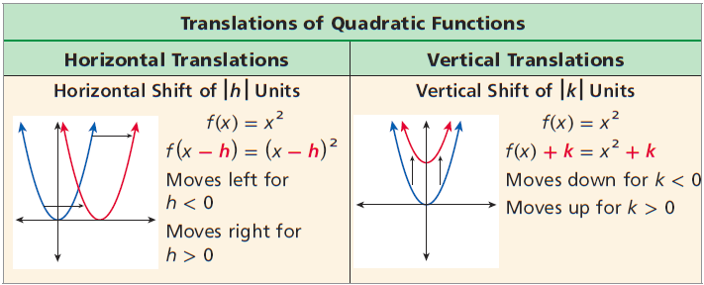
Translations

Slide 6
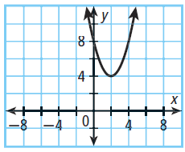
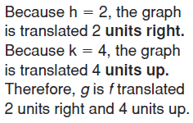
Example

Slide 7
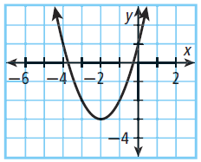
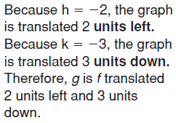
Example

Slide 8
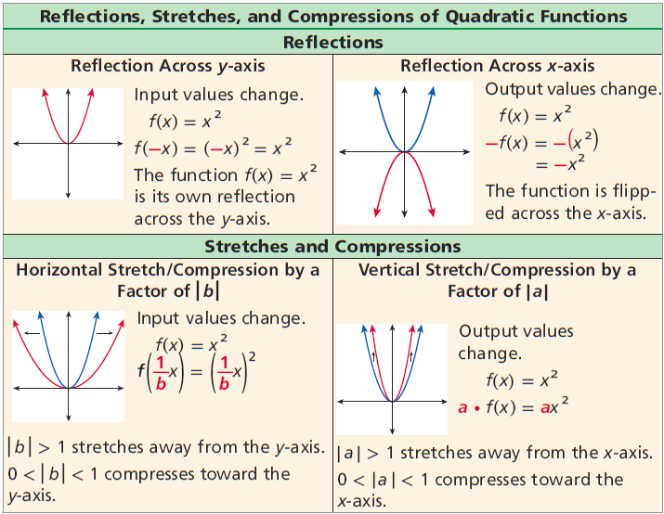
Reflections / Stretch-Shrink

Slide 9
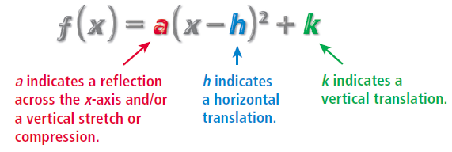
Vertex Form

Slide 10
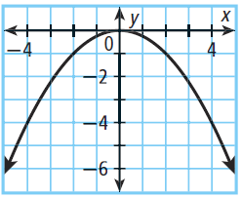
Example

Slide 11
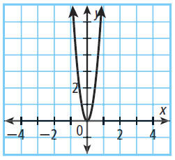
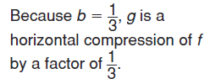
Example

Slide 12
Example

Slide 13
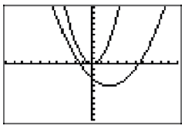
Example

Slide 14
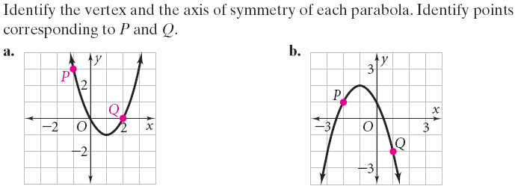
Parabola - Practice

Slide 16
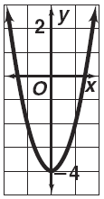
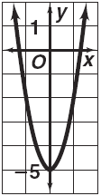
Graphing y = ax² + c

Slide 17
Graphing Parabolas

Slide 18
Graphing - Example

Slide 19
Homework
Pages 320 – 322
Graph on graph paper for credit
24 – 30 even, 39 – 41, 57

