Slide 1
Algebra 2 6-1
Polynomials

Slide 2
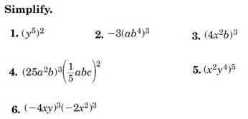
Do Now

Slide 3
Definitions
A monomial is a number, a variable, or a product of a number and one or more variables. An expression involving the division of variables is NOT a monomial.
Constants are monomials that are real numbers

Slide 4
Summary

Slide 5
Summary

Slide 6
Simplifying a Monomial
To simplify an expression involving monomials, write an equivalent expression in which:
Each base appears exactly once
There are no powers of powers
All fractions are in simplest form

Slide 7
Practice

Slide 8
Example

Slide 9
Summary

Slide 10
Summary

Slide 11
Summary

Slide 12
Vocabulary
Polynomial – A monomial or a sum of monomials

Slide 13
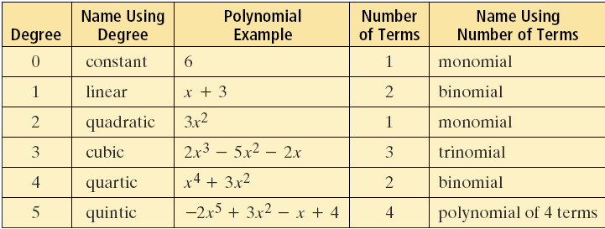
Vocabulary
The standard form of a polynomial lists the terms in descending order of degree

Slide 14
Standard Form

Slide 15
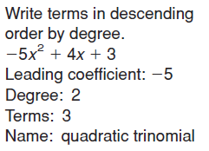
Example

Slide 16
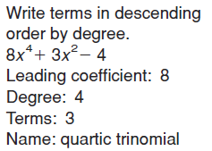
Example

Slide 17
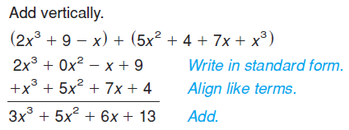
Example

Slide 18
Example

Slide 19
Example

Slide 20
Example

Slide 21
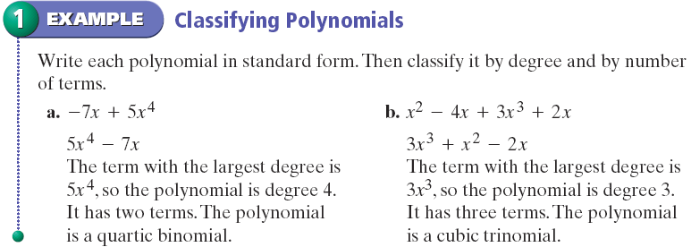
Polynomial Vocabulary - Example

Slide 22
Polynomial Vocabulary - Practice

Slide 23
Polynomial Factors - Example

Slide 24
Homework
Pages 410 – 412
23 - 30, 67 - 72

