Slide 1
Algebra 2 6-4
Factoring Polynomials

Slide 2
Factoring
Before factoring trinomials, ALWAYS check for a GCF first
If there is a GCF, factor it out with the distributive property, then proceed with factoring the trinomial

Slide 3
Summary

Slide 4
Summary

Slide 5
Steps for factoring Trinomials
Multiply first and last coefficients
Find all pairs of factors for the product
Select the pair of factors that adds (subtracts) to the value of the middle coefficient
Rewrite the original equation as four terms, replacing the middle term
Use factor by grouping
Set each binomial to zero if solving

Slide 6
Dealing with Negative Numbers
If the last term is negative, subtract the factored pair. The largest replacement term has the same sign as the original middle term
If the last term is positive, the replacement terms both have the same sign as the original middle term

Slide 7
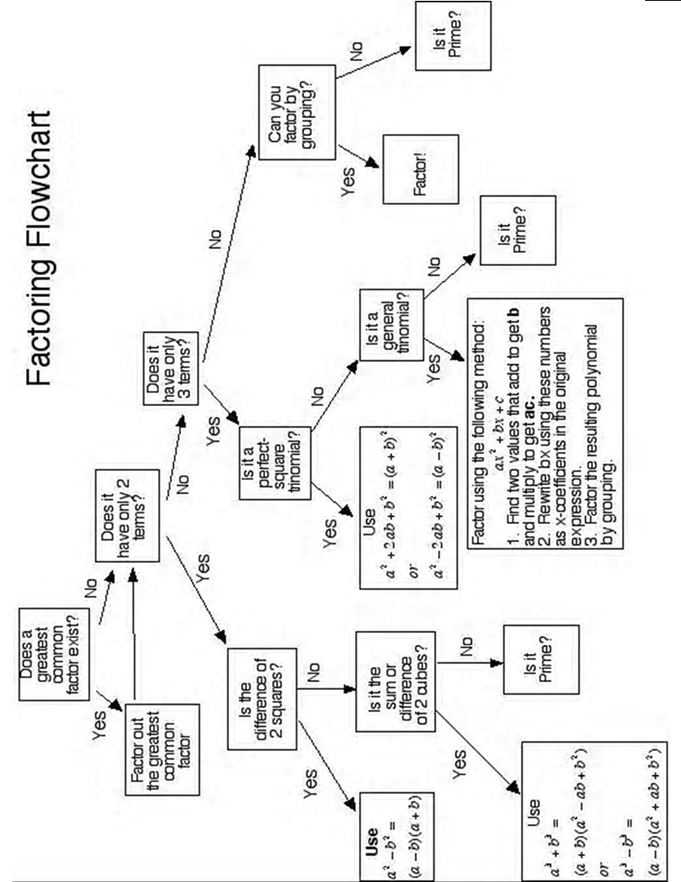

Slide 8
Factoring Summary
Terms | Technique | Example
2 | Difference of Squares | 9x²-49
3 | Perfect Square Grouping | 16x²-40x+25 6x²+5x-6
4 | Grouping | 2my+7x+7m+2xy
Factor out GCF whenever possible

Slide 9
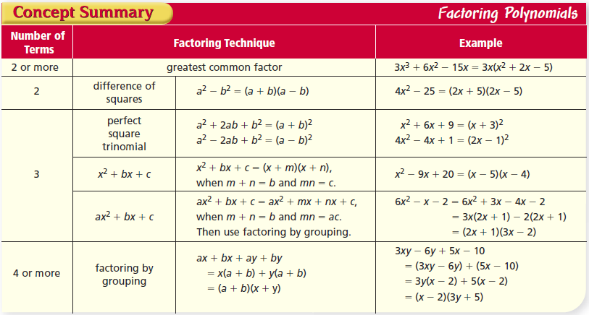
Factoring Summary

Slide 10
Factoring

Slide 11
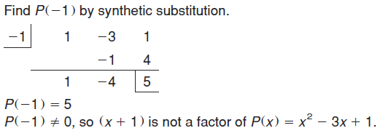
Example

Slide 12
Example

Slide 13
Sum and Difference of cubes

Slide 14
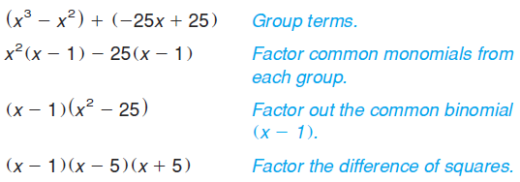
Example

Slide 15
Example

Slide 16
Example

Slide 17
Practice Problems

Slide 18
Practice Problems

Slide 19
Practice Problems

Slide 20
Practice Problems

Slide 21
Practice Problems

Slide 22
Practice Problems

Slide 23
Practice Problems

Slide 24
Practice Problems

Slide 25
Practice Problems

Slide 26
Practice Problems

Slide 27
Practice Problems

Slide 28
Practice Problems

Slide 29
Practice Problems

Slide 30
Practice Problems

Slide 31
Practice Problems

Slide 32
Practice Problems

Slide 33
Practice Problems

Slide 34
Practice Problems

Slide 35
Practice Problems

Slide 36
Practice Problems

Slide 37
Practice Problems

Slide 38
Practice Problems

Slide 39
Practice Problems

Slide 40
Practice Problems

Slide 41
Practice Problems

Slide 42
Practice Problems

Slide 43
Homework
Pg 433 - 435
20 – 32 even, 36, 38, 42, 44, 66

