Slide 1
Algebra 2 6-6
The Fundamental Theorem of Algebra

Slide 2
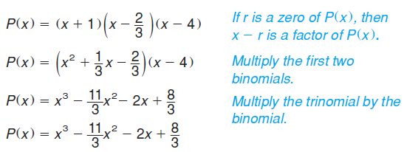
Example

Slide 3
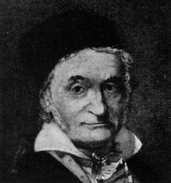
Roots and Zeros
Friedrich Gauss

Slide 4
Example

Slide 5
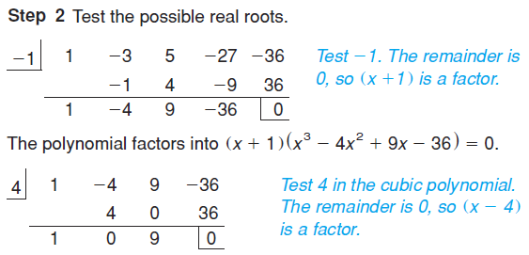
Example

Slide 6
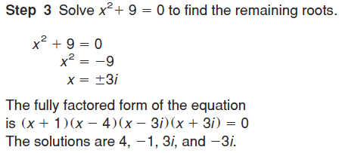
Example

Slide 7
Complex Conjugate Root Theorem

Slide 8
Example

Slide 9
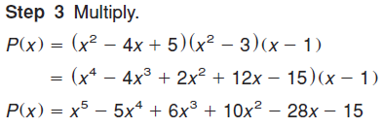
Example

Slide 10
Example

Slide 11
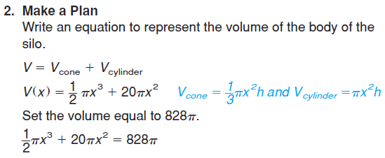
Example

Slide 12
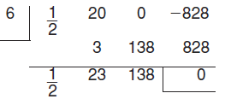
Example

Slide 13
Example

Slide 14
Roots and Zeros

Slide 15
Roots and Zeros
Number of Positive Real Zeros | Number of Negative Real Zeros | Number of Imaginary Zeros | Total
2 | 2 | 2 | 6
0 | 2 | 4 | 6
2 | 0 | 4 | 6
0 | 0 | 6 | 6

Slide 16
Roots and Zeros
So, the number of imaginary zeros for all polynomial functions must be an even number

Slide 17
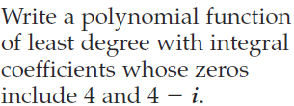
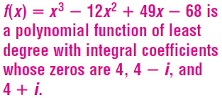
Roots and Zeros

Slide 18
Roots and Zeros

Slide 19
Roots and Zeros

Slide 20
Roots and Zeros
Roots and Zeros

Slide 21
Roots and Zeros

Slide 22
Practice Problems

Slide 23
Practice Problems

Slide 24
Practice Problems

Slide 25
Practice Problems

Slide 26
Practice Problems

Slide 27
Practice Problems

Slide 28
Practice Problems
3

Slide 29
Practice Problems

Slide 30
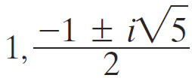
Practice Problems

Slide 31
Homework
Page 449 - 451
20 – 22, 26 – 36 even, 74, 75

