Slide 1
Geometry 11-4b
Segment Lengths

Slide 2
Chord Length Theorem
If two chords intersect inside a circle, two triangles can be constructed by adding two more chords
B
K
R
E
A

Slide 3
Chord Length Theorem
What is the relationship between angles B and R?
They are congruent because they are both inscribed angles with the same intercepted arcs
B
K
R
E
A

Slide 4
Chord Length Theorem
The same holds true for which other angles?
Angles A and E are congruent also
B
K
R
E
A

Slide 5
Chord Length Theorem
The two angles that meet at point K are congruent, why?
Vertical angles
B
K
R
E
A

Slide 6
Chord Length Theorem
So, all three angles of the two triangles are congruent, what does that tell us about the two triangles?
They are similar
B
K
R
E
A

Slide 7
Chord Length Theorem
Name the similar triangles
Triangle BKA ~ Triangle RKE
B
K
R
E
A

Slide 8
Chord Length Theorem
Knowing the two triangles are similar, and omitting sides AB and RE, what relationship can be written about the four other sides?
Triangle BKA ~ Triangle RKE
B
K
R
BK/KR = AK/KE
E
Simplify this fraction with cross multiplication
A

Slide 9
Chord Length Theorem
If two chords intersect in the interior of a circle, then the product of the lengths of the segments of one chord is equal to the product of the lengths of the segments of the other chord
B
BK • KE = AK • KR
K
R
E
A

Slide 10
Segment Definition
Tangent Segment – Line segment between a point and a tangent point
Secant Segment – Line segment between a point and a circle

Slide 11
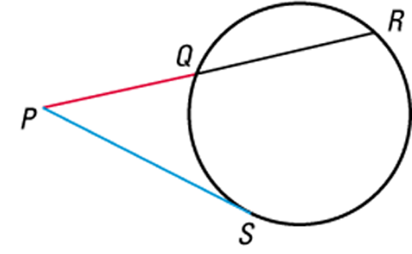
Segment Definition
Name each color segment in this figure
Secant Segment
Tangent Segment

Slide 12
Chord Investigation
Follow along with the following investigation

Slide 13
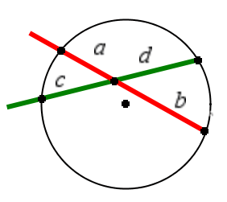
Chord Investigation
What is the equation?
ab = cd

Slide 14
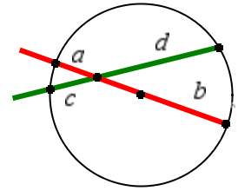
Chord Investigation
What is the equation?
ab = cd

Slide 15
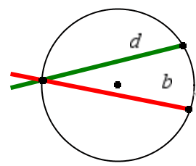
Chord Investigation
What is the equation?
No equation, both a and c are zero

Slide 16
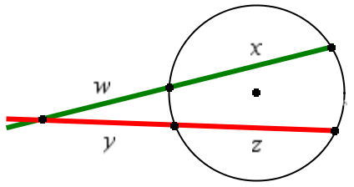
Chord Investigation
What is the equation?
Lets compare with previous

Slide 17
Chord Investigation
ab = cd
Starting at the intersecting point the values can be seen like this
Intersection to a times
Intersection to b
equals
Intersection to c times
intersection to d

Slide 18
Chord Investigation
What is the equation?
w(w+x) = y(y+z)

Slide 19
Secant Segment Theorem
The product of one secant outside the circle and the WHOLE secant equals the product of a second secant outside the circle and the WHOLE second secant.
B
EA • EB = EC • ED
A
E
C
D

Slide 20
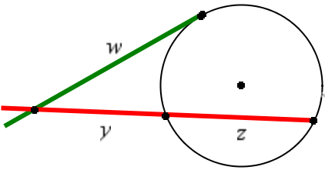
Chord Investigation
How is this changed when one secant becomes a tangent?
ww = y(y+z)

Slide 21
Secant Tangent Theorem
The product of one secant outside the circle and the WHOLE secant equals the square of a tangent segment
EA² = EC • ED
A
E
C
D

Slide 22
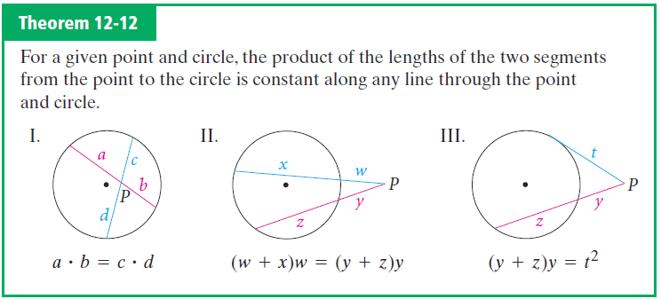
Chord Length Theorem

Slide 23
Sample Problems

Slide 24
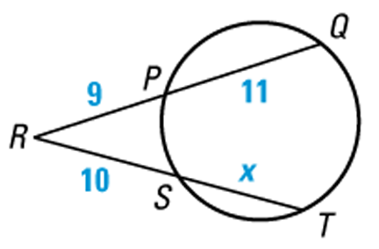
Finding Segment Lengths
Find the value of x.
RP • RQ = RS • RT
Use the chord length theorem
RP • RQ = RS • RT
Substitute.
9
(11 + 9)
10
(x + 10)
180 = 10x + 100
Simplify.
80 = 10x
Subtract 100 from each side.
8 = x
Divide each side by 10.

Slide 25
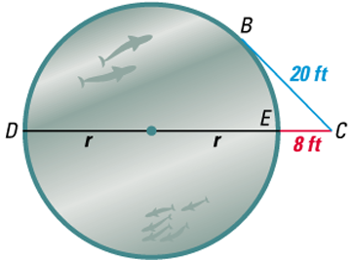
Estimating the Radius of a Circle
AQUARIUM TANK You are standing at point C, about 8 feet from a circular aquarium tank. The distance from you to a point of tangency on the tank is about 20 feet. Estimate the radius of the tank.
SOLUTION
(CB) ² = CE • CD
Secant Tangent Theorem.
(CB) ² ≈ CE • CD
Substitute.
20 ²
8
(2r + 8)
400 ≈ 16r + 64
Simplify.
336 ≈ 16r
Subtract 64 from each side.
21 ≈ r
Divide each side by 16.
So, the radius of the tank is about 21 feet.

Slide 26
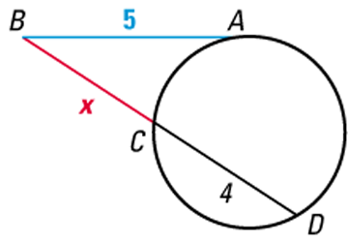
Finding Segment Lengths
Use the figure to find the value of x.
SOLUTION
(BA) ² = BC • BD
Use Theorem
(BA) ² = BC • BD
Substitute.
5 ²
x
(x + 4)
25 = x ² + 4x
Simplify.
0 = x ² + 4x – 25
Write in standard form.
x =
–4 ± 4 ² – 4(1)(–25)
2
Use Quadratic Formula.
x = –2 ± 29
Simplify.
Use the positive solution, because lengths cannot be negative.
So, x = –2 + 29
≈ 3.39.

Slide 27
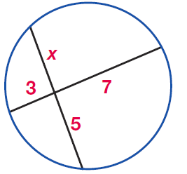
Example

Slide 28
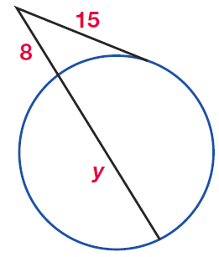
Example

Slide 29
Example

Slide 30
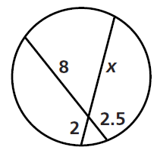
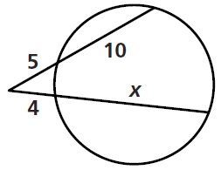
Practice Problems

Slide 31
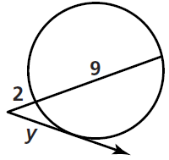
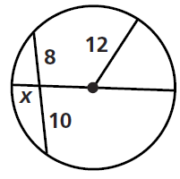
Practice Problems

Slide 32
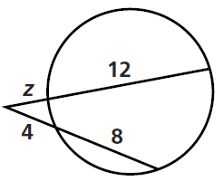
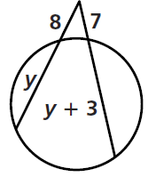
Practice Problems

Slide 33
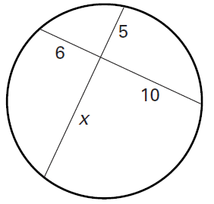
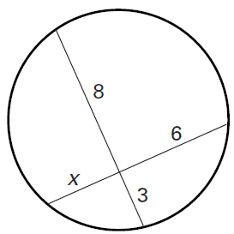
Example

Slide 34
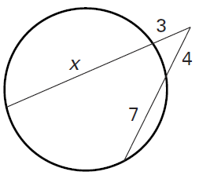
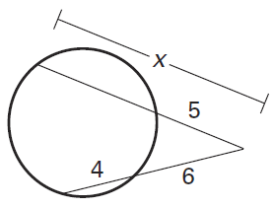
Example

Slide 35
Homework
Pages 611 – 613
9 – 14, 20, 21, 26

