Slide 1
Geometry 4-1
Congruent Figures

Slide 2
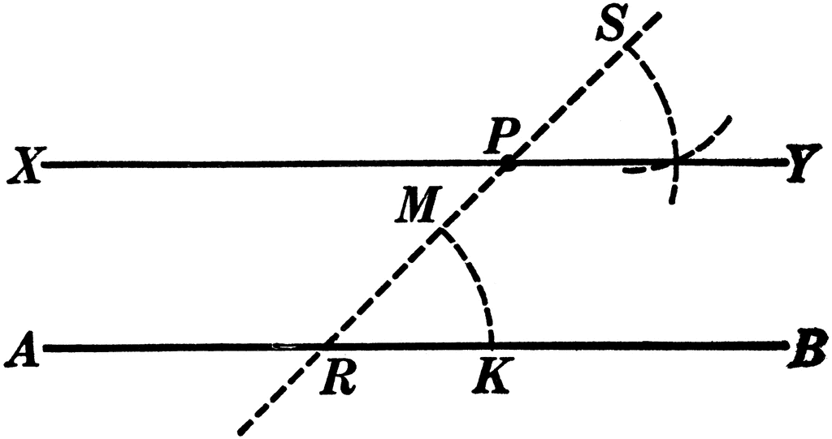
Exploration
Demonstration of proving the construction for parallel lines is true

Slide 3
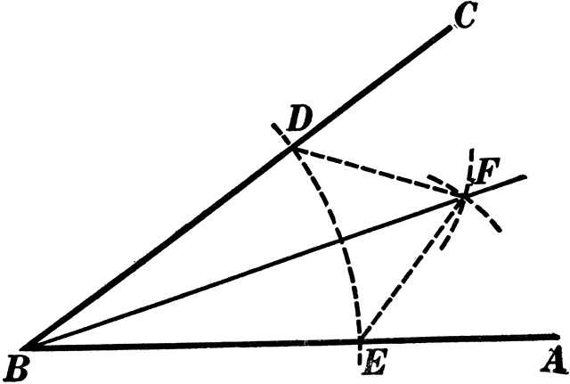
Exploration
Work in groups of two or three
Create a logic argument that the construction of an angle bisector is a true bisector

Slide 4
Exploration
The role of the skeptic
Take turns being the “skeptic” The skeptic can dispute your logic and challenge you to a better line of reasoning

Slide 5
Exploration
Prepare your best logic argument to present to the whole class

Slide 6
Definition
Congruent Polygons – All corresponding angles and all corresponding sides are congruent
When naming congruent figures, order of letters must correspond

Slide 7
Congruence
Are they congruent?
YES

Slide 8
Congruence
Are they congruent?
YES

Slide 9
Congruence
Are they congruent?
NO

Slide 10
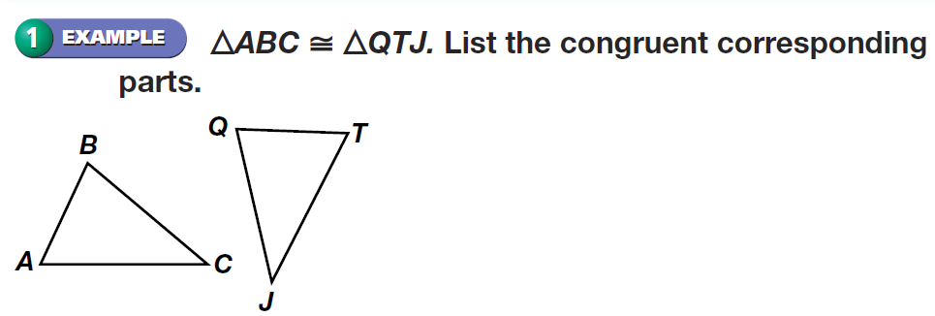
Congruence

Slide 11
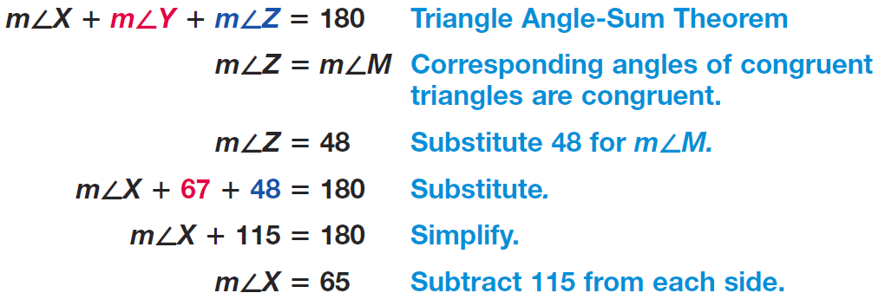
Congruence

Slide 12
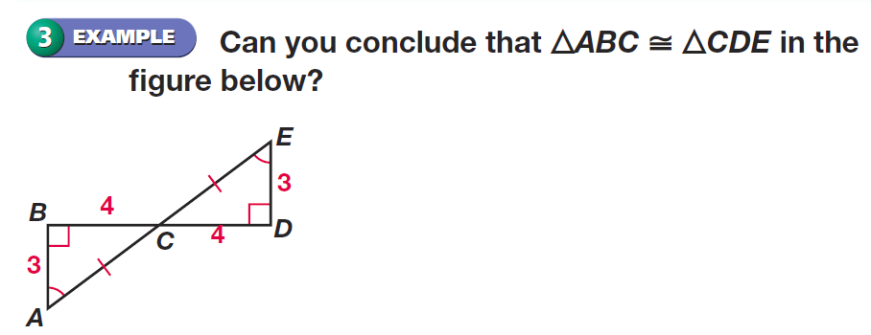
Congruence

Slide 13
Congruence

Slide 14
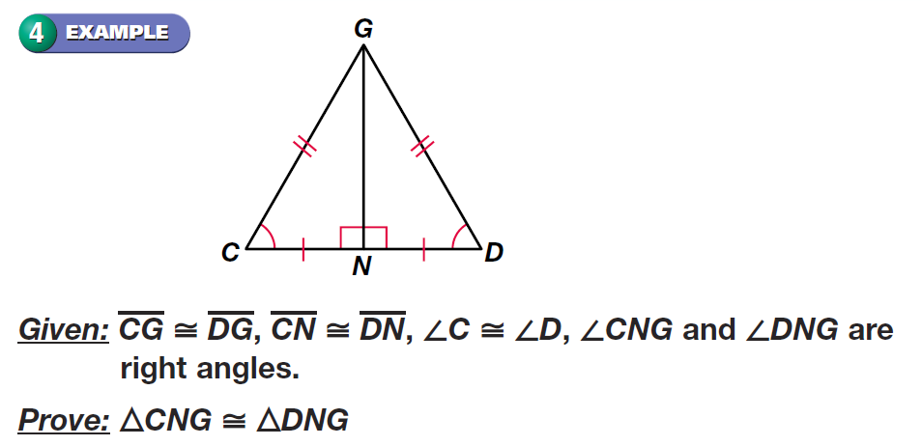
Congruence

Slide 15
Congruence

Slide 16
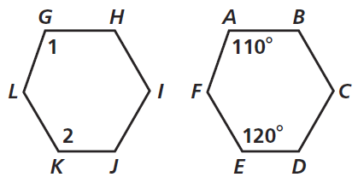
Practice

Slide 17
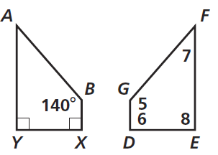
Practice

Slide 18
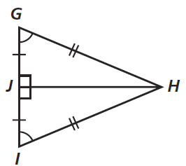
Practice

Slide 19
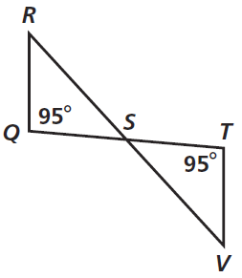
Practice

Slide 20
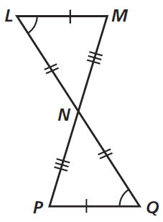
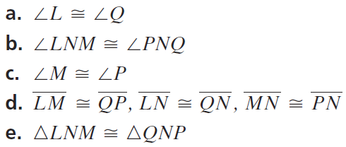
Practice

Slide 21
Homework
Pages 182 – 184
14, 15, 24 – 28, 30, 34, 38 – 40

