Slide 1
Geometry 1-7
Perimeter, Circumference, and Area

Slide 2
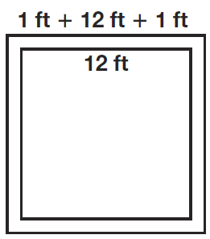
Example

Slide 3
Formulas

Slide 4
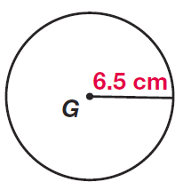
Example

Slide 5
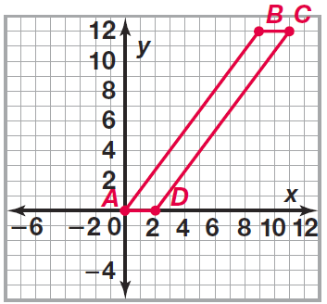
Example

Slide 6
Example

Slide 7
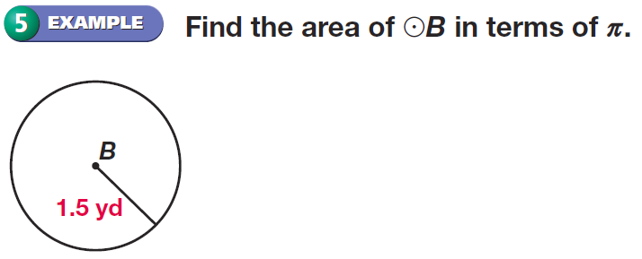
Example

Slide 8
Postulates

Slide 9
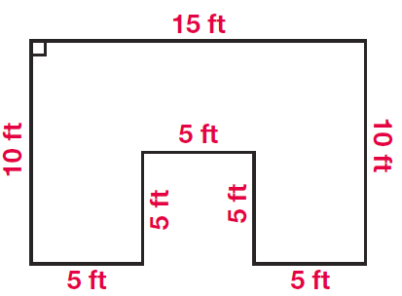
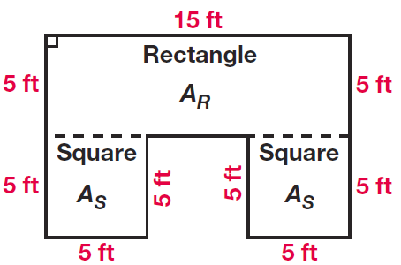
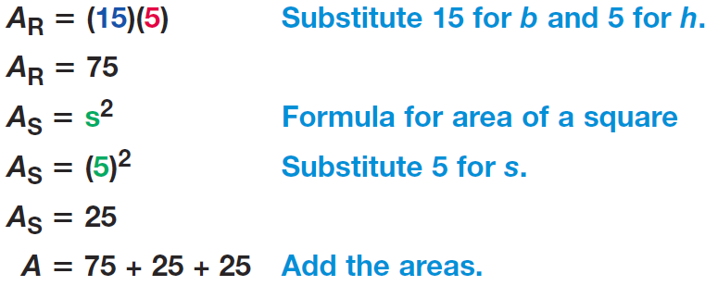
Example

Slide 10
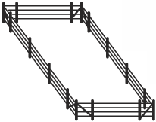
Investigation
Assume you are a farmer with 100 feet of fencing.
List six different rectangular sizes that could be used to create an enclosure for your animals.
Plot these results, one side on the x-axis, area on the y-axis, use both sides (plot 12 points).
Can you imagine that a shortcut to find the maximum size might be important?

Slide 11
Practice

Slide 12
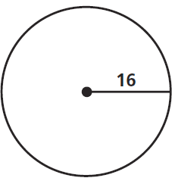
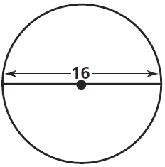
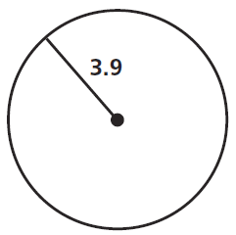
Practice

Slide 13
Practice

Slide 14
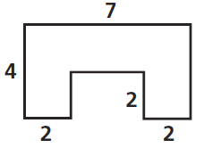
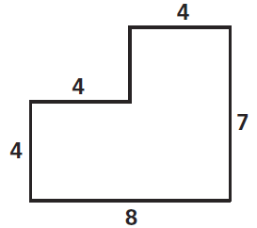
Practice

Slide 15
Practice

Slide 16
Homework
Pages 55 – 58
28, 31, 37, 38, 49, 50, 54, 65, 88

