Slide 1
Geometry 10-3
Surface Areas of Prisms and Cylinders

Slide 2
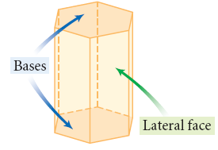
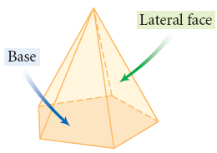
Surface Area
Lateral Faces and Bases in Prisms and Pyramids

Slide 3
Vocabulary
Prism – A polyhedron with two congruent and parallel bases
Lateral Faces – The non-base faces in a prism
Right Prism – A prism with the base a right angle from the lateral faces
Oblique Prism – A prism with lateral faces not at a right angle to either base
Lateral Area – The sum of the surface area of all the lateral faces

Slide 4
Surface Area

Slide 5
Surface Area of a Prism

Slide 6
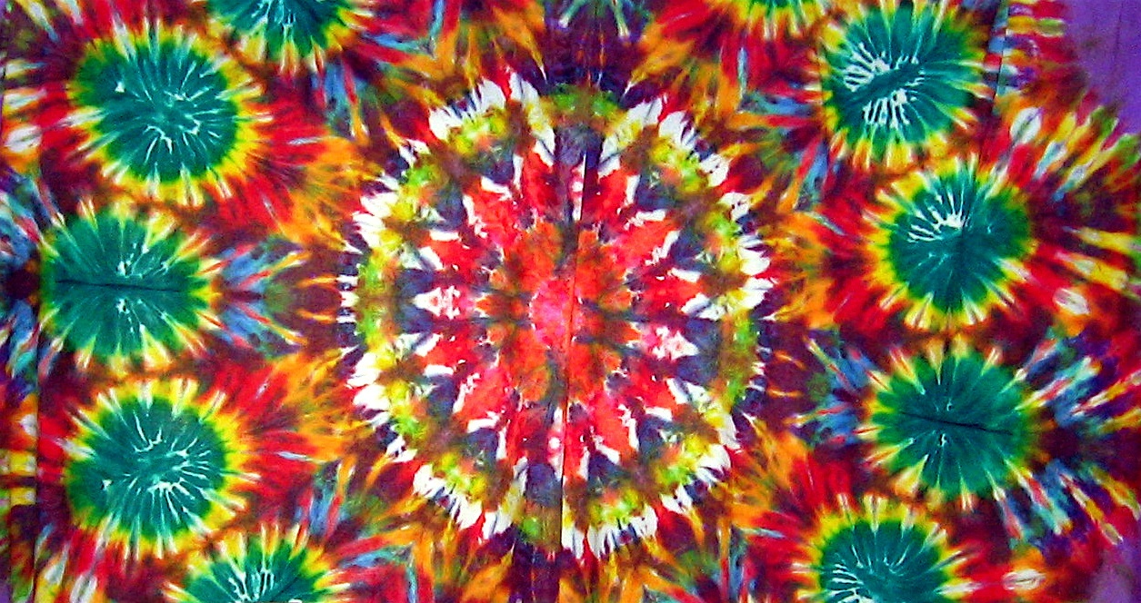
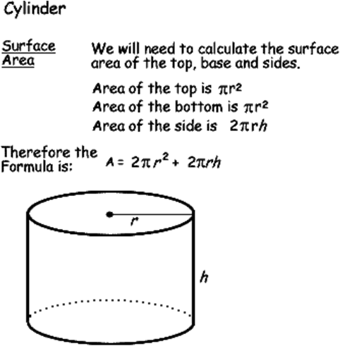
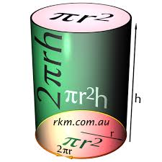
Surface Area of a Cylinder

Slide 7
Vocabulary
Cylinder – A figure with two congruent and parallel bases that are circles
Right Cylinder – A cylinder with the base a right angle from the lateral face
Oblique Cylinder – A cylinder with a lateral face not at a right angle to either base
Lateral Area – The lateral area of a cylinder is a rectangle

Slide 8
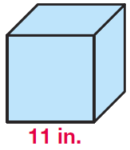
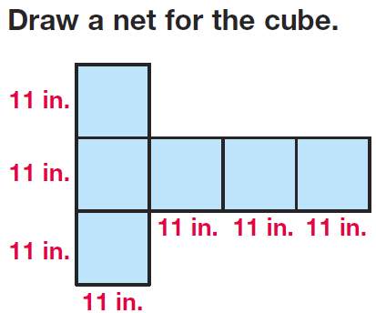
Example

Slide 9
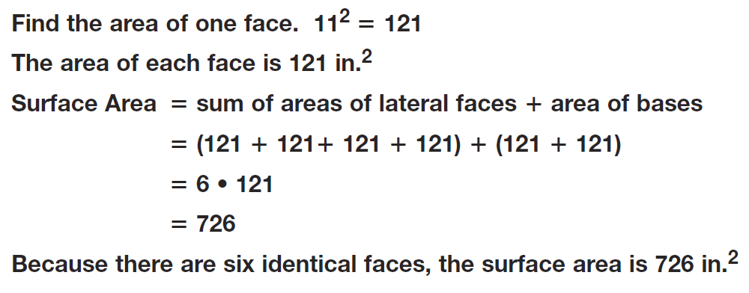
Example

Slide 10
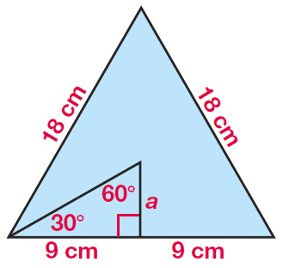
Example

Slide 11
Example

Slide 12
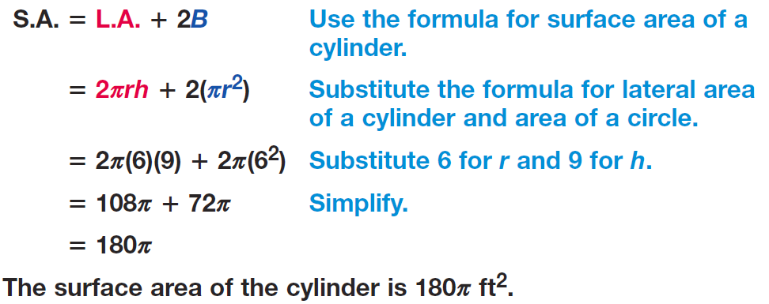
Example

Slide 13
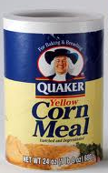
Example

Slide 14
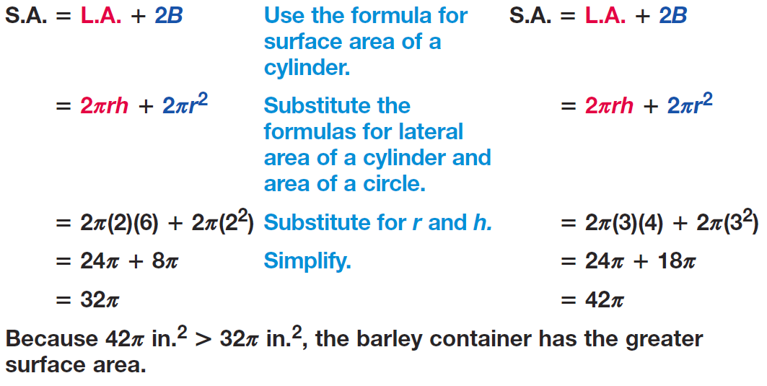
Example

Slide 15
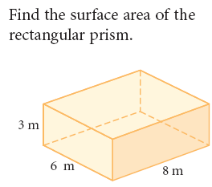
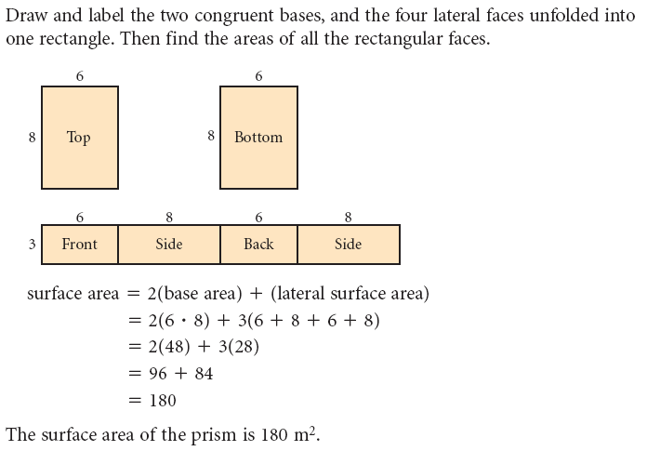
Surface Area - Example

Slide 16
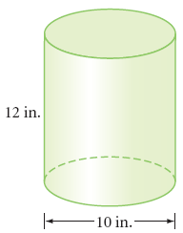
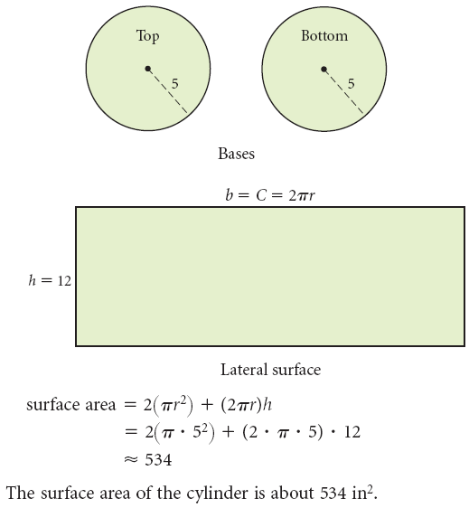
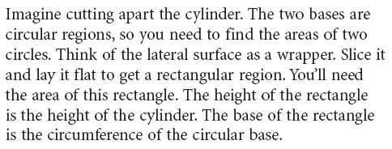
Surface Area

Slide 17
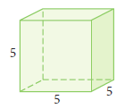
Practice Problems

Slide 18
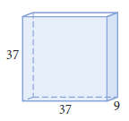
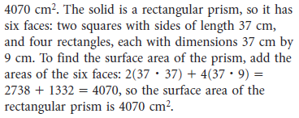
Practice Problems

Slide 19
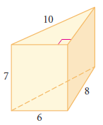
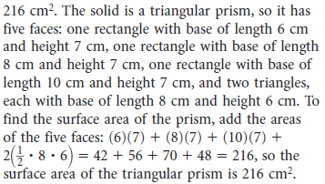
Practice Problems

Slide 20
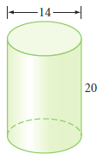
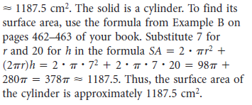
Practice Problems

Slide 21
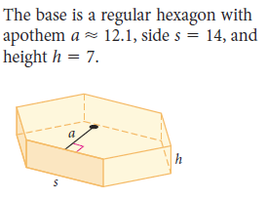
Practice Problems

Slide 22
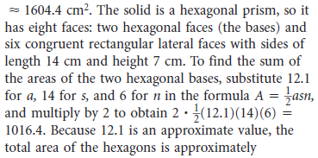
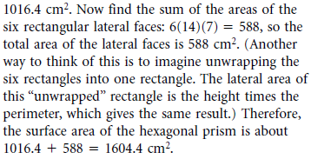
Practice Problems

Slide 23
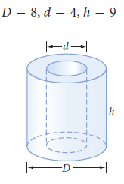
Practice Problems

Slide 24
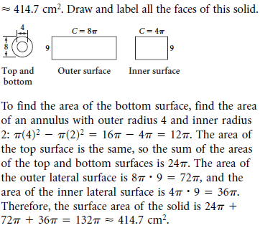
Practice Problems

Slide 25
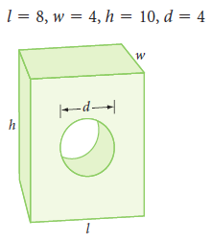
Practice Problems

Slide 26
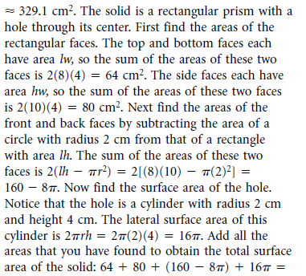
Practice Problems

Slide 27
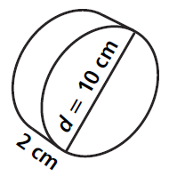
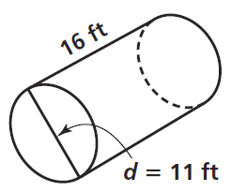
Practice

Slide 28
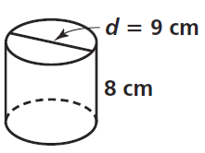
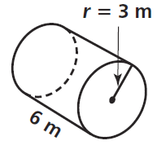
Practice

Slide 29
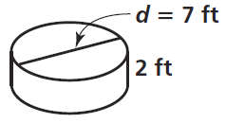
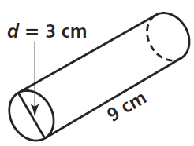
Practice

Slide 30
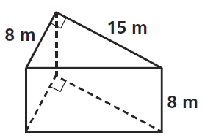
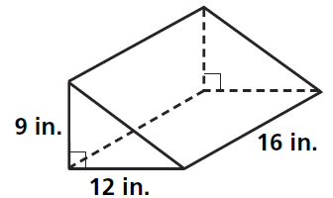
Practice

Slide 31
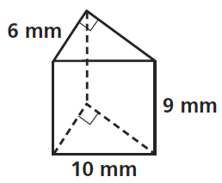
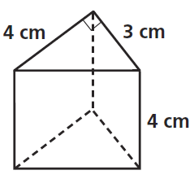
Practice

Slide 32
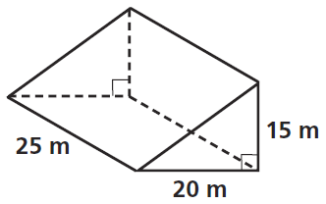
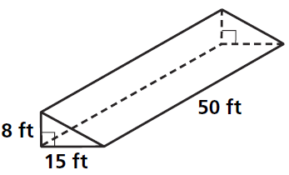
Practice

Slide 33
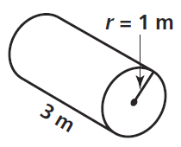
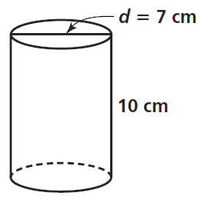
Practice

Slide 34
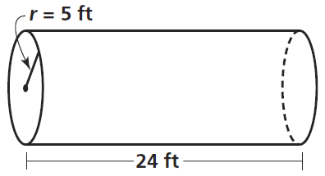
Practice

Slide 35
Homework
Pages 531 – 535
3, 6, 10, 13, 19, 46

