Slide 1
Geometry 11-1
Tangent Lines

Slide 2
Review
Review

Slide 3
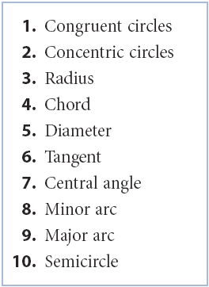
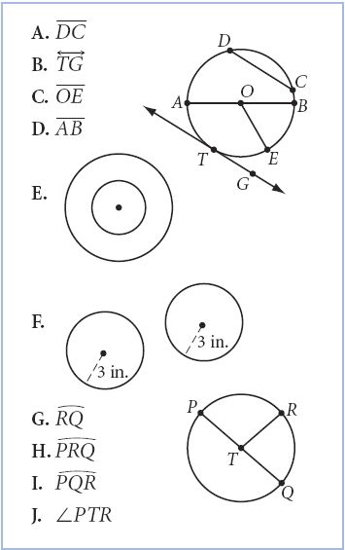
Match the figures and terms

Slide 4
Circle Vocabulary
Circle – The set of all points in a plane that are equidistant from a given point
Center – Equidistant point of a circle
Radius – Distance from the center of a circle to a point on the circle
Diameter – Distance from a point on the circle to another point on the circle through the center of the circle
Chord – Line segment with endpoints on the circle
Secant – Line that intersects the circle twice

Slide 5
Circle Vocabulary
Tangent – A line that intersects a circle in exactly one point
Concentric – Circles with a common center
Common Tangent – Line tangent to two circles
Tangent Circles – Circles that intersect in exactly one point
Interior of a circle – points inside a circle
Exterior of a circle – points outside a circle

Slide 6
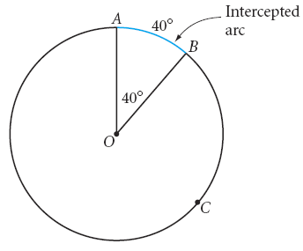
Intercepted Arc
Arc within an angle
Arc Vocabulary

Slide 7
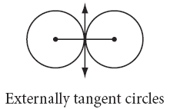
Externally Tangent Circles
Circles that share a point of tangency but do not share any interior points
Tangent Vocabulary

Slide 8
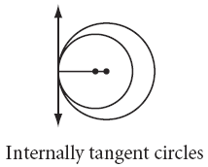
Internally Tangent Circles
Circles that share a point of tangency and interior points
Tangent Vocabulary

Slide 9
Tangent Properties
New Material

Slide 10
Tangent Properties
Supplies Needed
Compass
Ruler
Protractor

Slide 11
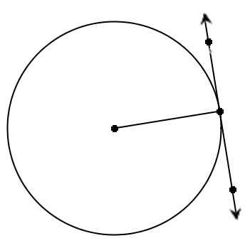
Investigation
Using a compass or a calculator
Create a large circle
Add a tangent to the circle
Add a radius from the point of tangency to the center of the circle
Measure the angle between the tangent line and the radius

Slide 12
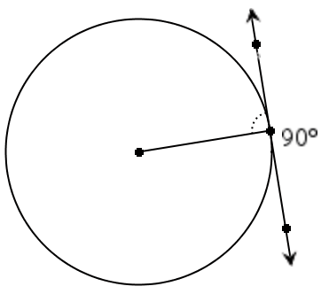
Investigation
Did everyone measure 90 degrees?
Is the converse true?

Slide 13
Tangent Theorem
A tangent to a circle is perpendicular to a radius drawn to the point of tangency.
If a line is perpendicular to a radius of a circle at its endpoint on the circle, then the line is tangent to the circle.
If a

Slide 14
Tangent Theorems

Slide 15
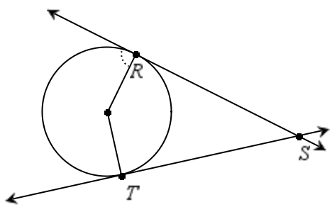
Investigation
Construct a circle
Construct two tangent lines that cross
Label the points as shown
R
S
T

Slide 16
Investigation
Compare line segments RS and ST
These line segments are called tangent segments
R
S
T

Slide 17
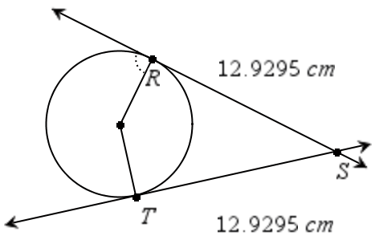
Tangent Segments Theorem
Tangent segments to a circle from a point outside the circle are congruent

Slide 18
Tangent Segments Theorem

Slide 19
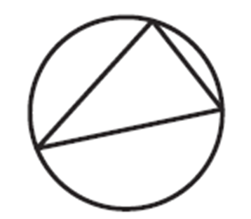
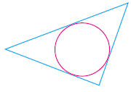
Vocabulary
Inscribed in – when all the vertices of a polygon lie on a circle
Circumscribed about – When each side of a polygon is tangent to the circle
The polygon is Inscribed In
The polygon is circumscribed about

Slide 20
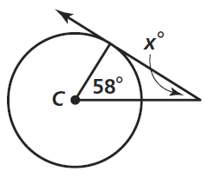
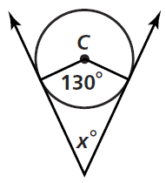
Practice Problems

Slide 21
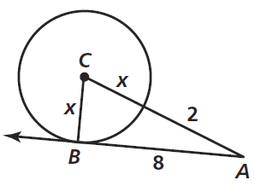
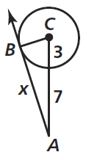
Practice Problems

Slide 22
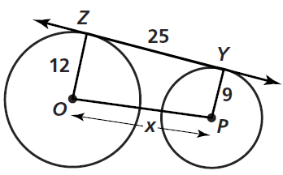
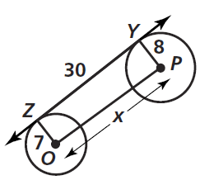
Practice Problems

Slide 23
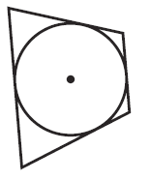
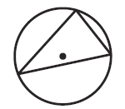
Practice Problems

Slide 24
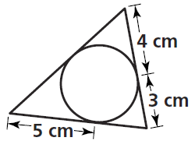
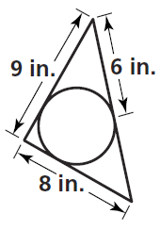
Practice Problems

Slide 25
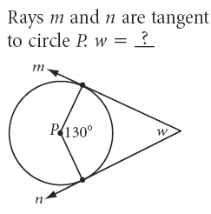

Slide 26
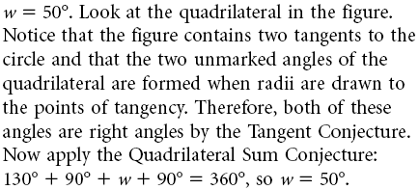

Slide 27
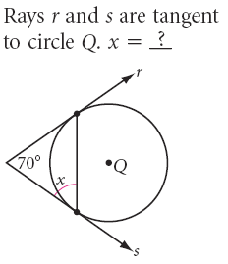

Slide 29
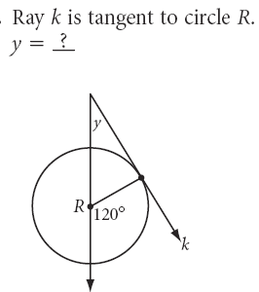

Slide 31
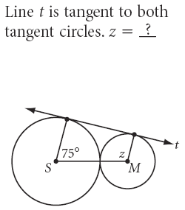

Slide 34
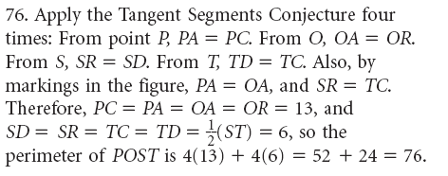

Slide 35
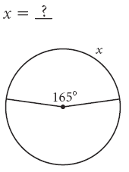

Slide 37
Homework
Pages 586 – 589
10 – 17 all, 20, 22, 52

