Slide 1
Geometry 7-7
Areas of Circles and Sectors

Slide 2
Review

Slide 3
Areas

Slide 4
Area
Area of a Triangle

Slide 5
Theorem
The Pythagorean theorem
In a right triangle, the sum of the squares of the legs of the triangle equals the square of the hypotenuse of the triangle
B
c
a
C
A
b

Slide 6
Theorem
Converse of the Pythagorean theorem
If the square of the length of the longest side of a triangle is equal to the sum of the squares of the lengths of the other two sides, then the triangle is a right triangle.
B
c
a
C
A
b

Slide 7
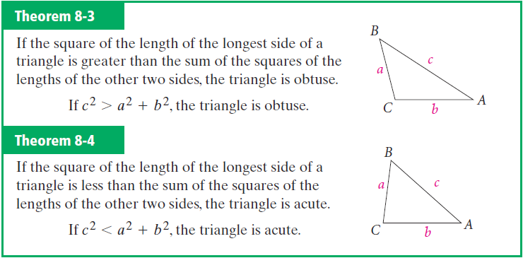
Converse of Pythagorean

Slide 8
Theorem
45° – 45° – 90° Triangle
In a 45° – 45° – 90° triangle the hypotenuse is the square root of two times as long as each leg

Slide 9
Theorem
30° – 60° – 90° Triangle
In a 30° – 60° – 90° triangle, the hypotenuse is twice as long as the shorter leg, and the longer leg is the square root of three times as long as the shorter leg

Slide 10
Area

Slide 11
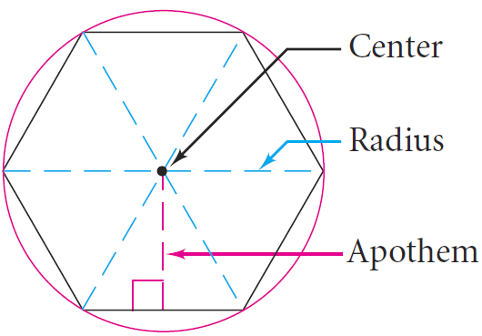
Vocabulary

Slide 12
Area

Slide 13
Circle Vocabulary (review)
Circle – The set of all points in a plane that are equidistant from a given point
Center – Equidistant point of a circle
Radius – Distance from the center of a circle to a point on the circle
Diameter – Distance from a point on the circle to another point on the circle through the center of the circle
Congruent Circles – Circles with congruent radii
Central Angle – Angle with vertex at the center of the circle

Slide 14
Arc Vocabulary
Central Angle
An angle whose vertex is the center of a circle
Major Arc
Part of the circle that measures between 180° and 360°
Part of the circle that measures between 0° and 180°
Minor Arc
Semicircle
An arc whose endpoints are the endpoints of a diameter of a circle
Measure of a Minor Arc
The measure of the arcs central angle
Measure of a Major Arc
The difference between 360° and the measure of its associated minor arc

Slide 15
New Theorem

Slide 16
Example

Slide 17
Area of Circles and Sectors
New Material

Slide 18
Area Exploration
Get your supplies
Two sheets of color paper (different)
Compass
Scissors
Glue (optional)

Slide 19
Area Exploration
Make a large circle
Cut out the circle

Slide 20
Area Exploration
Fold the circle in half
Fold it again
And again
And one last time (fourth)

Slide 21
Area Exploration
Open up your circle, and cut along all the fold lines 16 pieces total

Slide 22
Area Exploration
Arrange it into a parallelogram
What is the area of the parallelogram?
Glue onto other piece of paper

Slide 23
Area Exploration
Remember one side is half the circumference
πR
R

Slide 24
Circle Area Conjecture
The area of a circle is given by the formula A = πr² where A is the Area of the circle and r is the radius of the circle

Slide 25
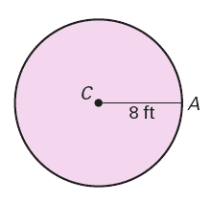
64 π ft²

Slide 26
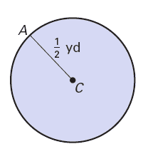
0.25 π yd²

Slide 27
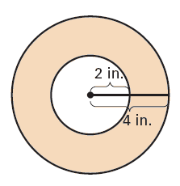
12 π in²

Slide 28
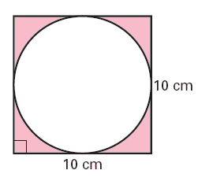
100 - 25 π cm²
21.46 cm²

Slide 29
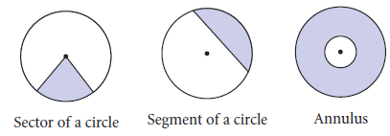
Vocabulary

Slide 30
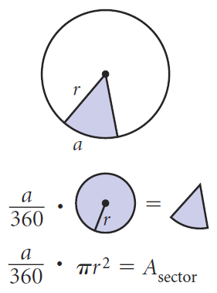
Sector of a Circle

Slide 31
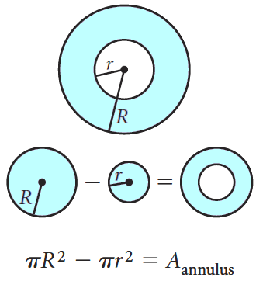
Annulus of a Circle

Slide 32
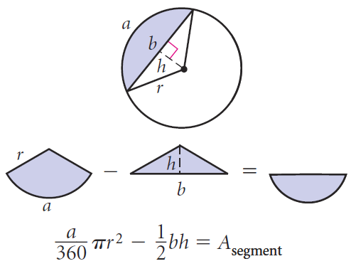
Segment of a Circle

Slide 33
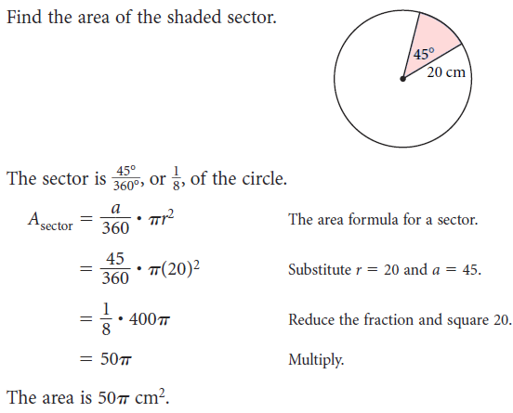
Circle Section Examples

Slide 34
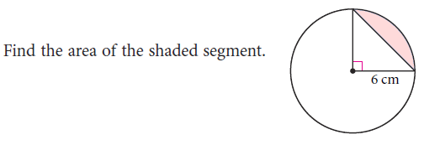
Circle Section Examples*

Slide 35
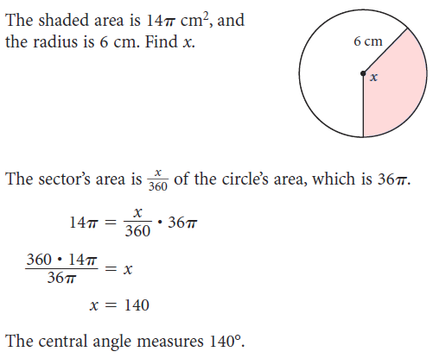
Circle Section Examples

Slide 36
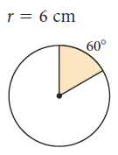
Sample Problems

Slide 37
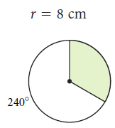
Sample Problems

Slide 38
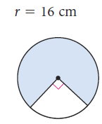
Sample Problems

Slide 39
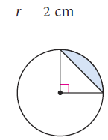
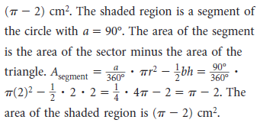
Sample Problems*

Slide 40
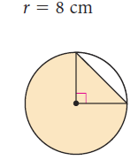
Sample Problems*

Slide 41
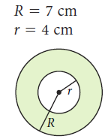
Sample Problems

Slide 42
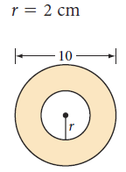
Sample Problems

Slide 43
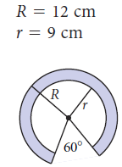
Sample Problems

Slide 44
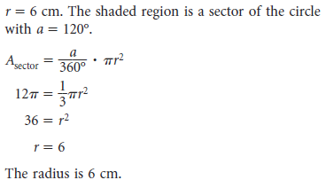
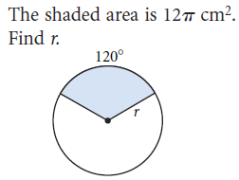
Sample Problems

Slide 45
12 π in²

Slide 46
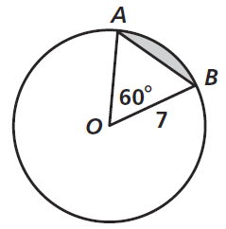
Practice

Slide 47
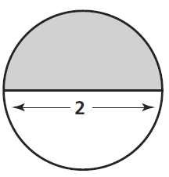
Practice

Slide 48
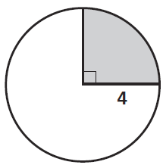
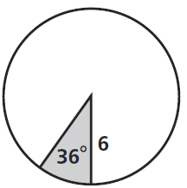
Practice

Slide 49
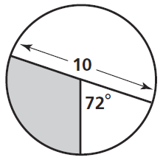
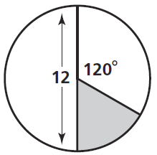
Practice

Slide 50
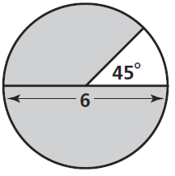
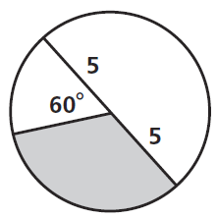
Practice

Slide 51
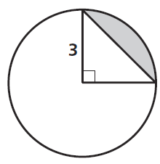
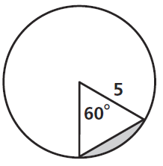
Practice

Slide 52
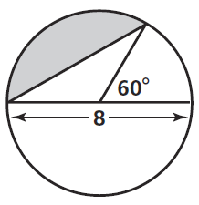
Practice

Slide 53
Homework
Pages 397 – 400
2, 8 – 26 even, 45

