Slide 1
Geometry 10-1
Space Figures and Nets

Slide 2
Vocabulary
Polyhedron – A solid formed by polygons that enclose a single region of space
Face – Flat polygon surfaces of a polyhedron
Edge – A segment where two faces intersect on a polyhedron
Vertex – A point of intersection of three or more edges on a polyhedron

Slide 3
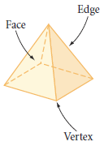
Vocabulary
Polyhedron – A solid formed by polygons that enclose a single region of space
Face – Flat polygon surfaces of a polyhedron
Edge – A segment where two faces intersect on a polyhedron
Vertex – A point of intersection of three or more edges on a polyhedron

Slide 4
Vocabulary
Just as a polygon is classified by its number of sides, a polyhedron is classified by its number of faces. The prefixes for polyhedrons are the same as they are for polygons with one exception: A polyhedron with four faces is called a tetrahedron.

Slide 5
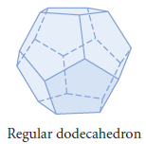
Vocabulary
Regular Polyhedron – A polyhedron where each face is a regular polygon, each face is congruent to all other faces, and the faces meet at the vertex in exactly the same way.

Slide 6
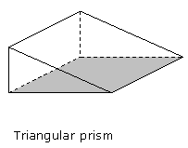
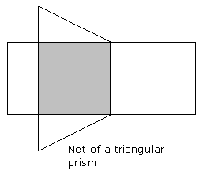
Nets
Net – A two dimensional pattern that can be folded to form a three dimensional figure

Slide 7
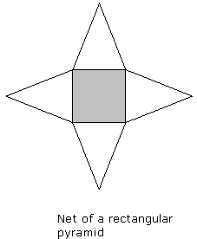
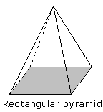
Nets - Examples

Slide 8
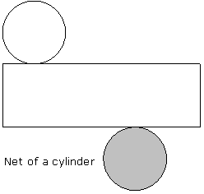
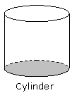
Nets - Examples

Slide 9
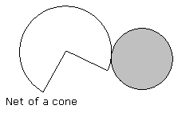
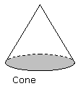
Nets - Examples

Slide 10
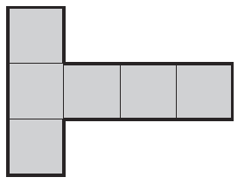
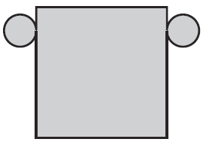
Nets - Practice

Slide 11
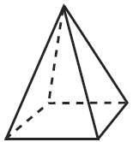
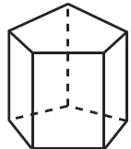
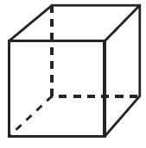
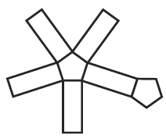
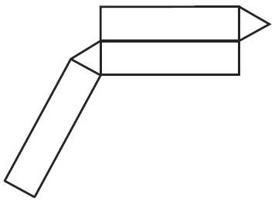
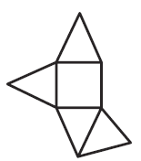
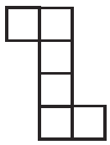
Practice Problems

Slide 12
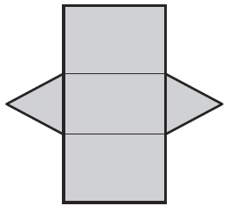
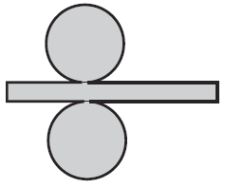
Nets - Practice

Slide 13
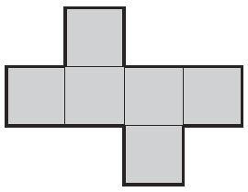
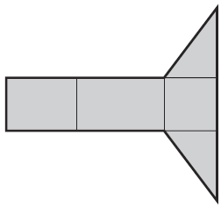
Nets - Practice

Slide 14
Space Figures and Nets
Day 2

Slide 15
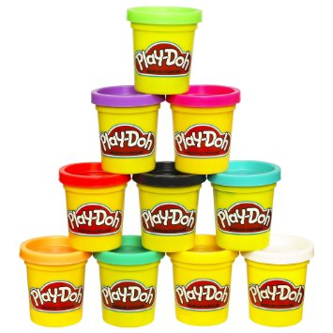
Group Activity
In groups of 2 or 3
Supplies
Toothpicks
Some Play Dough

Slide 16
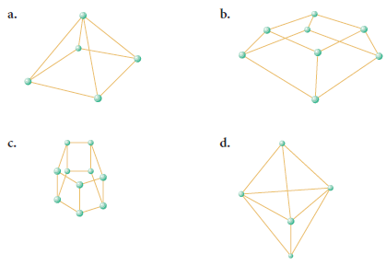
Group Activity
Build the following in each group

Slide 17
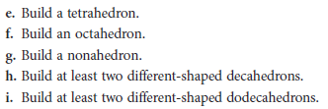
Group Activity
Build the following in each group

Slide 18
Group Activity
Classify all of the polyhedrons by name

Slide 19
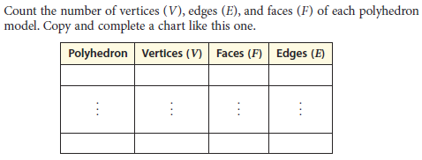
Group Activity

Slide 20
Euler’s Formula
In a polyhedron
E + 2 = F + V
Where E is the number of edges
F is the number of faces
V is the number of vertices

Slide 21
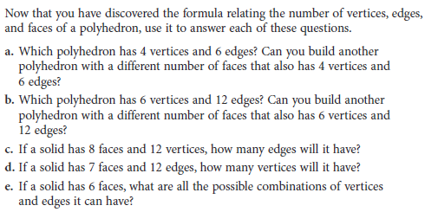
Group Activity

Slide 22
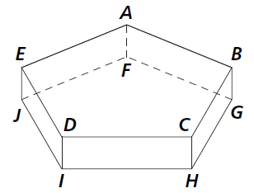
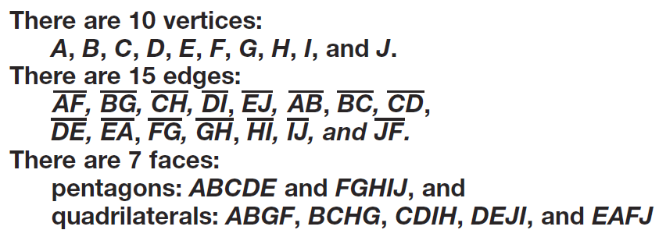
Practice Problems

Slide 23
Practice Problems

Slide 24
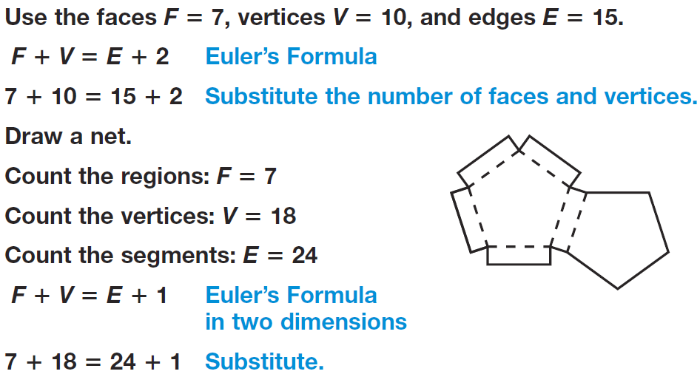
Practice Problems

Slide 25
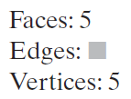
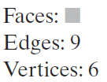
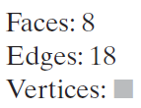
Practice Problems

Slide 26
Homework
Pages 514 – 516
4 – 9, 11 - 14, 16, 18, 20 – 23, 29, 42

