Slide 1
Geometry 4-7
Using Corresponding Parts of Congruent Triangles

Slide 2
Using CPCTC
Re-Drawing figures will often help to identify congruent triangles.
Reflexive property allows same sides to be congruent to themselves.

Slide 3
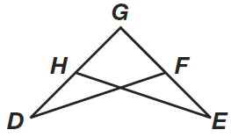
Using CPCTC

Slide 4
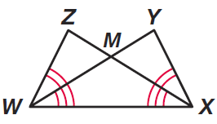
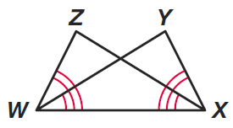
Using CPCTC

Slide 5
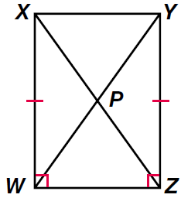
Using CPCTC

Slide 6
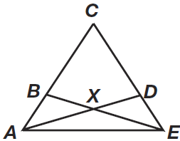
Using CPCTC

Slide 7
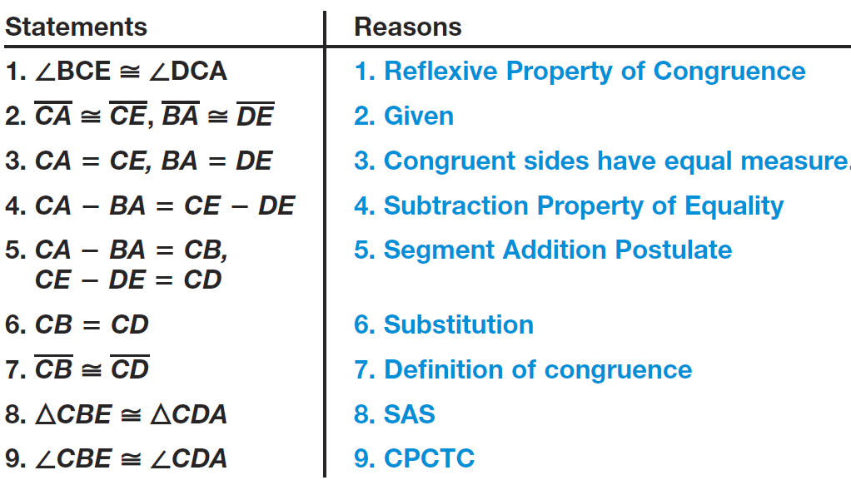
Using CPCTC

Slide 8
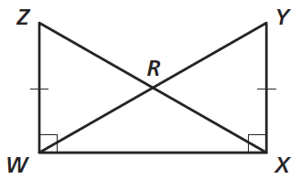
Practice

Slide 9
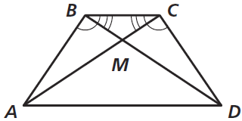
Practice

Slide 10
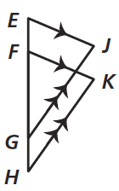
Practice

Slide 11
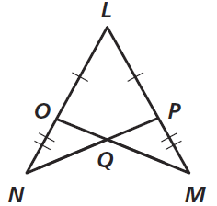
Practice

Slide 12
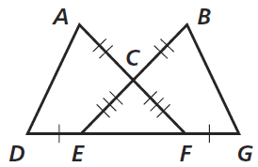
Practice

Slide 13
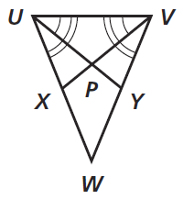
Practice

Slide 14
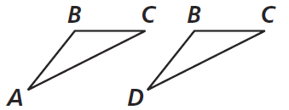
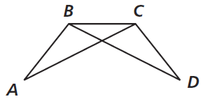
Practice

Slide 15
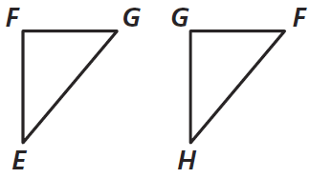
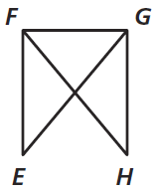
Practice

Slide 16
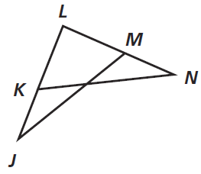
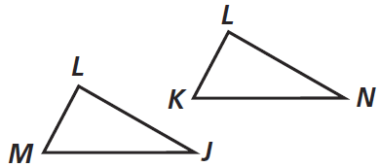
Practice

Slide 17
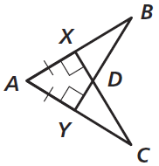
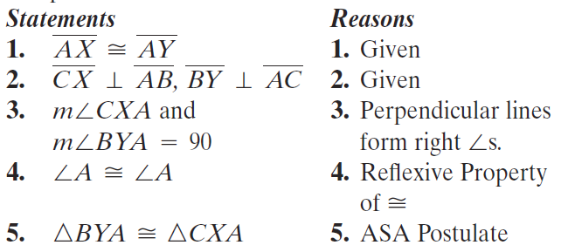
Using CPCTC

Slide 18
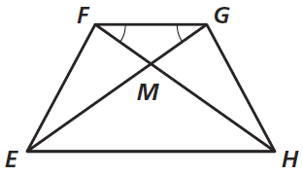
Using CPCTC

Slide 19
Homework
Pages 226 – 230
3, 5, 6, 8, 9, 10, 17, 23, 28, 42, 46

