Slide 1
Geometry 12-1
Reflections

Slide 2
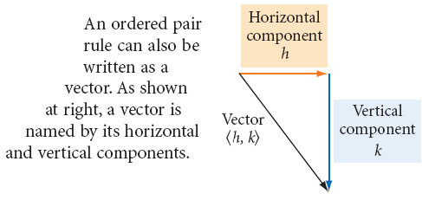
Vocabulary
Ordered Pair Rules – A rule that describes how to transform points on a coordinate plane

Slide 3
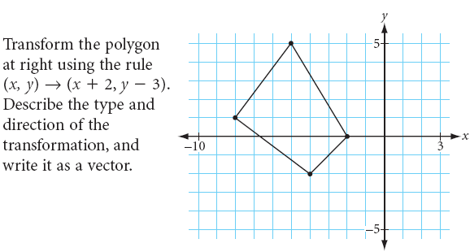
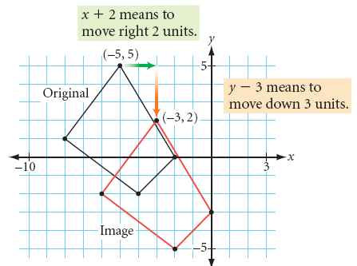
Transformation - Example

Slide 4
Investigation
Get your supplies
Graph paper
Patty Paper

Slide 5
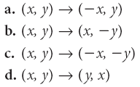
Investigation
Fold the graph paper both hot dog and hamburger

Slide 6
Investigation

Slide 7
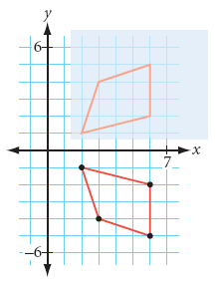
Investigation

Slide 8
Conjectures
The ordered pair rule (x,y) →(-x,y) is a reflection across the y-axis
The ordered pair rule (x,y) →(x,-y) is a reflection across the x-axis
The ordered pair rule (x,y) →(-x,-y) is a rotation about the origin
The ordered pair rule (x,y) →(y,x) is a reflection across the line y = x

Slide 9
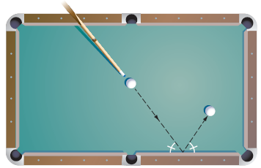
Investigation
Get your supplies
Protractor
Patty Paper

Slide 10
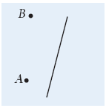
Investigation

Slide 11
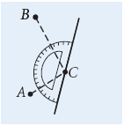
Investigation

Slide 12
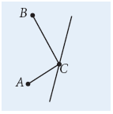
Investigation

Slide 13
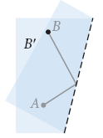
Investigation

Slide 14
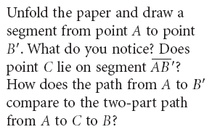
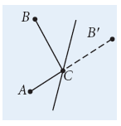
Investigation

Slide 15
Investigation

Slide 16
Conjecture
Minimal Path Conjecture
If points A and B are on one side of line l, then the minimal path from point A to line l to point b is found by reflecting point B across line l, drawing segment AB’, then drawing segments AC and CB where point C is the point of intersection of segments AB’ and line l

Slide 17
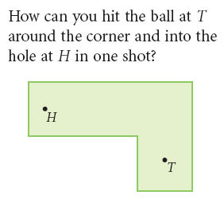
Example

Slide 18
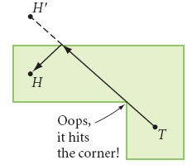
Example

Slide 19
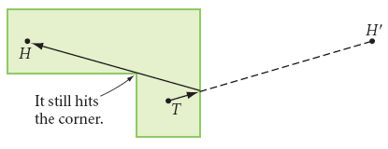
Example

Slide 20
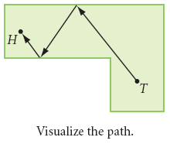
Example

Slide 21
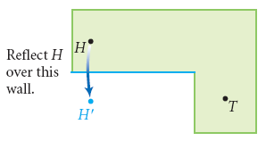
Example

Slide 22
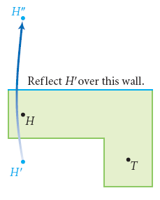
Example

Slide 23
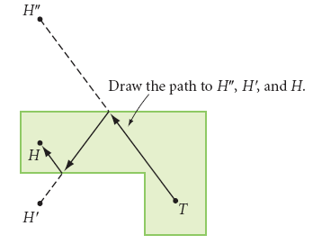
Example

Slide 24
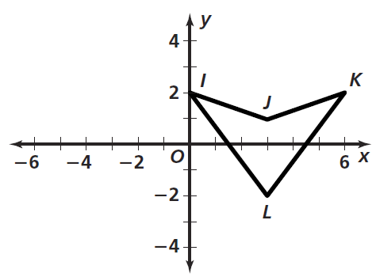
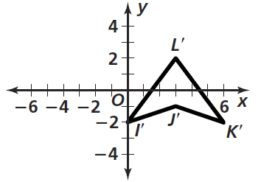
Practice

Slide 25
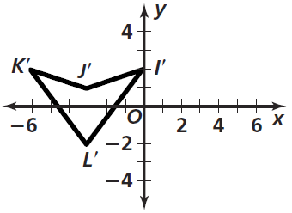
Practice

Slide 26
Practice

Slide 27
Homework
Pages 637 – 638
10 – 17, 32, 34, 38

Slide 28
Honors Homework
Pages 637 – 638
10 – 17, 32, 34, 38,47 – 52

