Slide 1
Geometry 7-1a
Area of Parallelograms

Slide 2
Vocabulary
Area – The measure of a figure enclosed by the figure
Base – Any side of a rectangle
Height – Length of a side perpendicular to a base in a rectangle, that is the altitude

Slide 3
Area
Area of a Rectangle – The area of a rectangle is given by the formula A = B x H Where A is area, B is the length of the base, and H is the height of the rectangle

Slide 4
Investigation
Get your supplies
Scissors
Paper
Straightedge

Slide 5
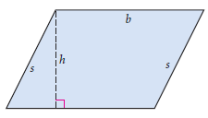
Investigation
Construct a parallelogram on your paper
To “cheat” you may use groups of rulers as parallel lines
Construct an altitude from an obtuse angle

Slide 6
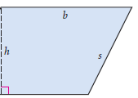
Investigation
Cut along the altitude, so there are two separate pieces

Slide 7
Investigation
Re-Arrange the pieces to more easily see a formula for area of a parallelogram

Slide 8
Area
Area of a Parallelogram – The area of a parallelogram is given by the formula A = B x H , where A is the area, B is the length of the base, and H is the height of the parallelogram

Slide 9
Areas

Slide 10
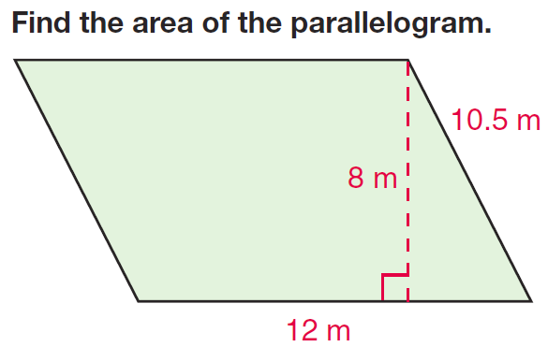
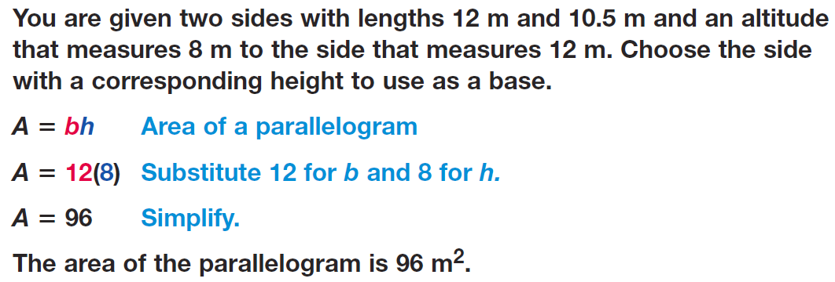
Example

Slide 11
Example

Slide 12
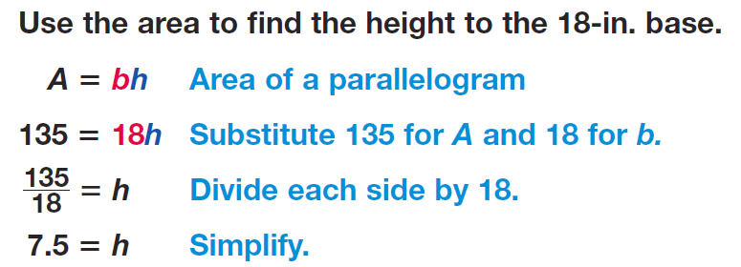
Example

Slide 13
Area of Parallelograms
Practice Problems

Slide 14
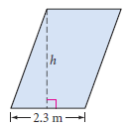
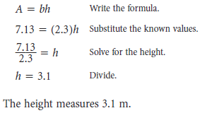
Practice Problems

Slide 15
Practice Problems

Slide 16
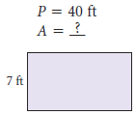
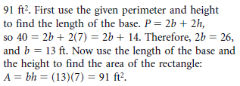
Practice Problems

Slide 17
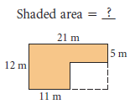
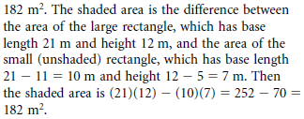
Practice Problems

Slide 18
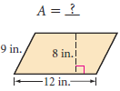
Practice Problems

Slide 19
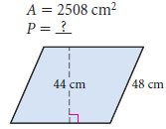
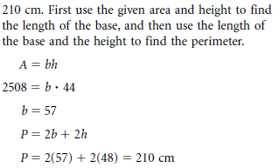
Practice Problems

Slide 20
Homework
Pages 351 – 354
2, 6, 8, 10, 15, 18, 58

