Slide 1
Geometry 5-6
Review Problems

Slide 2
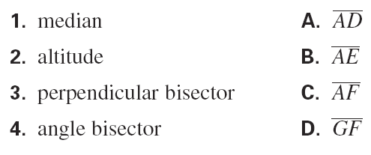
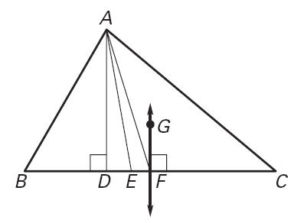
Practice Problems
C, A, D, B
1

Slide 3
Practice Problems
TRUE
FALSE
FALSE
2

Slide 4
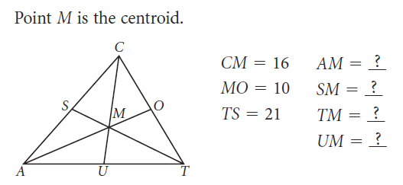
Practice Problems
20
7
14
8
3

Slide 5
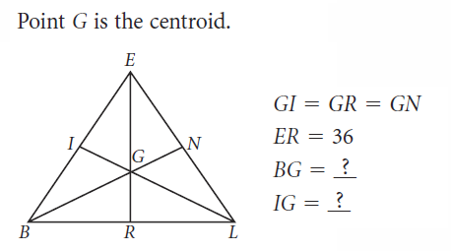
Practice Problems
24
12
4

Slide 6
Practice Problems
True
True
True
5

Slide 7
Practice Problems
No
No
Yes
6

Slide 8
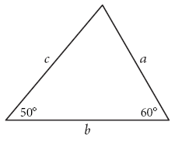
Practice Problems
b, c, a
7

Slide 9
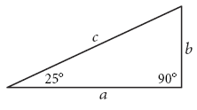
Practice Problems
c, a, b
8

Slide 10
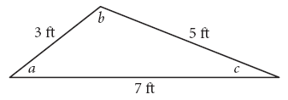
Practice Problems
b, a, c
9

Slide 11
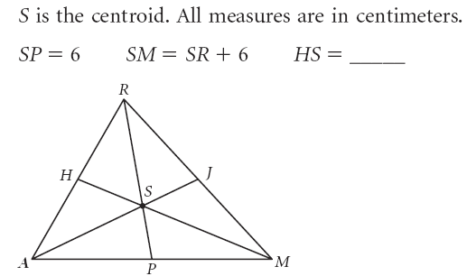
Practice Problems
9
10

Slide 12
Practice Problems
11

Slide 13
Practice Problems
12

Slide 14
Practice Problems
13

Slide 15
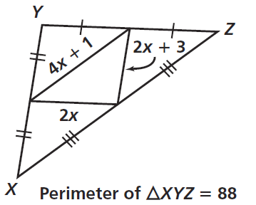
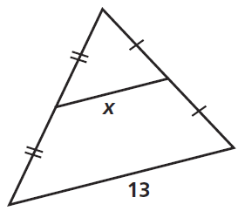
Practice Problems
14

Slide 16
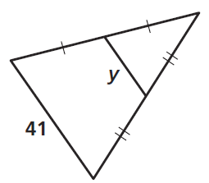
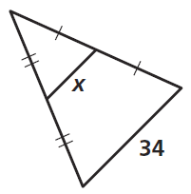
Practice Problems
15

Slide 17
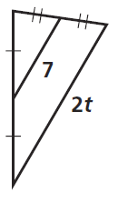
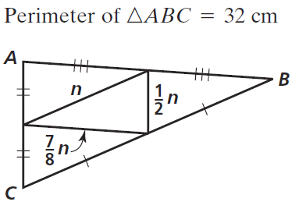
Practice Problems
16

Slide 18
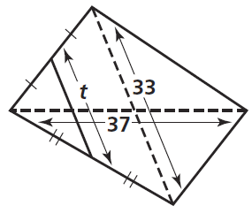
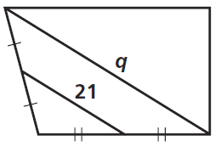
Practice Problems
17

Slide 19
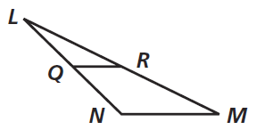
Practice Problems
18

Slide 20
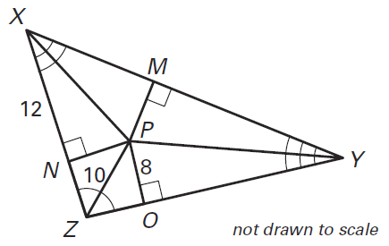
Practice Problems
19

Slide 21
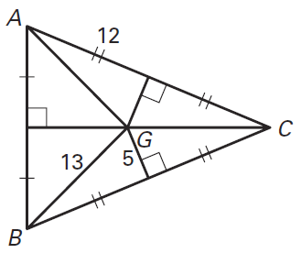
Practice Problems
20

Slide 22
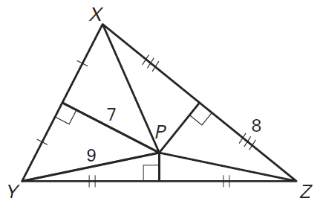
Practice Problems
21

Slide 23
Practice Problems
22

Slide 24
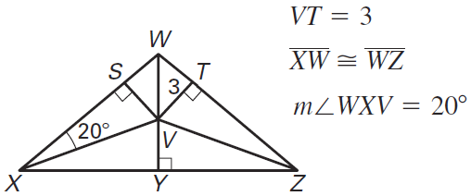
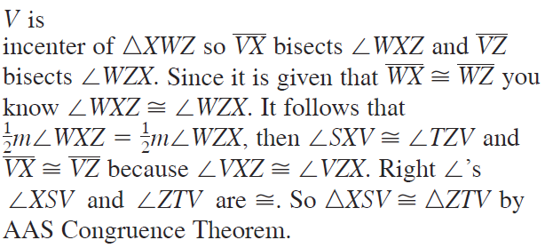
Practice Problems
23

Slide 25
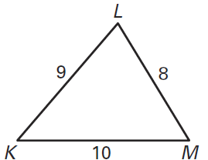
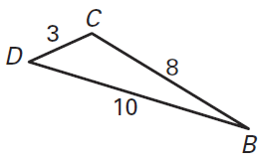
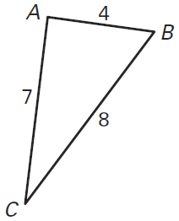
Practice Problems
24

Slide 26
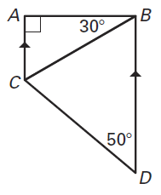
Practice Problems
25

Slide 27
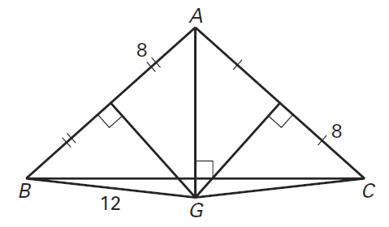
Practice Problems
26

Slide 28
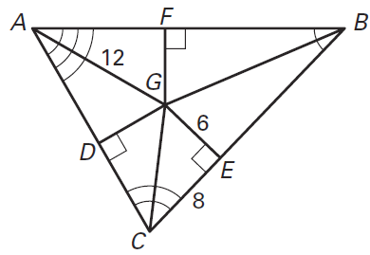
Practice Problems
27

Slide 29
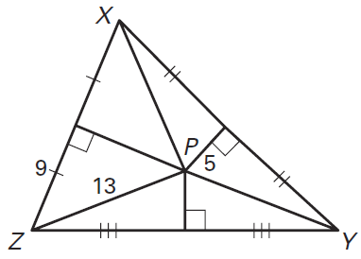
Practice Problems
28

Slide 30
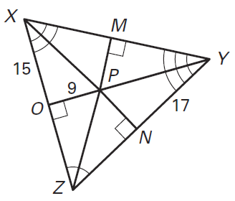
Practice Problems
29

Slide 31
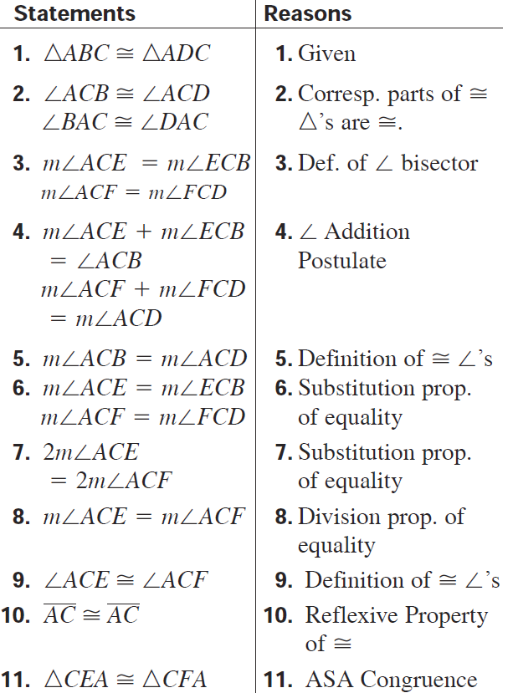
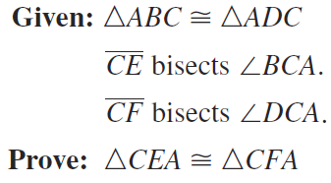
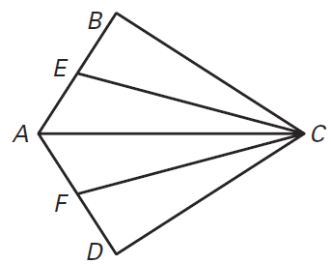
Practice Problems
30

Slide 32
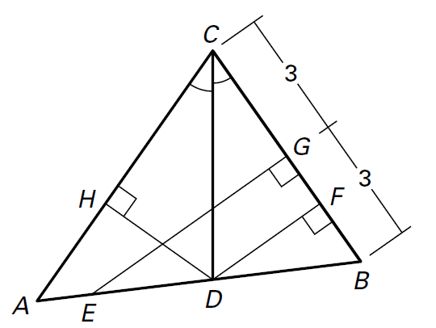
Practice Problems
31

Slide 33
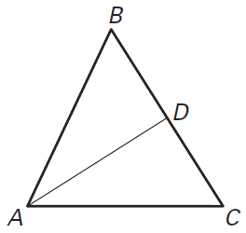
Practice Problems
32

Slide 34
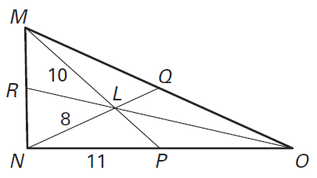
Practice Problems
33

Slide 35
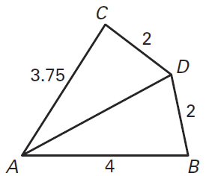
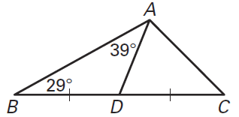
Practice Problems
34

Slide 36
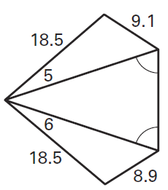
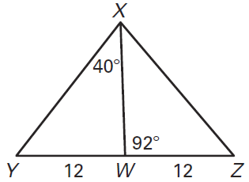
Practice Problems
35

Slide 37
Practice Problems
36

Slide 38
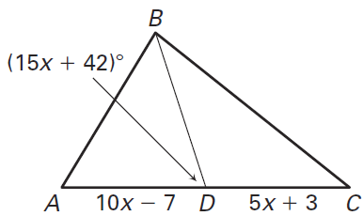
Practice Problems
37

Slide 39
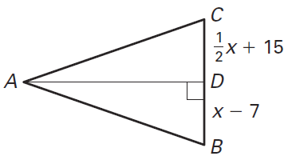
Practice Problems
38

Slide 40
Practice Problems
39

Slide 41
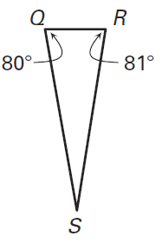
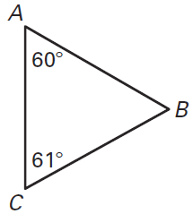
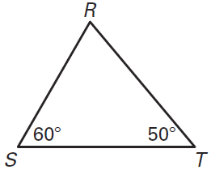
Practice Problems
40

Slide 42
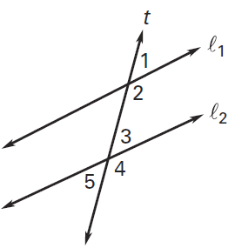
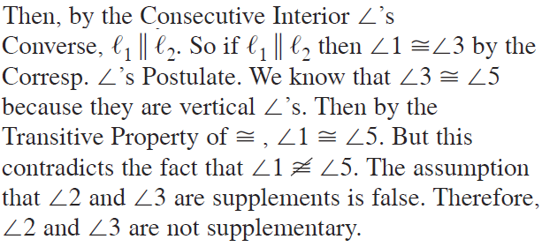
Practice Problems
41

Slide 43
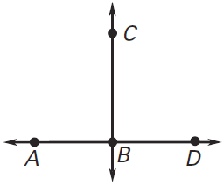
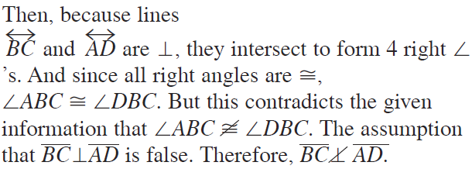
Practice Problems
42

Slide 44
Answers
C, A, D, B
TRUE
FALSE
FALSE
20
7
14
8
24
12
True
True
True
No
No
Yes
b, c, a
c, a, b
b, a, c
9

Slide 45
Answers
Proof

Slide 46
Answers
Proof
Proof

