Slide 1
Geometry 11-2
Chords and Arcs

Slide 2
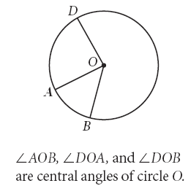
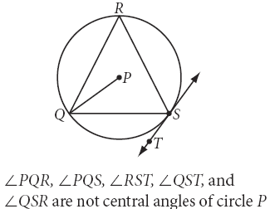
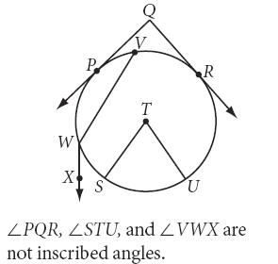
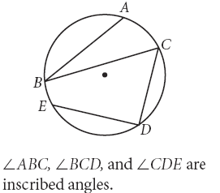
Vocabulary
Central Angle – An angle where the vertex is the center of the circle
Inscribed Angle – An angle where the vertex is on the arc of the circle and the sides of the angle are chords of the circle

Slide 3
Get your supplies
Compass
Protractor

Slide 4
Chord Exploration
Draw a large circle, O
Draw two congruent chords ST and AR, use your compass to ensure they are congruent.
Construct lines OS, OT, OA and OR
Measure angles AOR and TOS
T
A
O
S
R

Slide 5
Chord Central Angle Theorem
If two chords in a circle are congruent, then they determine two central angles that are congruent
T
A
O
If two central angles in a circle are congruent, then they determine two arcs that are congruent
S
R

Slide 6
Chord Arc Theorem
If two chords in a circle are congruent, then their intercepted arcs are congruent
T
A
O
S
R

Slide 7
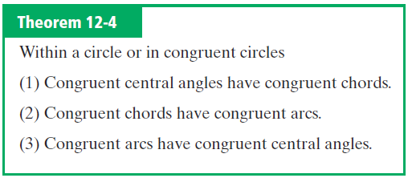
Chord Arc Theorem

Slide 8
Chord Exploration
Draw a large circle
Add a chord to the circle
Construct a perpendicular bisector of the chord – use the compass and the ruler
Repeat steps 2 and 3 with a congruent chord
What do you notice about the two bisector lines?

Slide 9
Perpendicular to a Chord Theorem
The diameter from the center of a circle perpendicular to a chord is the perpendicular bisector of the chord

Slide 10
Chord Exploration
Compare the distance from the center of the circle to each of the congruent chords

Slide 11
Chord distance to center Theorem
Two congruent chords in a circle are equidistant from the center of a circle

Slide 12
Chord Exploration
Construct a perpendicular bisector of the chord – use the compass and the ruler

Slide 13
Chord Exploration
Repeat the process again

Slide 14
Chord Exploration
What do you notice about the two bisector lines?

Slide 15
Chord Exploration
What do you notice about the two bisector lines?
This is the center of the circle
So what conclusion can we draw about the two bisectors?
They are both diameters

Slide 16
Perpendicular to a chord Theorem
The perpendicular bisector of a chord passes through the center of a circle

Slide 17
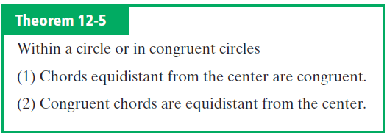
Chord Theorems

Slide 18
Chord Theorems

Slide 19
Sample Problems

Slide 20
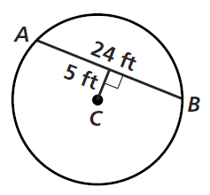
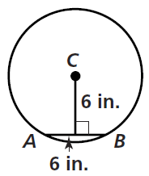
Practice Problems

Slide 21
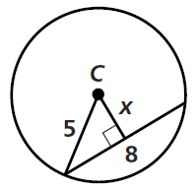
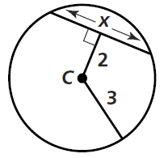
Practice Problems

Slide 22
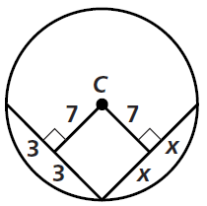
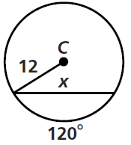
Practice Problems

Slide 23
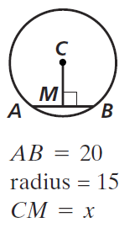
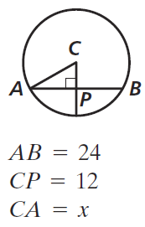
Practice Problems

Slide 24
Practice Problems

Slide 25
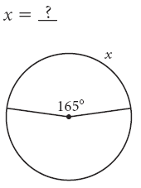

Slide 27
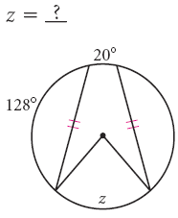

Slide 28
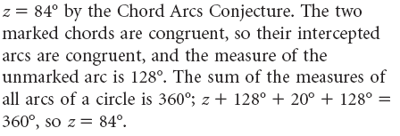

Slide 29
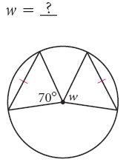

Slide 31
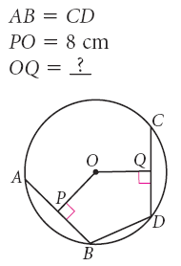

Slide 33
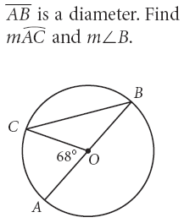

Slide 34
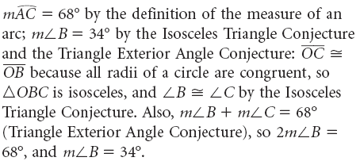

Slide 35
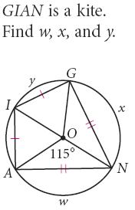

Slide 36
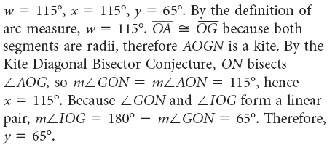

Slide 37
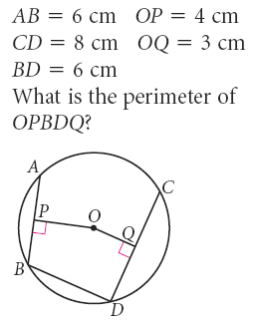

Slide 39
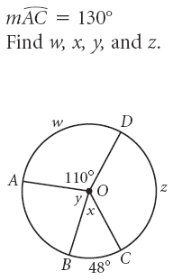

Slide 40
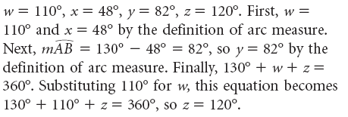

Slide 41
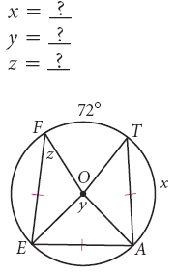

Slide 42
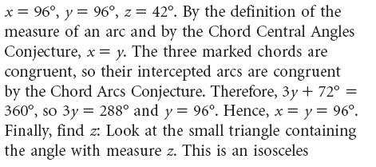

Slide 43
Homework
Pages 593 – 596
4 – 18 even, 26, 30, 48

