Slide 1
Geometry 1-4
Measuring Segments and Angles
Notes:
Supplies: Handouts – Example B and Example C

Slide 2
Postulate

Slide 3
Vocabulary
Line Segment – Consists of two points called endpoints. Symbol = line without arrows over letters.

Slide 4
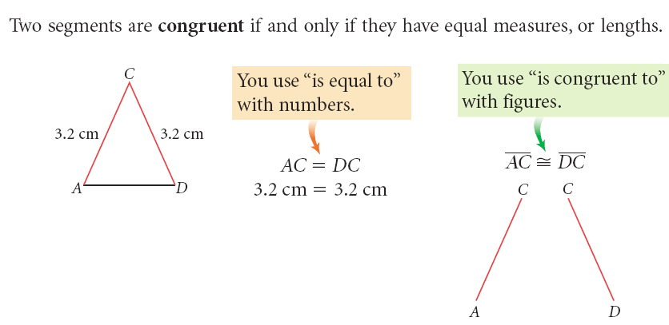
Congruencies

Slide 5
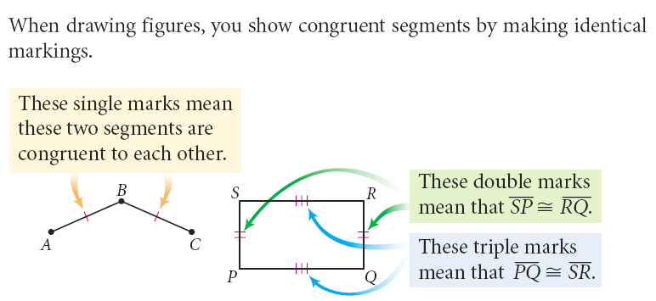
Congruencies

Slide 6
Vocabulary
Midpoint – The point on the segment that is the same distance from both endpoints.
Bisect – Dividing a segment in two congruent segments

Slide 7
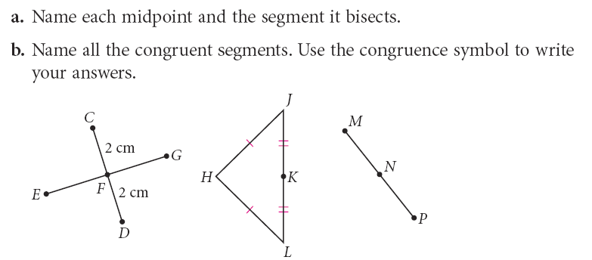
Example

Slide 8
Vocabulary
Ray – Begins at a point and extends infinitely in one direction. Symbol = letters with line with one arrow head above

Slide 9
Midpoint
Midpoint – The point on a line segment that is the same distance from both endpoints.
When using a coordinate graph

Slide 10
Postulate

Slide 11
Practice

Slide 12
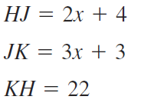
Practice

Slide 13
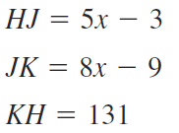
Practice

Slide 14
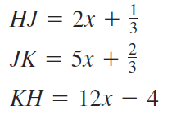
Practice

Slide 15
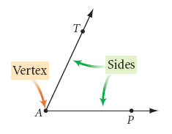
Vocabulary
Angle – Two rays that share a common endpoint, and are not collinear
Vertex – The common endpoint of two rays
Rays - Sides of an angle
Angles may be written with three letters, a number or just the vertex

Slide 16
Practice

Slide 17
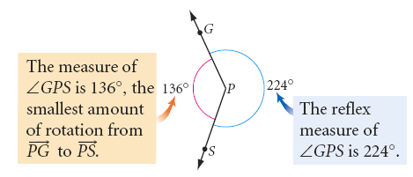
Vocabulary
Measure of an angle – The amount of rotation about the vertex from one ray to another
Degrees – The measurement for angles
Reflex measure of an angle – the largest measurement less than 360 for an angle

Slide 18
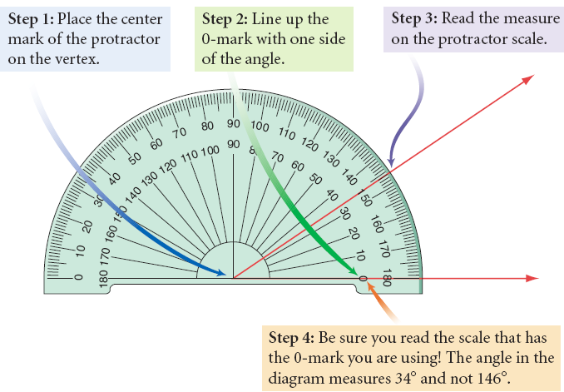
Protractor

Slide 19
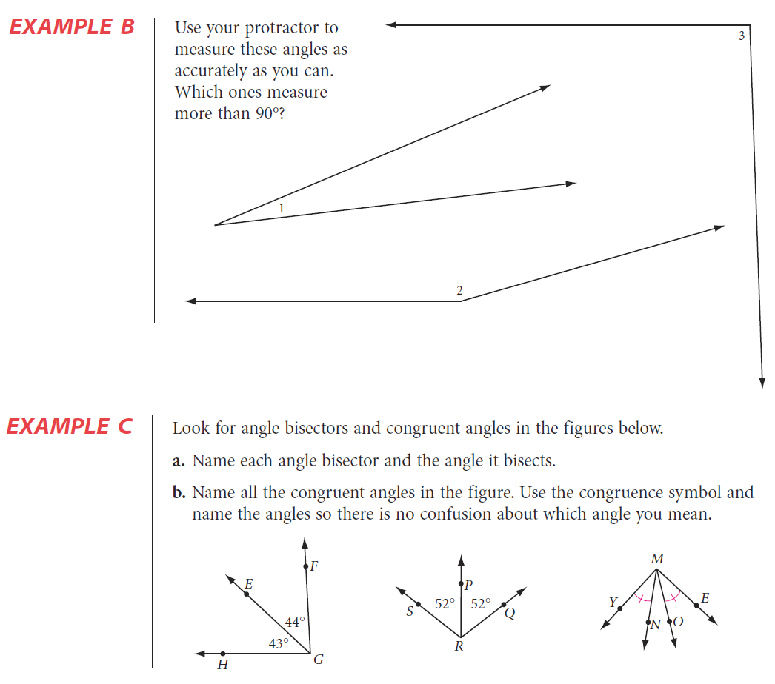
Practice
Handout
Work on Example B
Work with a partner

Slide 20
Answers

Slide 21
Vocabulary

Slide 22
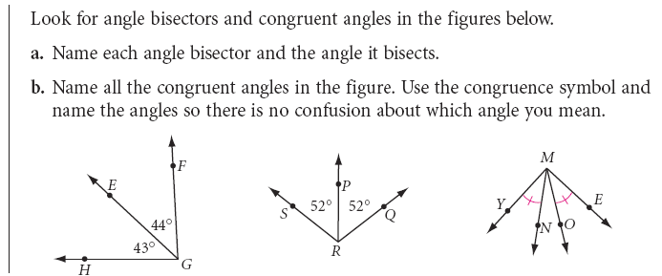
Practice
Handout
Work on Example C
Try these on your own

Slide 23
Answers

Slide 24
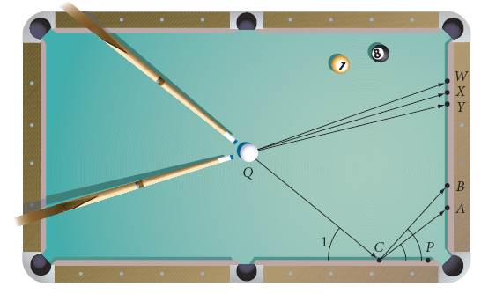
Exploration
Complete the Pool Investigation on the handout
Turn in a paper with your name and the five steps completed.

Slide 25
Postulate

Slide 26
Postulate

Slide 27
Definitions
Try writing definitions for
Acute Angle
Right Angle
Obtuse Angle
Straight angle

Slide 28
Definitions
Acute Angle – An angle that is between 0° and 90°
Right Angle - An angle that is 90°
Obtuse Angle - An angle that is between 90° and 180°
Straight Line - An angle that is 180°

Slide 29
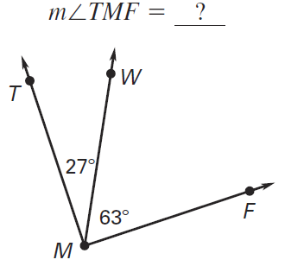
Practice

Slide 30
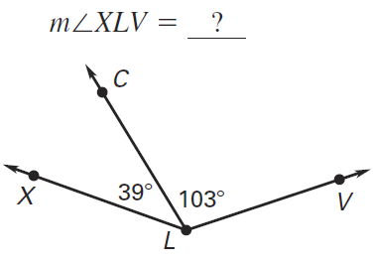
Practice

Slide 31
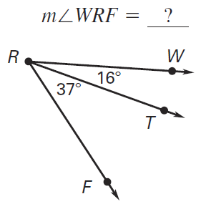
Practice

Slide 32
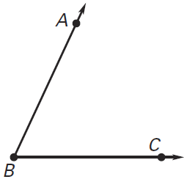
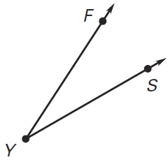
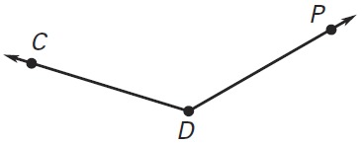
Practice
Classify each angle
Obtuse
Acute
Acute

Slide 33
Homework
Pages 30-33
16 – 28 even, 34, 42 – 45, 48, 54, 56 – 58, 71, 72, 76

